Slide 1
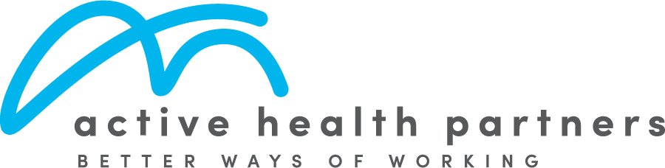
Practical Solutions for Hybrid Workplace Health, Safety and Wellbeing.
5 practical strategies HR teams can implement immediately.
Dr Daniel Grynberg - Chiropractor & Hybrid WHS Specialist

Slide 2

Hybrid Work Has Changed the Workplace
Work is now split across office and home environments
Employees move between multiple work settings
Responsibility for health, safety and wellbeing remains unchanged
Key Risk Shifts:
Office = structured, visible, controlled
Home = variable, less visible, harder to manage
Important:
Your duty of care extends to wherever work is performed (including the home)
Dr Daniel Grynberg - Active Health Partners
linkedin.com/in/drdanielgrynberg

Slide 3
What You’ll Walk Away With
By the end of this session, you will have…
A simple, practical way to manage hybrid workplace risks
1–2 actions you can implement immediately
A clear structure to improve:
Visibility, Consistency and Documentation
Outcome:
Greater confidence you are taking the right steps to support your hybrid team
Dr Daniel Grynberg - Active Health Partners
linkedin.com/in/drdanielgrynberg

Slide 4

The Core Problem
The reality for most HR teams is managing:
WHS obligations
Psychosocial risk requirements
Culture and engagement
Compliance, governance and documentation
While also having to be mindful of:
“We are accountable for everything,
but don’t have simple systems to manage it”
Limited time
Limited budget
Limited resources
Dr Daniel Grynberg - Active Health Partners
linkedin.com/in/drdanielgrynberg

Slide 5

Where the Risk Sits
Risk in Hybrid Work Environments
Office environments are generally:
Structured, supported and easier to manage.
Home environments are often:
Inconsistent, less visible, harder to control, less communication.
Key Risk Insight:
Less consistence and visibility = Greater risk
Dr Daniel Grynberg - Active Health Partners
linkedin.com/in/drdanielgrynberg

Slide 6

Why This Matters
Safe Work Australia Compliance Expectations
Organisations must be able to demonstrate:
Hazards have been identified
Employees have received relevant WHS training
Reasonable steps have been taken to reduce risk
systems have been implemented and reviewed
Key Insight:
It’s not just about doing the right thing, it’s being able to prove it.
Dr Daniel Grynberg - Active Health Partners
linkedin.com/in/drdanielgrynberg

Slide 7
Why good intentions still get poor outcomes
Hybrid Work health & Safety is not a people problem.
It’s a system problem.
Assuming individuals to just “know what to do” = Inconsistent outcomes
Just because people haven’t reported issues, doesn’t mean there aren’t any
Lack of structure and visibility = increased risk
The solution:
Build a system that makes the right behaviour easy
Dr Daniel Grynberg - Active Health Partners
linkedin.com/in/drdanielgrynberg

Slide 8
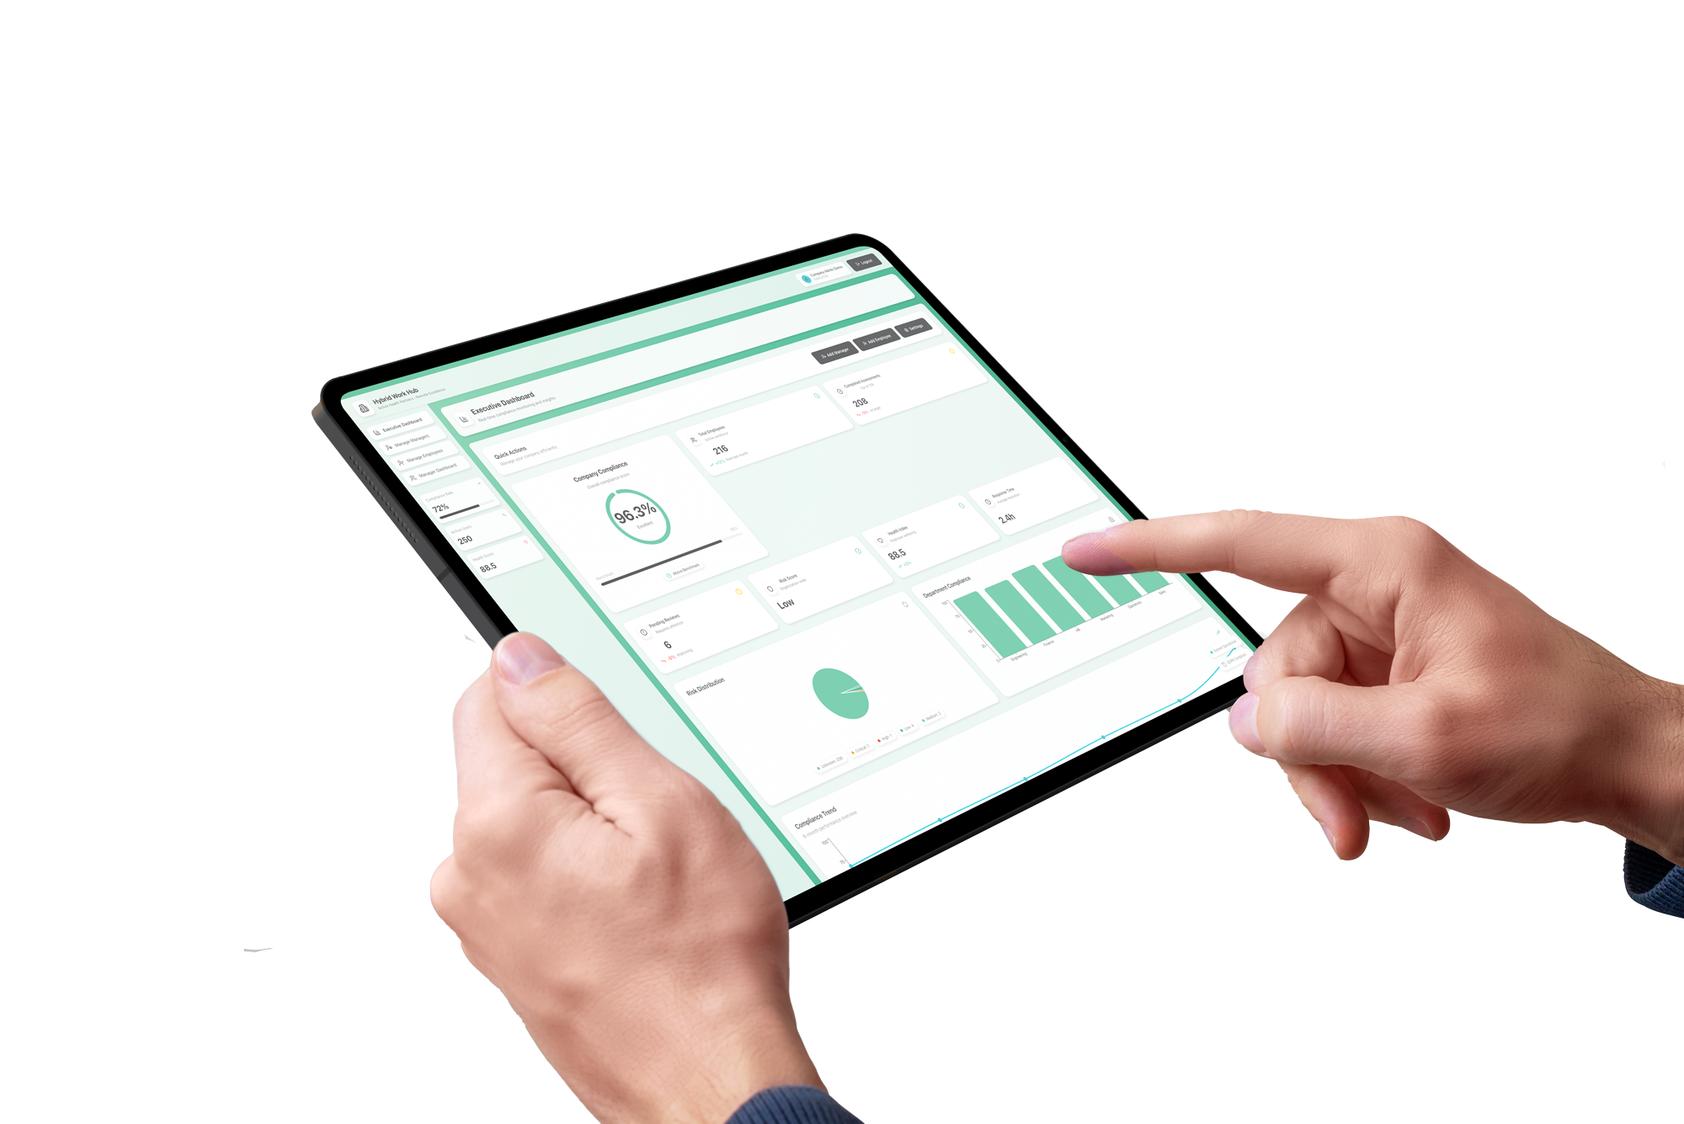
AHP’s Hybrid Work Playbook
A simple 5 step approach to managing:
Health & safety
Wellbeing
Risk
Compliance
Designed to be:
Practical
Scalable
Low Admin
Easy to implement
Dr Daniel Grynberg - Active Health Partners
linkedin.com/in/drdanielgrynberg

Slide 9
AHP’s Hybrid Work Playbook
1. Educate & Train
2. Self Assess / Audit
3. Reporting
4. Data Analysis + Early intervention
5. Communication & Connection
Dr Daniel Grynberg - Active Health Partners
linkedin.com/in/drdanielgrynberg

Slide 10
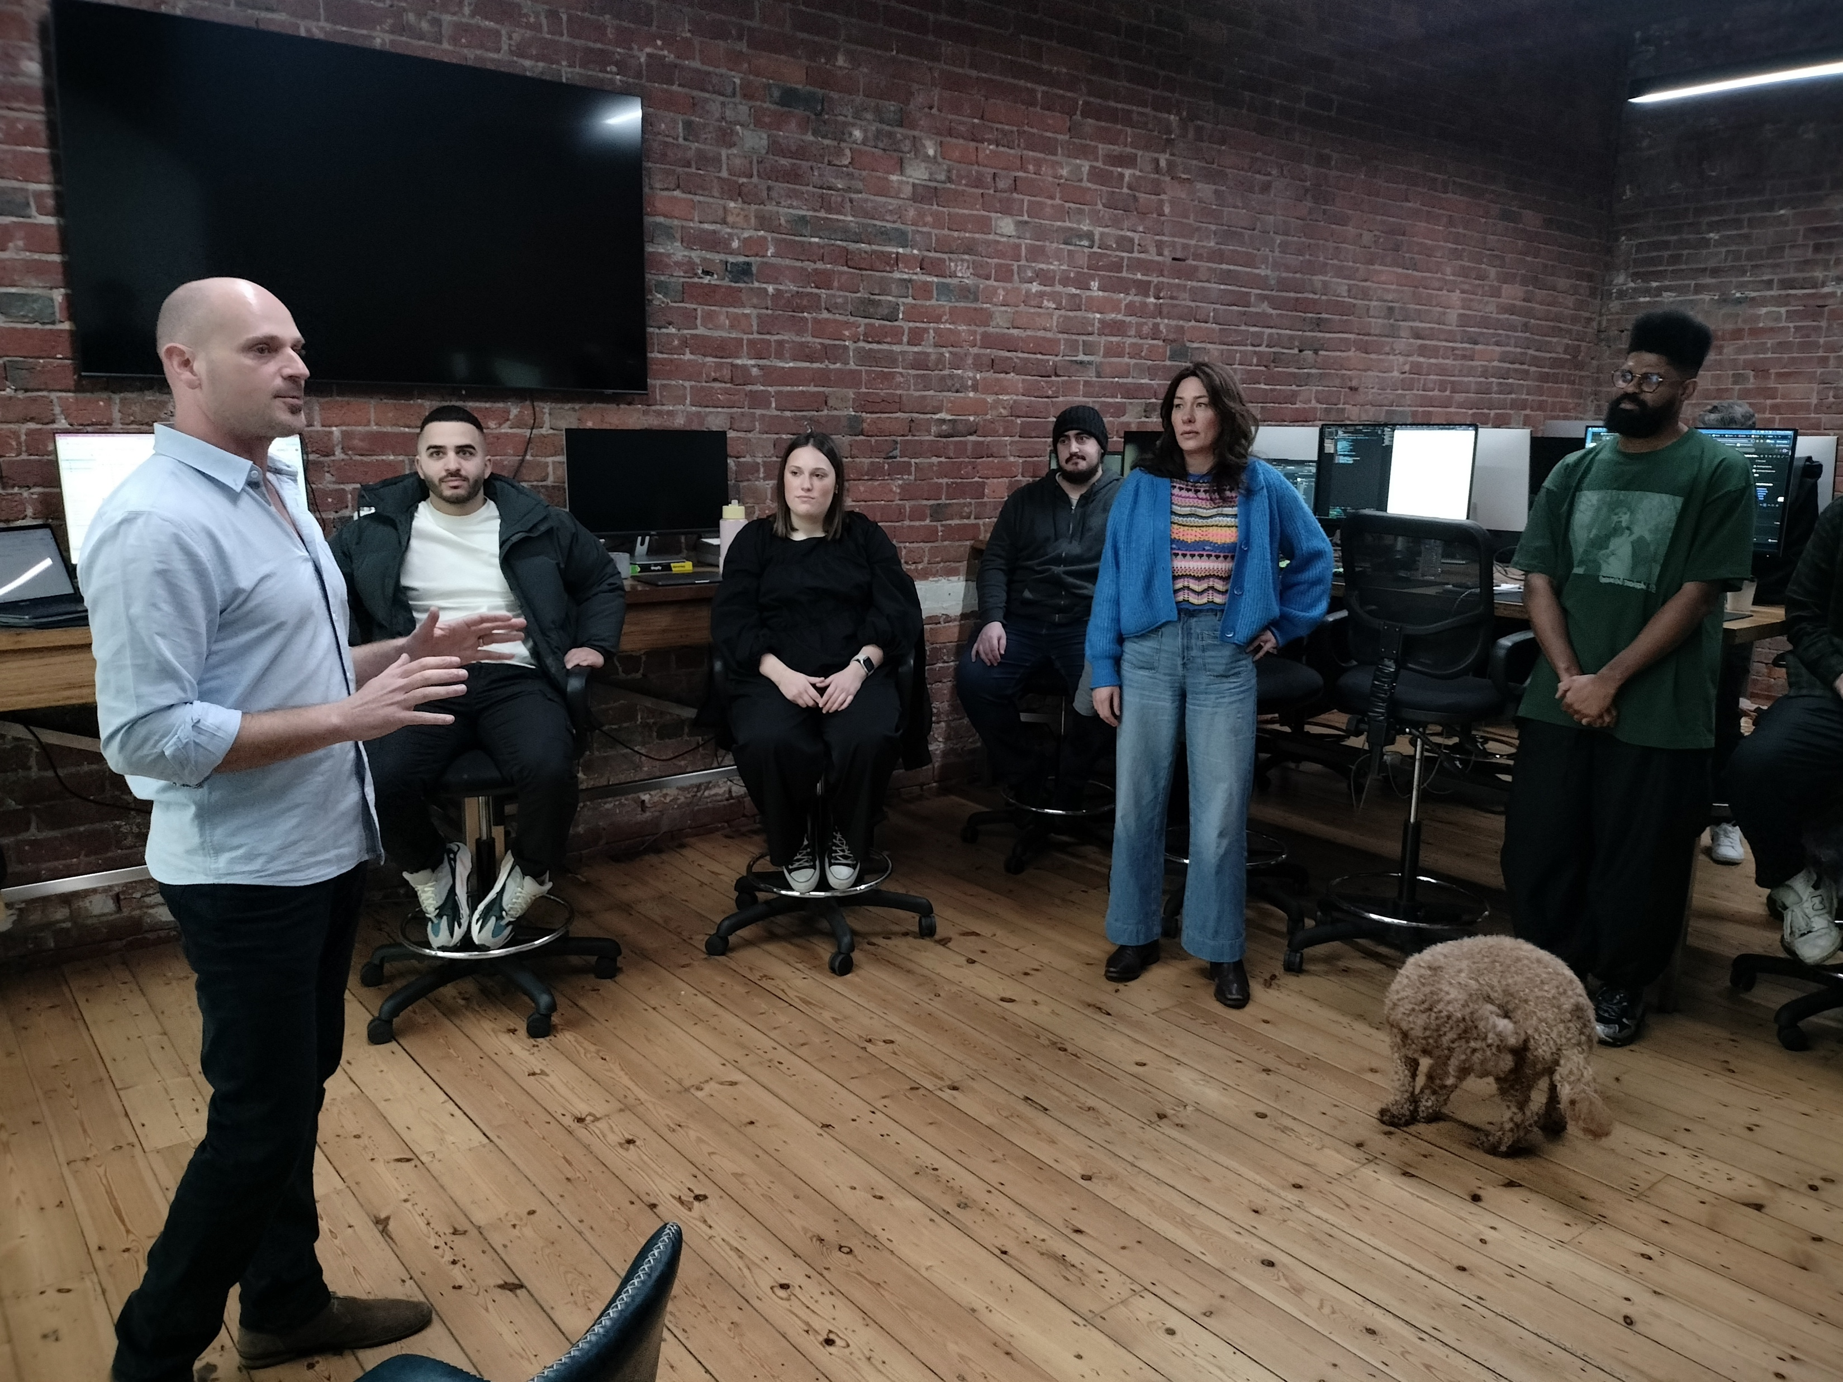
Step 1 - Educate & Train
You can’t assess what you don’t know.
Start with Knowledge
Key Areas
Practical
Relevant
Focus on real world application
Not just ergonomics
Risks & Hazards
Workstation Set Up
Posture & Movement
Mental wellbeing
Focus & Productivity
This applies to both home and office
Dr Daniel Grynberg - Active Health Partners
linkedin.com/in/drdanielgrynberg

Slide 11
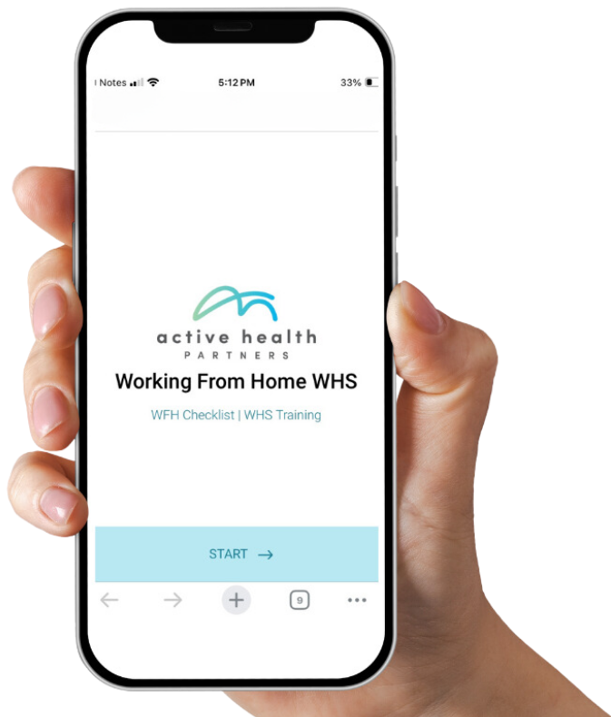
Step 2 - Self Assess / Audit
You now have educated assessors in every workspace
Create visibility at scale
Staff assess their own setups
Works across all locations
Benefits
Early hazard identification
Increased awareness
Creates a safety mindset
Scalable across teams
Dr Daniel Grynberg - Active Health Partners
linkedin.com/in/drdanielgrynberg

Slide 12
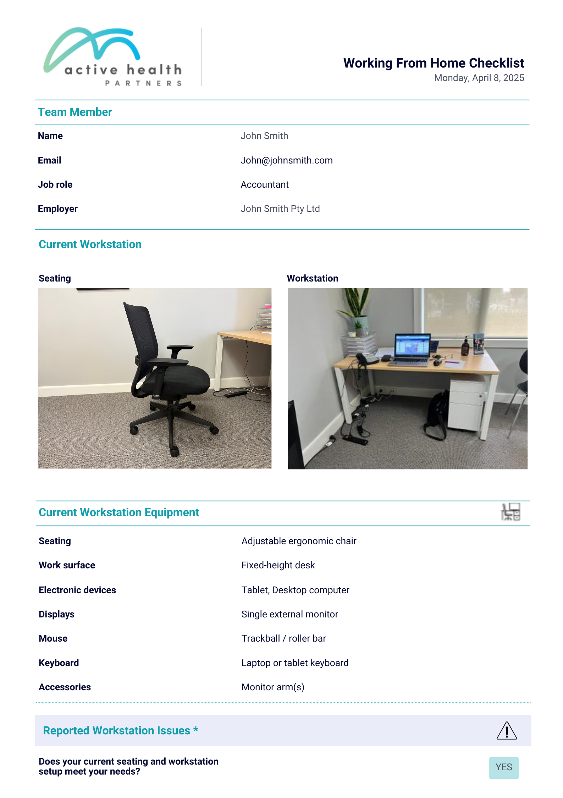
Step 3 - Reporting
Make reporting quick, simple and automated
Mobile friendly online forms:
Easy to access and use
Minimal friction
Consistent inputs
Customised for your organisation
Automated compliance reports
Must include photos of the workstation
Dr Daniel Grynberg - Active Health Partners
linkedin.com/in/drdanielgrynberg

Slide 13
Step 4 - Data Analysis
Online forms enable intelligent data collection
Turn your data into strategic insights
Individual issues highlight immediate risks
Workplace patterns identify system level problems
Organisational trends lead to better decision making
Intervene before issues escalate
Lower long-term costs
Improve employee engagement
Dr Daniel Grynberg - Active Health Partners
linkedin.com/in/drdanielgrynberg

Slide 14
Real World - Case Study
Large Health insurer – 450 employees
Problem – Sporadic and reactive in office ergonomic assessments leading to high consulting fees, frustrated employees and inaction.
Data Collection – Survey employees and managers to identify key issues.
Insights – Managers were reactive and didn’t co-ordinate. Employees only asked for help once injured. Hot desking with inconsistent equipment.
Solution – Regular ergonomic roaming, simple reporting introduced, consistent
processes across teams
Action Taken – Standardised Equipment in hotdesk areas, provide training on how to
Set up and adjust for individual needs.
Dr Daniel Grynberg - Active Health Partners
linkedin.com/in/drdanielgrynberg

Slide 15

Step 5 – Communication & Connection
Culture and connections need to be intentional
In Office
At home
Easier and more organic
All in days for teams / divisions
Prioritise team building activities
Creative and collaborative workshops
Training is more effective in person
Create a consistent experience
Regular check ins with manager/team
Prioritise deep work
Maintain work / life boundaries
WFH days should be consistent with work group
Dr Daniel Grynberg - Active Health Partners
linkedin.com/in/drdanielgrynberg

Slide 16

Common Mistakes
What I often see and hear from hybrid workplaces
Lots of policies but no practical implementation
No regular or relevant training
No follow ups after reported issues or assessments
No clear reporting pathway
Paper forms, fillable PDF’s that go nowhere
Wrong metrics used – no issues reported so all must be good
Dr Daniel Grynberg - Active Health Partners
linkedin.com/in/drdanielgrynberg

Slide 17

What Does good look like?
Organisations that do this well have:
Consistent system across all environments
Employees understand expectations
Risk & hazards are identified early
Reporting is simple and used frequently
Data informs decision making
Actions taken are proactive
Dr Daniel Grynberg - Active Health Partners
linkedin.com/in/drdanielgrynberg

Slide 18
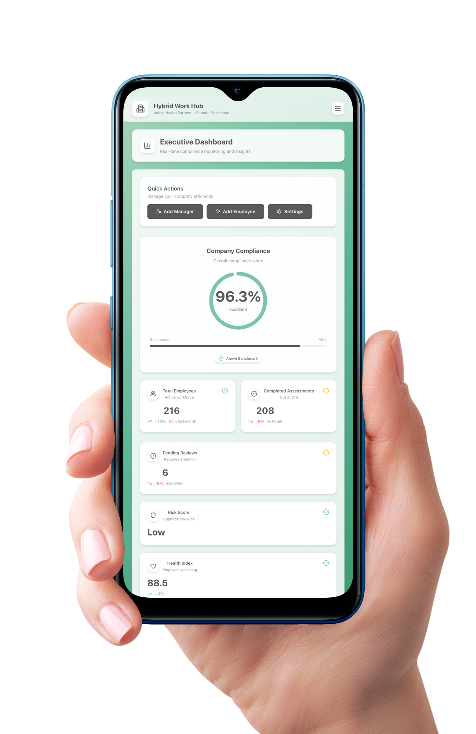
The Recap
Hybrid work creates added complexity due to the hidden risks.
Ensuring the health safety and wellbeing of your hybrid team is simple if you have the right system in place.
The Hybrid Work Playbook
1. Educate & Train
2. Self Assess / Audit
3. Reporting
4. Data Analysis + Early intervention
5. Communication & Connection
Dr Daniel Grynberg - Active Health Partners
linkedin.com/in/drdanielgrynberg

Slide 19
Your Next Step
Your individual Challenge
Choose 1-2 steps your organisation is not doing right now,
and implement it in within the next 2 weeks.
My insider tips:
1. Keep it simple and practical
2. Consult your team so find out what they want
3. Observe and track what works with good data
4. Tweak / amend if required
5. If you’re unsure where to start or what to do, ask for help
Dr Daniel Grynberg - Active Health Partners
linkedin.com/in/drdanielgrynberg

Slide 20
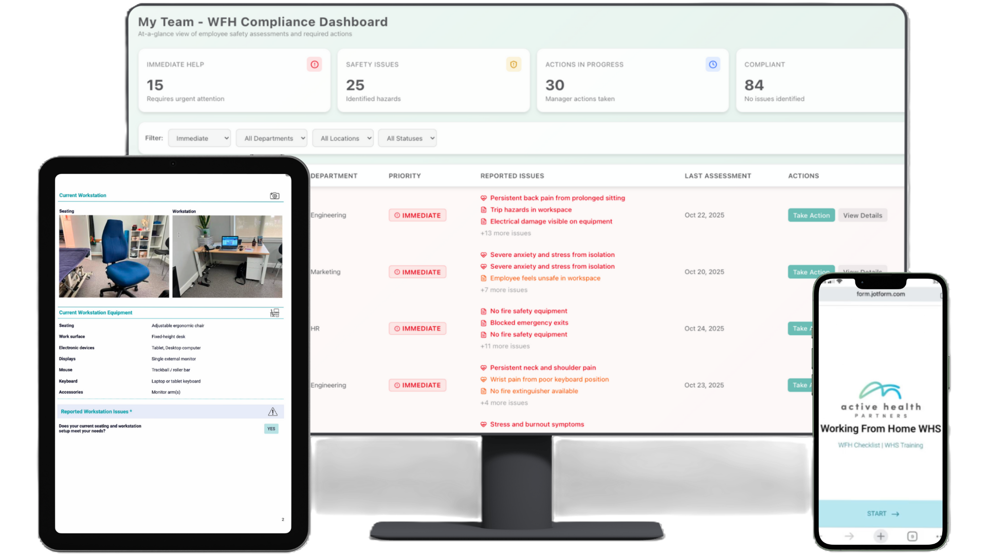
Final Thoughts
Make It Simple. Make It Consistent. Make It Used.
Hybrid work doesn’t fail because people don’t care
It fails when there’s no clear system
If you want to go further and you…
Don’t know where to start
Don’t have the man-power to implement it
Not sure what training to provide
Want to reduce admin hours and overheads
That’s exactly what I help organisations do
Dr Daniel Grynberg - Active Health Partners
linkedin.com/in/drdanielgrynberg

