Slide 1

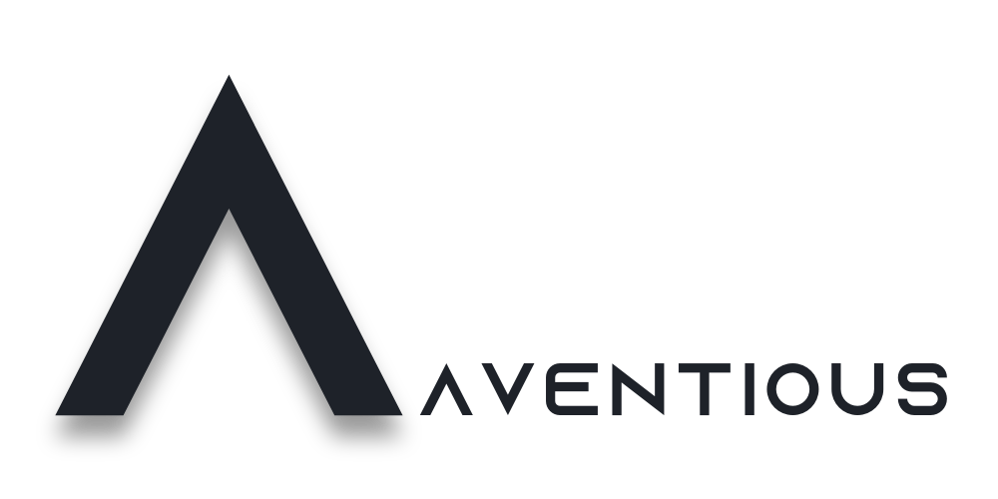
Creating a Better Workplace Culture
Christopher Rannard
Managing Director | Aventious Pty Ltd
ACT Small Agencies HR Forum
Thursday, 12 February 2026
Notes:
Good morning, everyone and thank you for having me. Special thanks to Cassandra for her conversations and guidance late last year in readiness for today. I want to start by saying this upfront: I’m not here as a culture expert, and I’m definitely not here to lecture anyone. I’m here because I’ve lived, experienced, and shaped culture from a lot of different angles.
I’ve been an employee in the Australian Public Service. I’ve been a manager inside organisations, both public and private. I’ve worked across some pretty intense, high-pressure programs and reforms, where the stakes were high (as was the general levels of stress) and the pace was relentless.
And now, I’m a business owner in recruitment. Which means culture isn’t a ‘nice to have’ for me, it’s everything. It affects how we operate, how we show up, who we attract, and honestly… whether the business survives.
But more than that, culture has shaped how I’ve felt as a person throughout my career. Not just at work, but at home. With my family. With my health. With my sense of identity.
So today, I just want to share some reflections, things I’ve learned along the way, both good and bad, and invite you into a conversation about what culture really feels like.

Slide 2
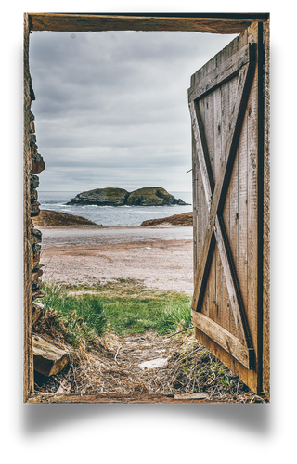
A quick expectation setter
This isn’t a lecture
I’m not here to try tell you what to do
I’m sharing lived experience, the good and the bad
Notes:
Before we go any further, I just want to set expectations for how this session will run.
This isn’t a lecture and I’m not trying to preach the obvious. I’m not here to tell anyone how to do their job, especially not HR professionals!
I know the reality many of you are working in, limited resources, competing priorities, and a lot of responsibility that sits with very small teams.
I’m also not an expert on culture. What I am is someone who’s experienced it, from multiple angles, and learned and/or observed some things along the way.
I’ll share a few personal experiences today, some positive, some not so positive, and talk honestly about how they affected me as a person. Not just my performance at work, but how I showed up at home, and how I felt about myself.
If anything I share resonates, great. If it doesn’t, that’s okay too. My hope is just that this feels relevant, that it feels and real.

Slide 3

What do we actually mean by “culture”?
“Culture is a set of meanings, behavioral norms, and values used by members of a particular society, as they construct their unique view of the world.”
“Culture is conceived as a set of denotative (what is or beliefs), connotative (what should be, or attitudes, norms and values), and pragmatic (how things are done or procedural roles) knowledge, shared by a group of individuals who have a common history and who participate in a social structure.”
“Culture is an integrated pattern of human behavior which includes but is not limited to—thought, communication, languages, beliefs, values, practices, customs, courtesies, rituals, manners of interacting, roles, relationships, and expected behaviors of an ethnic group or social groups whose members are uniquely identifiable by that pattern of human behavior.”
“Culture is a system of collectively held values, beliefs, and practices of a group which guides decisions and actions in patterned and recurrent ways. It encompasses the organization of thinking, feeling, believing, valuing and behaving collectively that differentiates one group from another. Values and beliefs often function on an unconscious level.”
Notes:
When we talk about workplace culture, we usually start with a definitions like these which make sense and are factual, sure, but I’ve always felt they don’t speak to or convey the deep impact or emotional force culture has on human beings.
For example, ‘a set of meanings, behavioral norms, and values used by members of a particular society, as they construct their unique view of the world’. Technically correct, but I feel like you need a map and compass to follow these types of definitions. I find the best definitions aren’t those whereby you need to allocate significant brain power to understand.
In my experience, culture is far simpler, and far more personal.

Slide 4

…the feeling in your stomach on a Sunday night when thinking about work in the morning
Notes:
Before bringing definition on screen
There’s something someone said to me once, many, many years ago and it remains one of the most impactful and insightful perspectives I’ve ever learned. I carry this with me in every capacity, and it has since underpinned all my behaviours and the way I operate in any workplace.
Pause, then land the line
‘Culture is the feeling in your stomach on a Sunday night when thinking about work in the morning’
Let it sit for a moment, then expand
For some people, that feeling is neutral. For some, it’s positive, they feel energised or proud of the work they do. And for others, it’s dread. Anxiety. Tightness. Fatigue. Dread, before the week has even started. And that feeling doesn’t stay at work. It follows you home. It affects how you sleep. How patient you are. How present you are with the people you care about. I’ve felt all of these things, as I am sure everyone here today has as well.
To anchor this point, I wanted to share a quick, personal example early in my career where I truly felt the power of workplace culture.
Examples:
Negative: Early career when being bullied. 6-months of mental and physical affects.
Positive: How the above situation resolved itself through intervention and how that had an immediate, profound impact on me knowing the behaviour wouldn’t be tolerated and priority action was taken.
That’s why culture matters. Not because it’s a strategy or a value statement, but because it shows up in people’s bodies, homes, and lives.

Slide 5

What we already know to be true
Workplace culture directly affects wellbeing, retention, and performance.
Poor culture increases burnout, absenteeism, and turnover.
Psychological safety is one of the strongest predictors of team effectiveness.
Most people don’t leave organisations, they leave environments.
Notes:
I want to touch briefly on evidence, not because you need convincing, but because it validates what most of us already feel.
There’s been a huge amount of research over the years, across the public and private sectors, and it consistently tells us the same thing.
Culture isn’t just a ‘nice to have’. It has a direct and measurable impact on people’s wellbeing, on whether they stay, and on how effectively they work.
When culture isn’t healthy, we see burnout. We see people disengage. We see good people quietly exit, often long before anyone realises there’s a problem.
One of the strongest predictors of whether teams perform well is something very simple, psychological safety. Do people feel safe to speak up, to make mistakes, to be human?
Most people don’t leave organisations. They leave environments
And I don’t think any of this is surprising to anyone in attendance.

Slide 6

Culture is shaped by patterns, not programs
What gets noticed
What gets tolerated
What gets protected
Notes:
When we talk about improving culture, we often jump straight to initiatives, training, frameworks, engagement surveys, action plans.
But in my experience, culture isn’t shaped by programs, it’s shaped by patterns. In small agencies especially, culture is shaped by three things:
First animation
What gets noticed
What leaders notice and acknowledge sends incredibly strong signals.
Example: I’ve worked in high pressure, time sensitive programs where stress and complexity are high. In that environment, the leaders valued output above all else. This led to an environment where people were treated poorly, morale was low, good staff left the organisation, and where seemingly one ‘problem’ may have been solved due to its focus in the spotlight, the behaviours tolerated caused significant cultural issues which didn’t immediately cause noticeable problems, though over the mid-long term, they created an extremely challenging environment to work within, ultimately impacting the overall program.
Over time, people learn what actually matters, regardless of what the values say.
Second animation
What gets tolerated
This is the one I’ve found to be most powerful. What gets tolerated, especially from high performers or senior staff, quietly becomes a key part of the culture.
Example: Having managed many teams in my career, I have felt the impact of this myself. A lead delivery manager of mine was at times was acting in an unprofessional manner towards the rest of the team. His attendance and communication began to slack. For a brief time, I figured it easier to tolerate this, but it didn’t take long for the broader, negative affect on the team to set in. I learned quickly that whilst uncomfortable, difficult conversations are a must.
People are always watching and noticing what’s allowed, not what’s written down.
Third animation 3. And what gets protected.
The flip side to the above examples, given then do sound quite negative in nature is that the aspects of strong team performance and positive behaviours that are protected form the backbone of culture.
Example: Refer back to TGA example where Roz protected me and the impact it had, not just on me, but the broader team.
To this day, I remember and reflect about those leaders who protected me, or who I observed protect others when timelines were tight, pressure was high, or behaviour was poor. Those moments stick with people, making immediate and longer-term impacts.

Slide 7

A quiet culture killer
People are hired for a job description but expected to do the job. The gap is where frustration grows.
If people don’t know what ‘good’ looks like, they will assume they are failing.
Notes:
First animation
One of the most common cultural issues I see, across agencies of all sizes, is not bad intent, but unclear reality.
People are recruited based on a job description. But they are measured, judged, and often burned out by the actual job.
The job description rarely reflects the real complexity, the informal expectations, the competing priorities, or the political and stakeholder realities.
People start their role already behind, not because they lack capability, but because the goalposts were never clear. Over time, that creates anxiety, self-doubt, and resentment. Not because the work is necessarily hard, but because it feels unfair.
This is not a performance issue. It’s a clarity issue.
Second animation
And when people assume they are failing, culture quietly erodes.
For reference, we have included a document that provides candid information on lessons I have learned during my career as an employee, manager, and company owner.

Slide 8

Small agencies have the advantage
Proximity to leadership.
Visibility of behaviour.
Faster feedback loops.
Culture is harder to hide.
Notes:
I want to be really clear about something; small agencies are often talked about as if they’re at a disadvantage when it comes to culture. But in many ways, they’re actually better positioned than large organisations.
First animation
Proximity to leadership
In small agencies, leaders aren’t abstract. They’re visible. People see how decisions are made, and how pressure is handled.
Example.
I’ve learned, sometimes uncomfortably, that in smaller environments, people see everything you do.
Second animation
Visibility of behaviour
In small teams, behaviour travels fast, both good and bad. You can’t hide behind layers of structure or process.
Example.
I’ve seen one conversation, one decision, or one moment of support ripple through an entire team.
Third animation
Faster Feedback Loops
Culture in small agencies responds faster. When something’s off, people feel it quickly, and when something improves, they feel that too.
Example.
Some of the biggest cultural shifts I’ve seen came from very small changes, simply because people noticed.
Fourth animation
Culture is harder to hide
In small agencies, culture is harder to hide behind policy or language.
People experience it directly, every day.
That can be confronting, but it also means your efforts matter more than you think.

Slide 9

A personal reflection
Culture is something you carry with you, long after you’ve finished working.
Notes:
I want to finish with a personal reflection, not as a Managing Director, but just as a person who’s spent a long time in workplaces.
When I look back over my career, the moments that stay with me aren’t the programs, the restructures, or the policies. They’re how I felt. Whether I felt safe. Whether I felt supported. Whether I felt seen. I remember periods where work took a lot out of me, not because the work was hard, but because the environment was.
And I remember other periods where the work was intense, but I still went home with energy, because the culture was human.
Personal reference cue (choose one only):
Realisation learned later in life about the cost of certain environments.
What I’ve learned, sometimes too late, is that culture doesn’t stay at work. It shapes who you are outside of it. That’s why I care so deeply about it now, as a leader, as a business owner, and as a human being.

Slide 10

Culture is a form of care
Culture isn’t what we say.
It’s how people feel when it matters most.
Notes:
I want to leave you with one final thought.
Culture, at its core, is a form of care.
It’s shown in the moments when people are under pressure. When mistakes are made. When someone is struggling, quietly.
In small agencies, those moments are visible. They’re not abstract. And that means the way we respond matters more than we sometimes realise.
You don’t need big budgets or complex frameworks to shape culture. You shape it every day, through what you notice, what you tolerate, and what you protect.
Bring it home (subtly anchoring Aventious’ values without naming services):
For me, that belief shapes how I lead, how I hire, and how I think about the environments we help create for people. Thank you for the work you do, often quietly, to hold culture together in small agencies. It matters more than you’re probably told.
Thanks for listening. I’m really happy to open it up for questions or discussion.

Slide 11

Contact us
https://www.linkedin.com/in/christopherrannard/
https://www.linkedin.com/company/aventious
Christopher.Rannard@aventious.com.au
0468 567 362

