Slide 1
OFFICIAL
APS HR Professional Stream
Building capability, leadership development, and strategic partnerships while signalling growth opportunities for APS HR professionals
12 February 2026
OFFICIAL

Slide 2

Today’s presentation
Setting the scene
Building capability
Leadership development
Strategic partnerships
Signalling growth opportunities
How we deliver
Continuing to grow and mature
Our ask
OFFICIAL
Notes:
Sharing how the HR Profession builds capability, supports leadership, partners strategically, and signals growth opportunities for HR practitioners.

Slide 3
Setting the scene: Why this matters now
APS capability is an APS priority
Foundational to building a modern, capable and responsive public service
Helps attract, grow and retain specialist skills
Lifting capability and positioning HR as a strategic partner across the APS
A more connected and resilient profession across disruption
Investing in ourselves as professionals strengthens the public service for everyone
OFFICIAL
Notes:
The HR Profession exists to lift strategic HR capability - so we can lead change, partner credibly, and build a future-ready APS workforce.

Slide 4

Setting the scene: What the data tells us
Engagement increasing since 2022
Immediate supervisor leadership increasing year on year
Innovation and wellbeing rebounded
Results are equal or above most APS benchmarks
However systems barriers persist
OFFICIAL
Notes:
Census results show real strengths to build on, and pinpoints the system barriers we should keep addressing as a profession

Slide 5
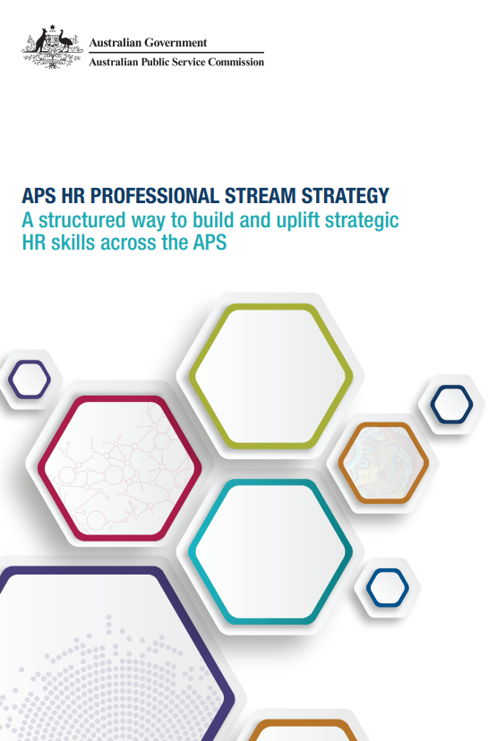
Building capability: Our uplift agenda
APS HR Professional Stream Strategy
Key principles: Grow capability, Share knowledge and practice, Collaborate
Themes: Establish profession, Define standards and capabilities, Embed initiatives
Notes:
The Stream Strategy sets the principles and program of work that professionalises HR and lifts strategic HR capability across the APS.

Slide 6
Building capability: The Stream Strategy
Four objectives and eleven initiatives aligned to the three themes:
1. APS has a new HR Professional Stream
1. Establish Reference Group
2. Identify HR Head of Professional Stream
3. Develop HR Professional Stream Strategy
4. Source resources to support
2. A new APS HR Professional Network
5. Establish professional network
6. Link professional bodies
3. New HR standards/ capabilities for the HR workforce
7. Identify professional HR standards
8. Identify professional HR capabilities
9. Communicate the case for change
10. Develop an APS HR Profile
4. Implementation and prioritised program of work
11. Create implementation plan
Initial signature initiatives:
Streamline HR Graduate recruitment for the APS
Create HR Professional Network
Implement HR mobility program
Develop an HR workforce strategy
Getting it right from the start
OFFICIAL
Notes:
The signature initiatives are practical and continue today - creating pipelines, connection, mobility and stronger recruitment foundations.

Slide 7

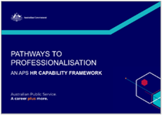
Building capability: Professionalising the HR function
Growing individual capability for HR professionals
Delivering consistent, high-quality services for organisations
Maturing the HR profession across the APS
APS HR Leader Attributes
‘How We Work’ behaviours
HR personas
Pathway mapping tools
Notes:
The Workforce Strategy and Pathways make capability uplift practical - giving every HR practitioner and leader clear actions and a common language.

Slide 8
Building capability: What we delivered in 2025
HR foundations
Future HR leaders
HR data and analytics
BAU
OFFICIAL
Notes:
In 2025, the HR Profession delivered targeted work on foundations, future leaders and HR data - supported by strong participation, governance, mobility and network growth.

Slide 9
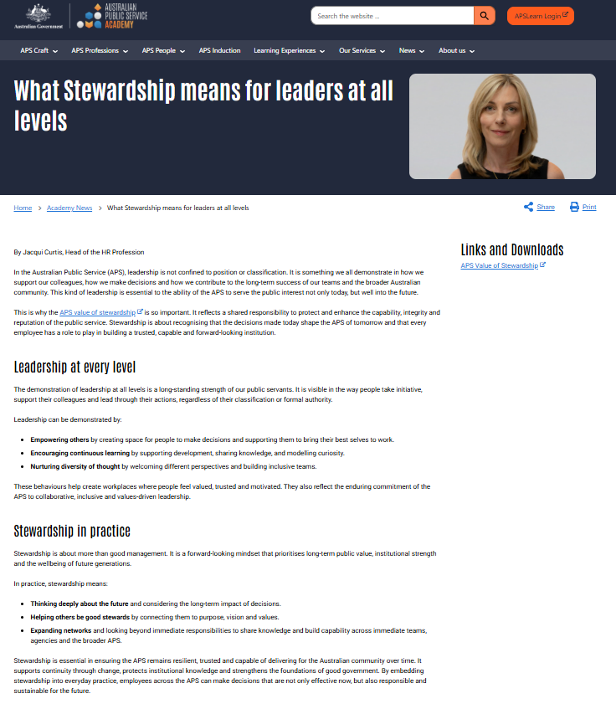
Leadership development: Leaders at every level
Everyday leadership behaviours
Building trust and capability
Collaborating and shaping the system
Notes:
The HR Profession makes stewardship real by connecting HR leaders to people, practice and opportunities across the APS.

Slide 10
Leadership development: Stewardship in practice
Stewardship behaviours in action
Using networks and channels
Sharing practice and enabling mobility
Leading beyond your agency boundaries
OFFICIAL
Notes:
The HR Profession turns stewardship into action by connecting HR leaders to people, practice, and opportunities across the APS

Slide 11
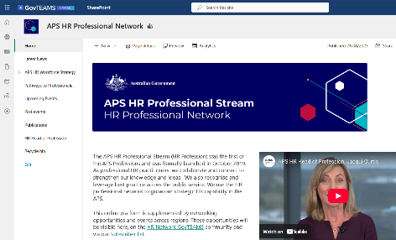

Strategic partnerships: Partners, purpose and practical benefits
APS HR practitioners
HR Senior Executive
APSC
APS Professions
Departments and agencies
Scale and reach
Shared standards
Faster capability uplift
Better practice, sooner
Pathways for people
Notes:
Partnerships scale impact by connecting people with shared standards, tools, networks and development pathways.

Slide 12
Signalling growth opportunities: Pathways to develop and thrive
Mobility opportunities
Present and lead practice
Pilot programs
Pathways self-assessment
OFFICIAL
Notes:
Growth is signalled through real opportunities (mobility, contribution and pilots) and real ways to plan your next steps (Pathways)

Slide 13

How we deliver: Our collective approach to capability uplift
Capability: Frameworks and learning
Leadership: Stewardship and behaviours
Partnerships: APS, AHRI and Professions
Growth: Mobility, piloting and presenting
Notes:
The HR Profession delivers these themes at scale through shared standards, networks, and practical opportunities across agencies

Slide 14
Continuing to grow and mature: What is next
Network data analysis and integrity
Member engagement
Strategy review
Capability library
Continuity
OFFICIAL
Notes:
Next, we’re strengthening foundations -so the HR Profession stays current, connected, reliable, and easier to engage with.

Slide 15
Continuing to grow and mature: Our 2026 rhythm
Item | January | February | March | April | May | June | July | August | September | October | November | December
Networking Events |  |  |  |  |  |  |  |  |  | 
Newsletters |  |  |  |  |  |  |  |  |  |  |  | 
SES Governance meetings |  |  |  |  |  |  |  |  |  |  |  | 
Webinars & Masterclasses |  |  |  |  |  |  |  |  |  |  |  | 
AG Graduate Program – HR Stream |  |  |  |  |  |  |  |  |  |  |  | 
AG Career Starter Program – HR Stream |  |  |  |  |  |  |  |  |  |  | 
Mobility Bulletins |  |  |  |  |  |  |  |  |  |  |  | 
Profession Leads Meetings |  |  |  |  |  |  |  |  |  |  |  | 
External speaking / event |  |  |  |  |  |  |  | 
HRPS Team project/initiative | Network data |  | Member Community Engagement |  | Strategy review and refresh |  |  | Capability library |  | Continuity and process assurance
OFFICIAL
Notes:
Expect a consistent rhythm of connection, learning, and opportunity across 2026

Slide 16
Our ask: How you can get the most value from the HRPS
Connect
Contribute
Capability
OFFICIAL
Notes:
Your engagement is the multiplier—join, contribute, and use the profession tools to build capability and opportunities

Slide 17
OFFICIAL
Questions?
APSHRProfessionalStream@ato.gov.au
OFFICIAL

