Slide 2


Notes:
I’ve created a number of shows. Most recently a show called I Was Actually There on the ABC. Also YCAT. Heard of it?
We’re very proud of the show, it’s doing remarkably well…
The success comes down to honesty + candidness…
For those that don’t know the show…

Slide 3


Slide 4
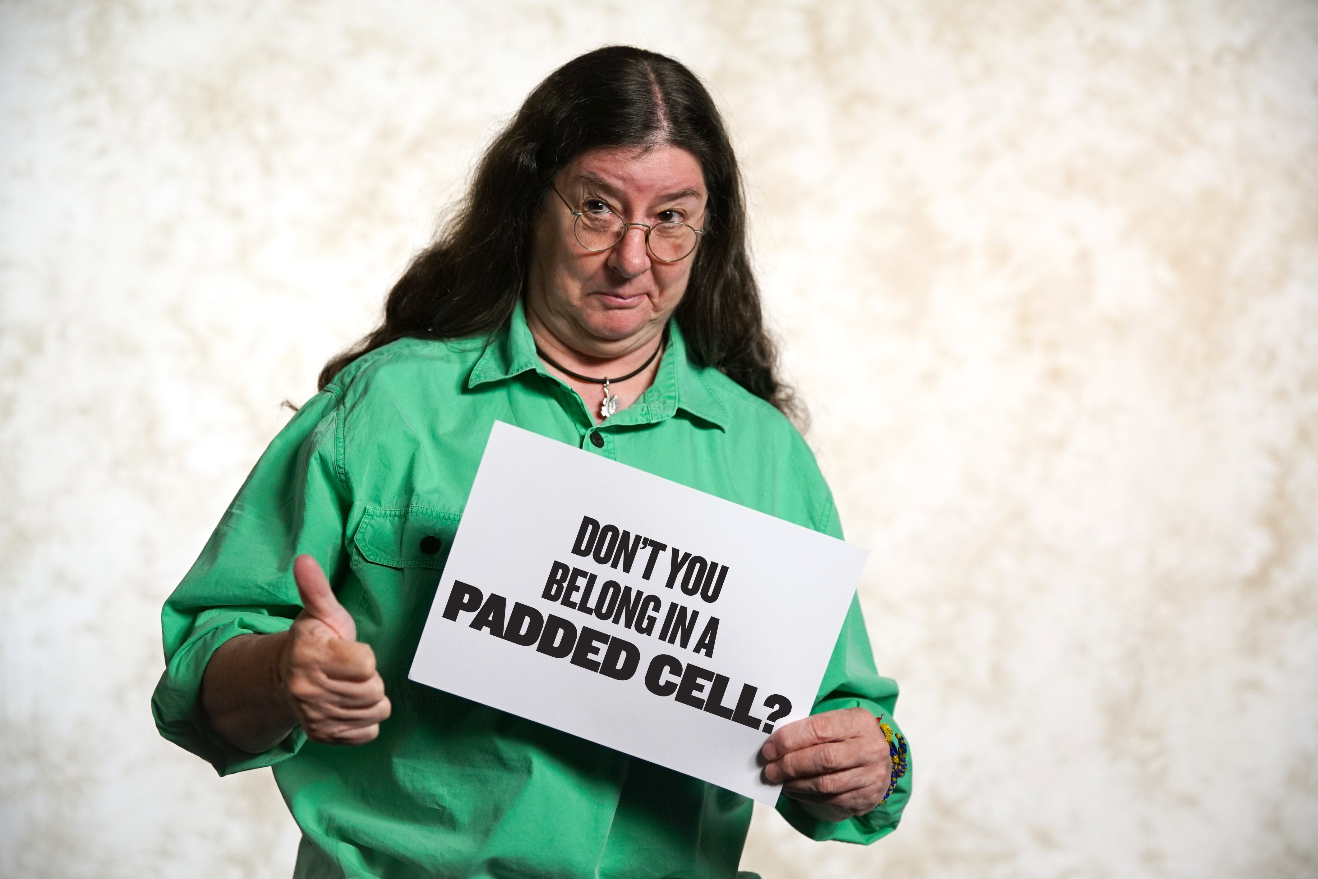

Slide 5
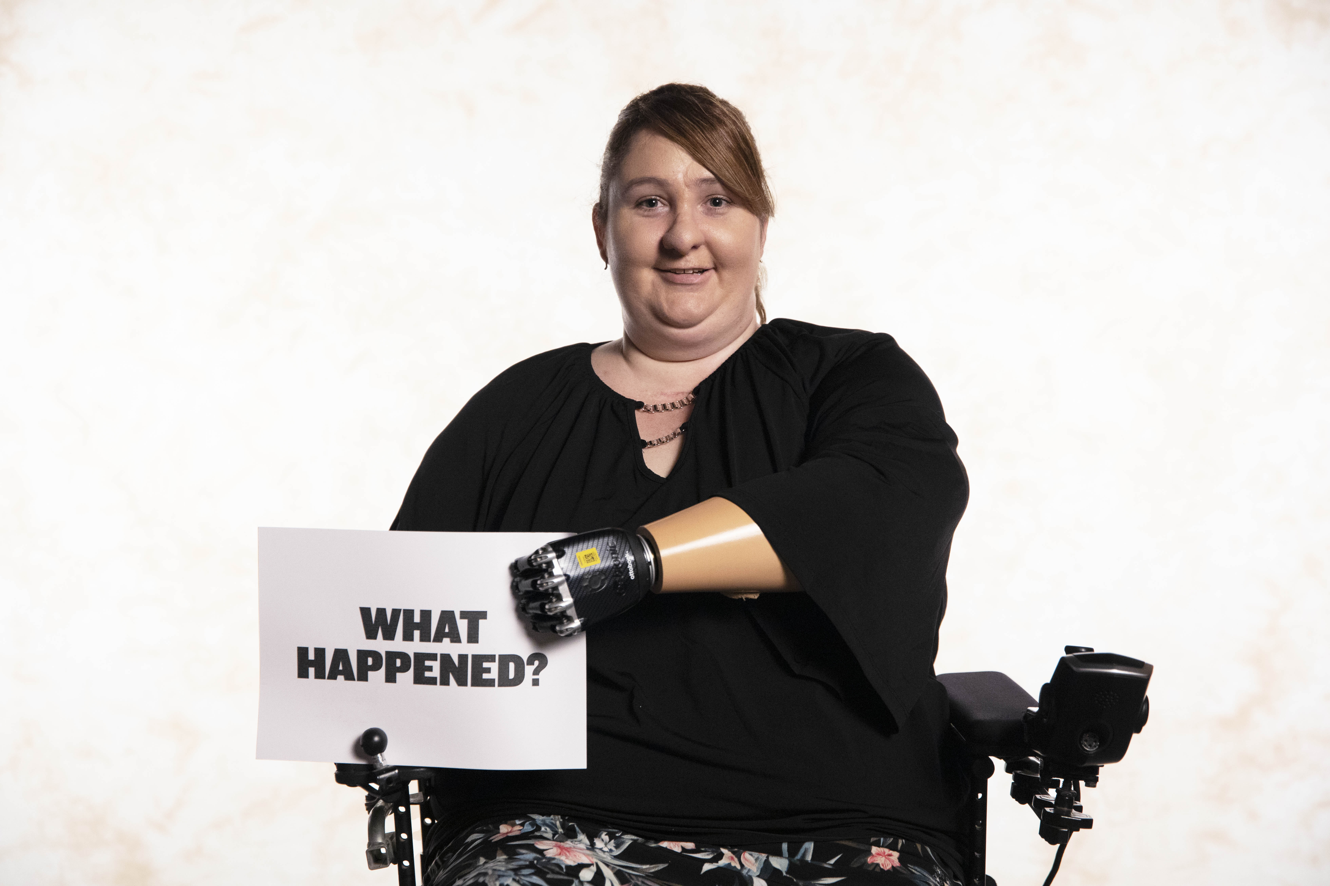
Notes:
-Participants live w label, go past label to understand who truly are.
-We do by asking questions you’re not supposed to - maybe like to but too rude or politically incorrect or don’t have access to person.
People then get to answer however they want.
This show only features people with first hand experience…
Just because they have this label, it doesn’t mean they all think the same.
-Here’s trailer

Slide 7
VIDEO 1: YCAT7 TRAILER

Slide 8
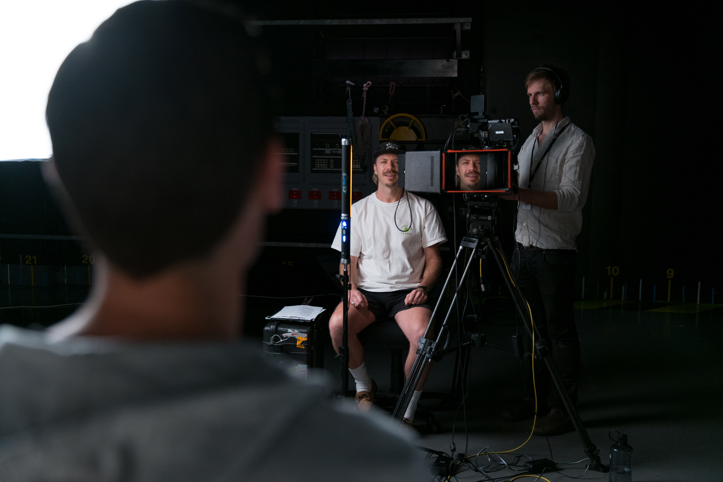
Notes:
My role on this show is the interviewer. I get to ask the most interesting people in the world the most honest, personal, gut wrenching questions about who they are. And then I get to listen to them.
Through having hundreds and hundreds of these interactions, I’ve learnt we all share a core value

Slide 9
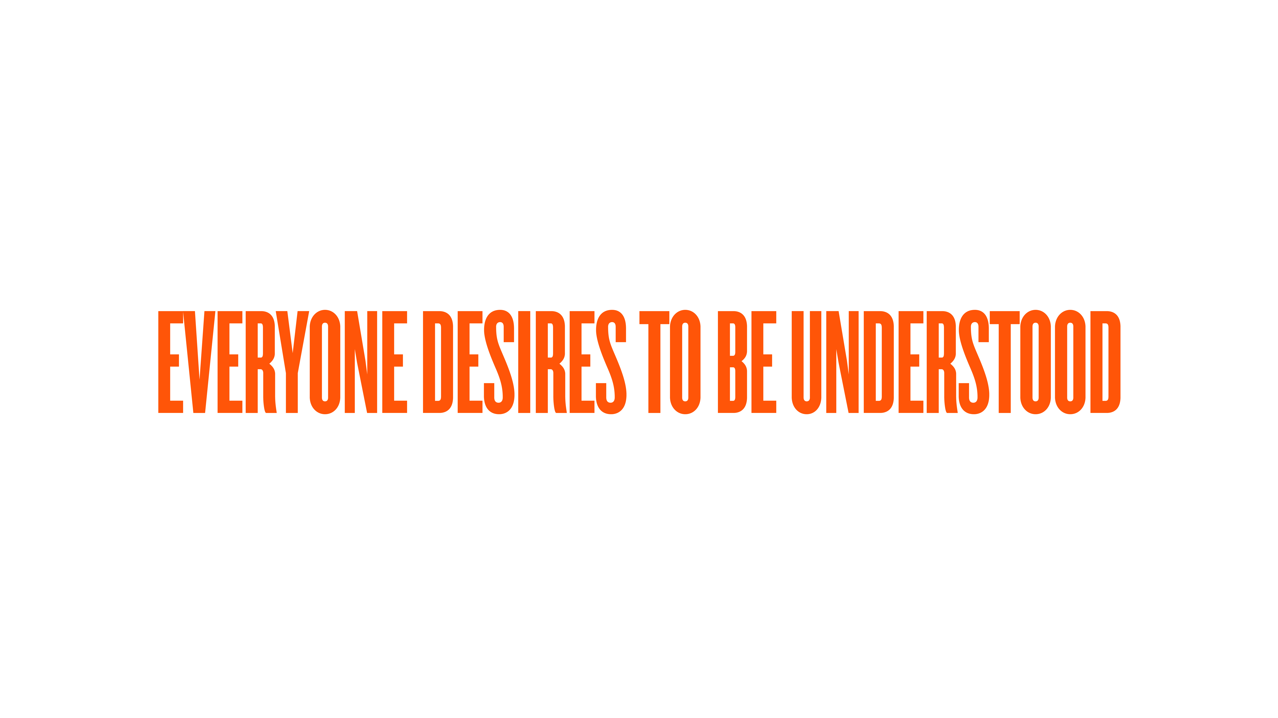
Notes:
-no matter what believe or what into
-go into interactions that way
-create a shift in your approach and Q asking

Slide 10
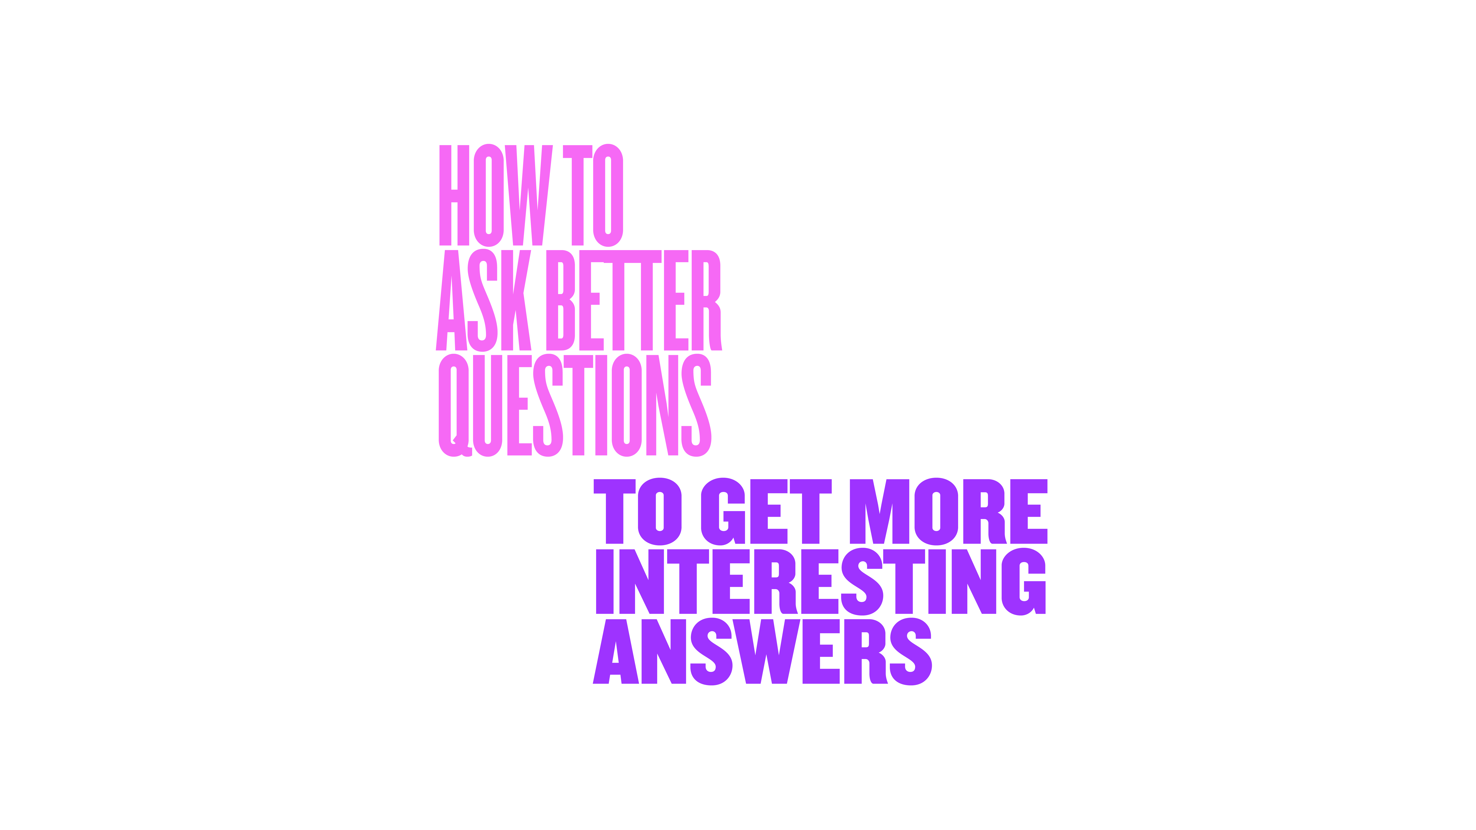
Notes:
-today going to teach you
-IV the YCAT way, KD way
-lots ways to IV - a shock jock is very different to a sports reporter
-all have diff aims & outcomes
-I’m gonna show you mine

Slide 11
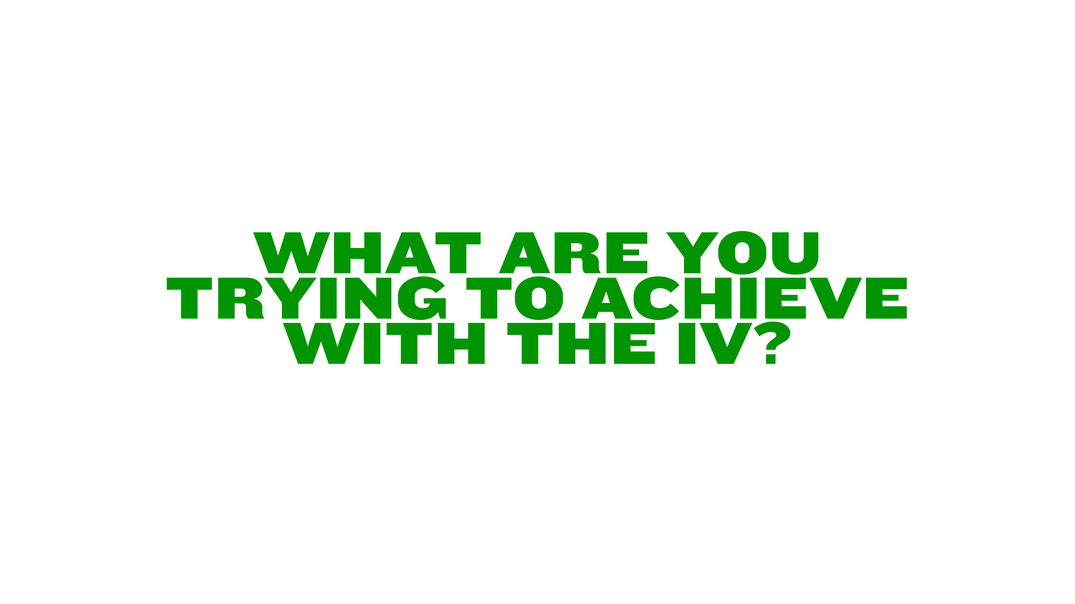
Notes:
Before we ask Qs, need to understand, “What are you trying to achieve with the IV?”
What you’re hoping to achieve with the interview will dictate the sorts questions you ask.

Slide 12
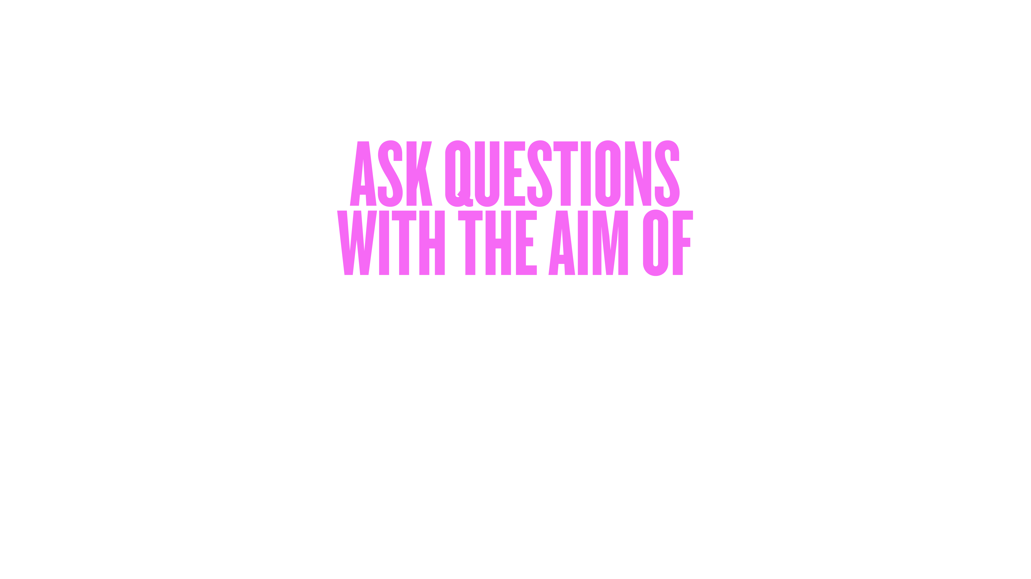
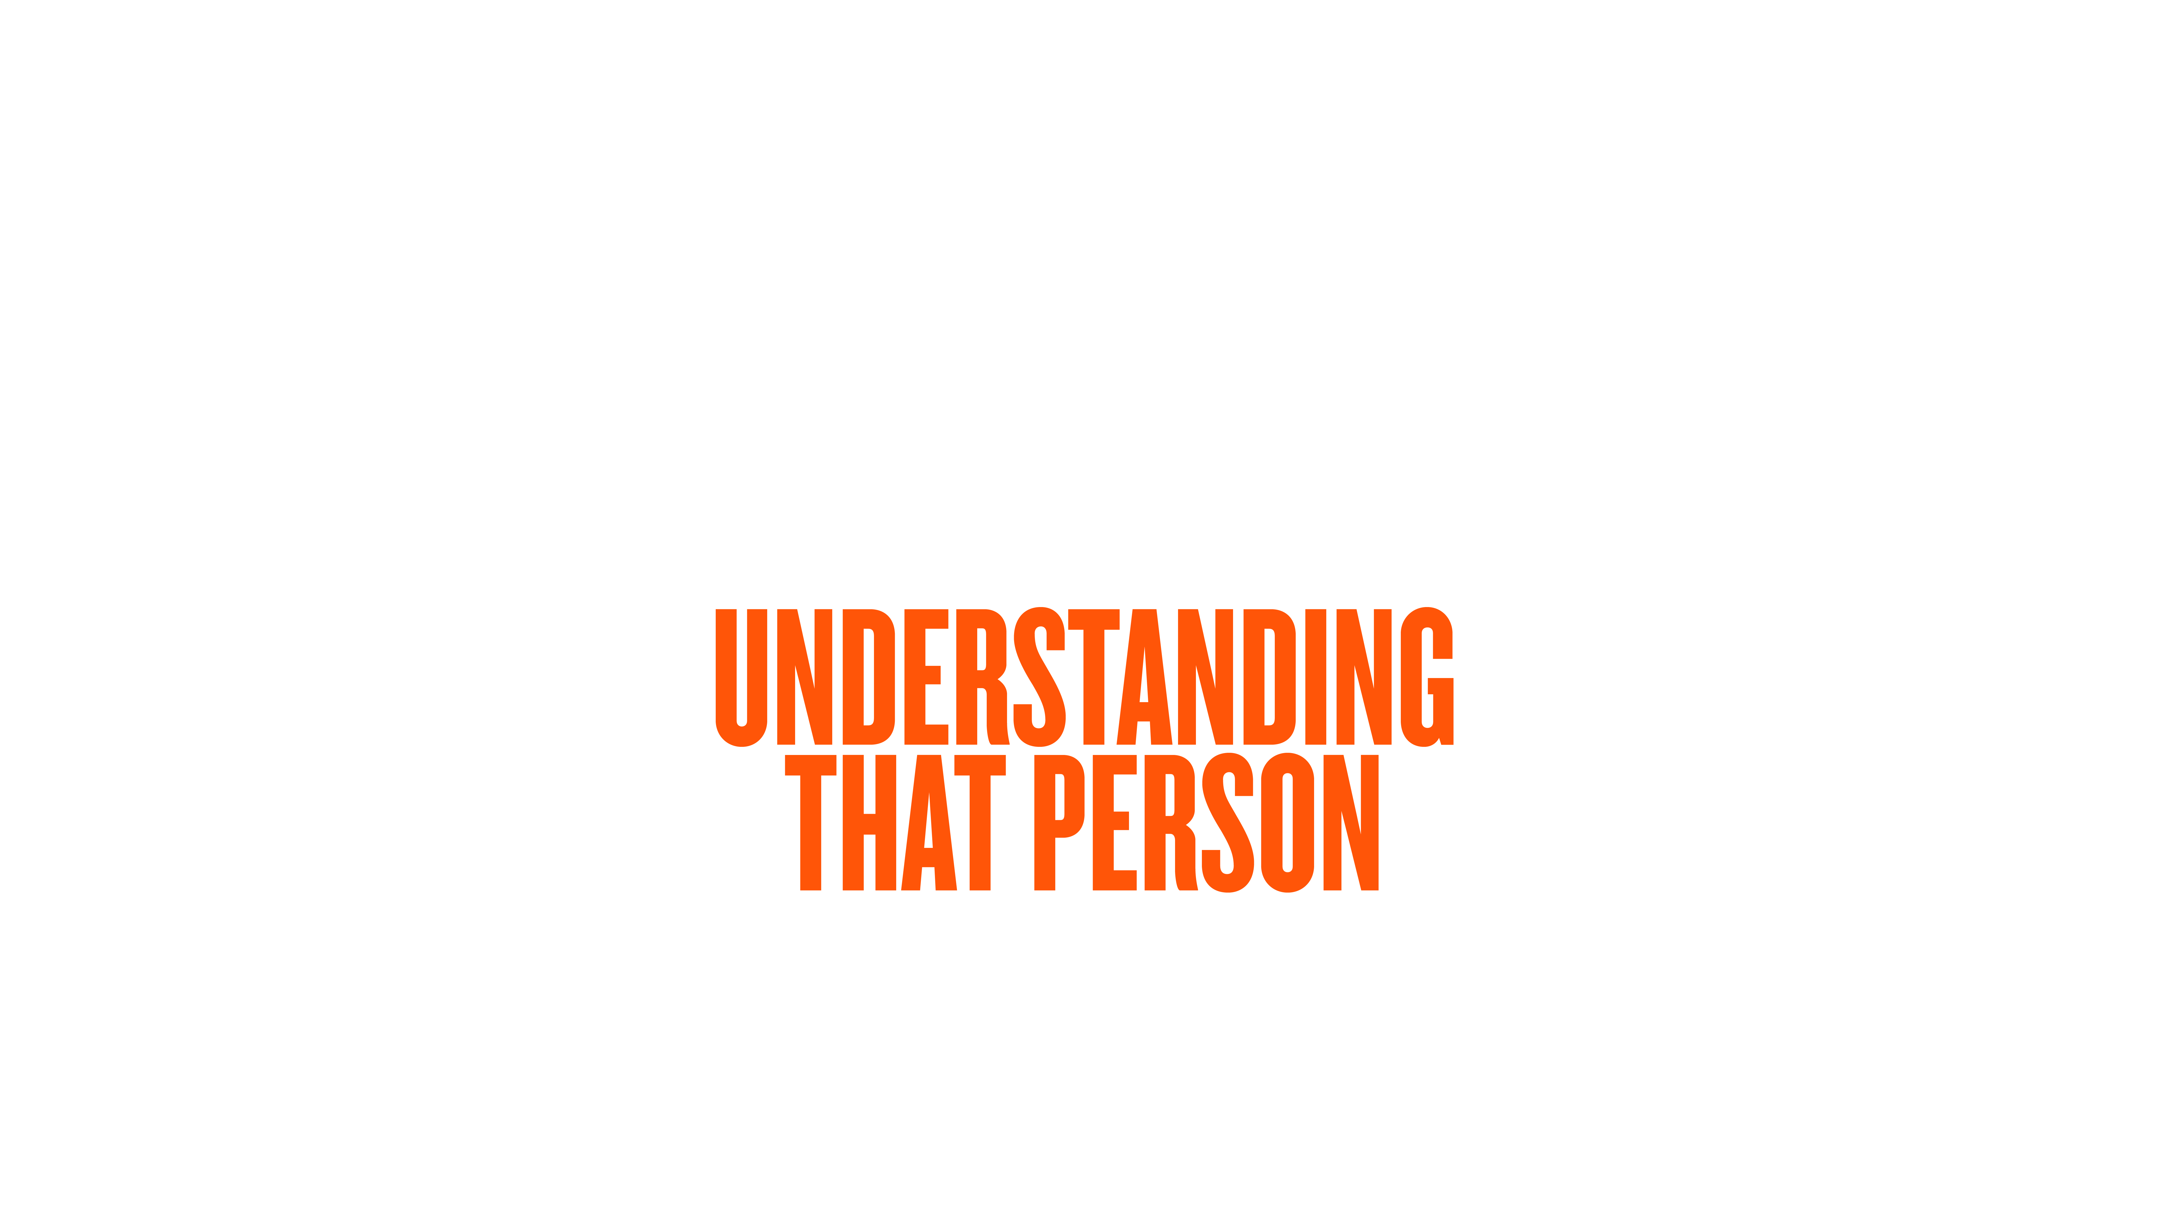
Notes:
There are multiple things I’m trying to achieve with an inteview. One of my big aims, is to ask questions with the aim of understanding that person.
Past the stereotypes and truly understand how they think, their belief systems, their experiences.
If my aim is to understand, what I’m looking for in a response, is authenticity.
Authentic Expression

Slide 13

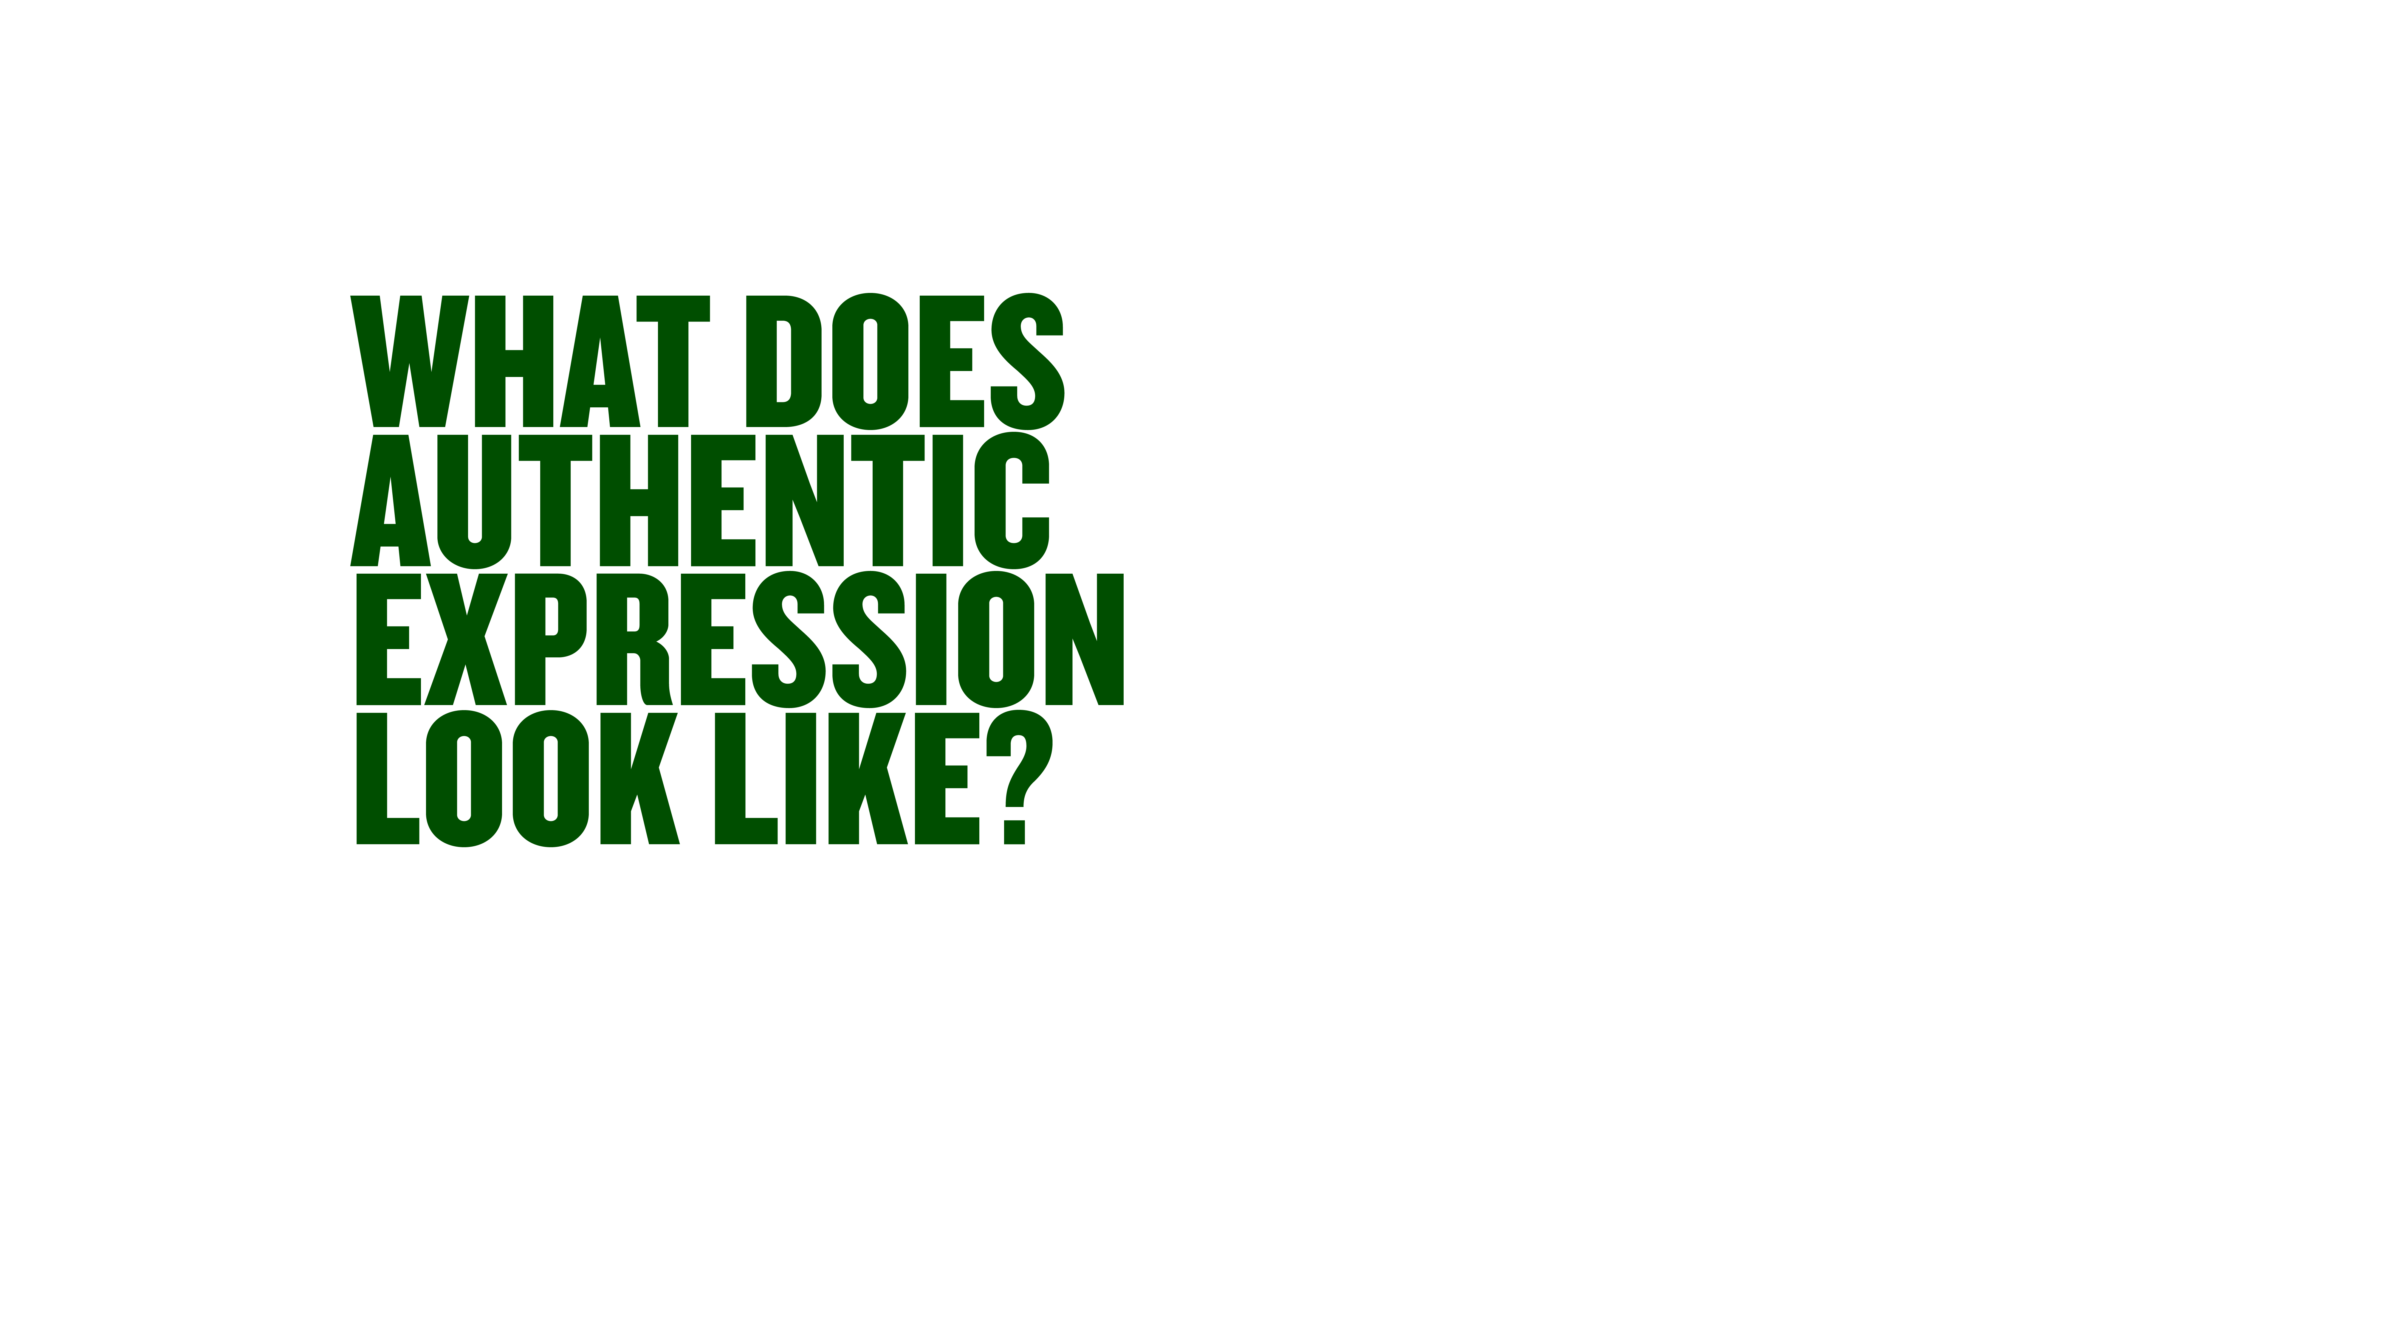

Notes:
It’s a bit of a buzz phrase atm. Authentic Expression.
If you’re talking to someone and they’re expressing authentically, what does that look like?

Slide 14



Notes:
When I’m speaking to someone and they’re being authentic, it feels like:
When someone is speaking honestly and truthfully, you can feel the difference.
Compared to someone that is holding back, being careful what they say.
Authentic answers are always interesting because they are the truth.

Slide 15


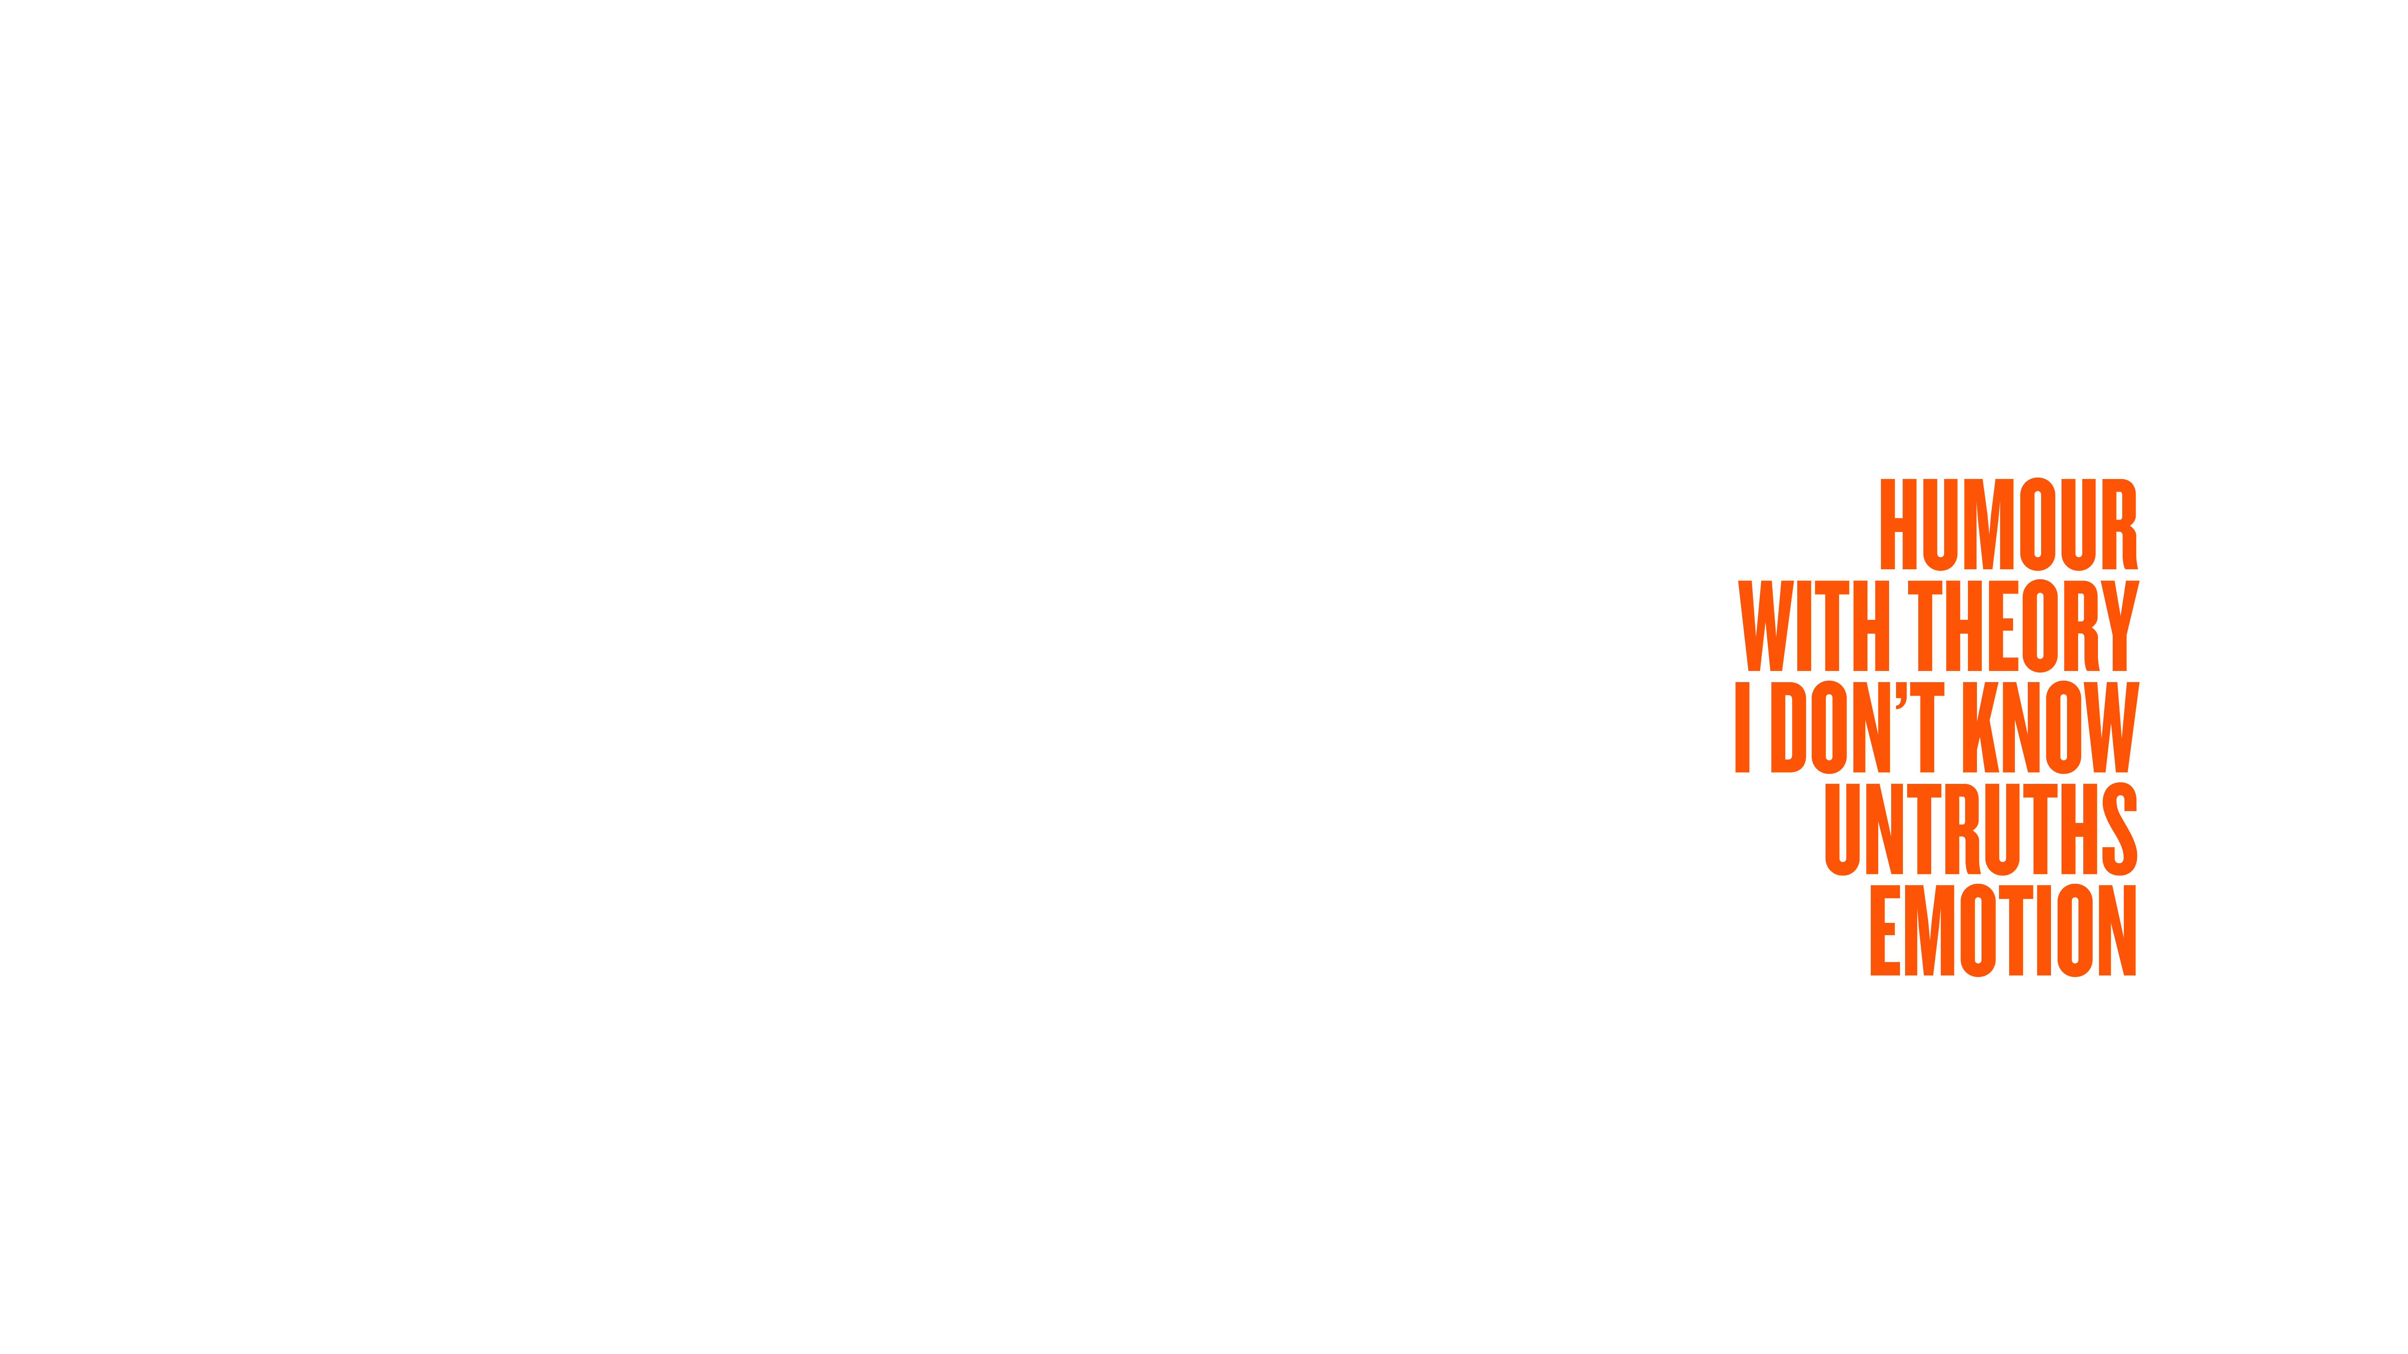

Notes:
When people aren’t being authentic, it’s often because of fear.
Fear of consequences, what will happen with that information
And these fears could have something to do with you - fears around the fact you’re the boss, or based on your reputation, true or untrue
Or the fears could be patterns, based on history
When people fear, they deflect out of danger…

Slide 16
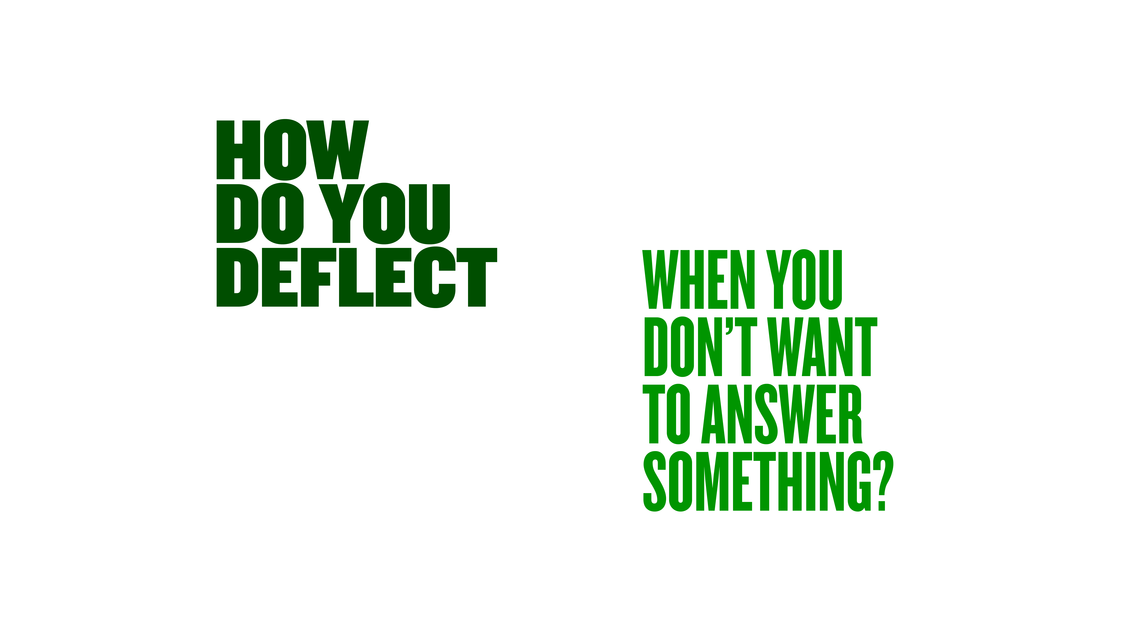
Notes:
I deflect by being charismatic… fudge my way through with energy.
Or tell a story that I think is interesting, gives something to work with, but not what they were asking…
Activity: How do you deflect if you don’t want to answer something? When you feel out of your depth? Or nervous?
I’m not telling you this so you can call people out when you suspect they’re deflecting.
If start identifying when you’re deflecting, you identify when others are.
They are feeling uncomfortable, have to work hard to get comfortable again, so they can relax and speak honestly.

Slide 17

Notes:
I thought it would be fun to do it via a fictionalised episode called YCAT HR Professionals. Not a sexy title, but accurate
You’re all producers on the episode. Which is great caus this is a group you know well.

Slide 18


Notes:
There’s 2 parts to the IV, this is how it do it with my producers…
-Preparation
-The IV
With your help, I want to prepare an interview with an HR Professional for our fictionalised show, YCAT HR Professionals.

Slide 19

Notes:
The part of the preparation I want to focus on today on the question itself.
What do you want to ask?
On You Can’t Ask That I ask questions that are very honest and to the point…
People ask questions don’t care what answer is,
I learnt this the hard way interviewing centenarians, 100 year olds…

Slide 20
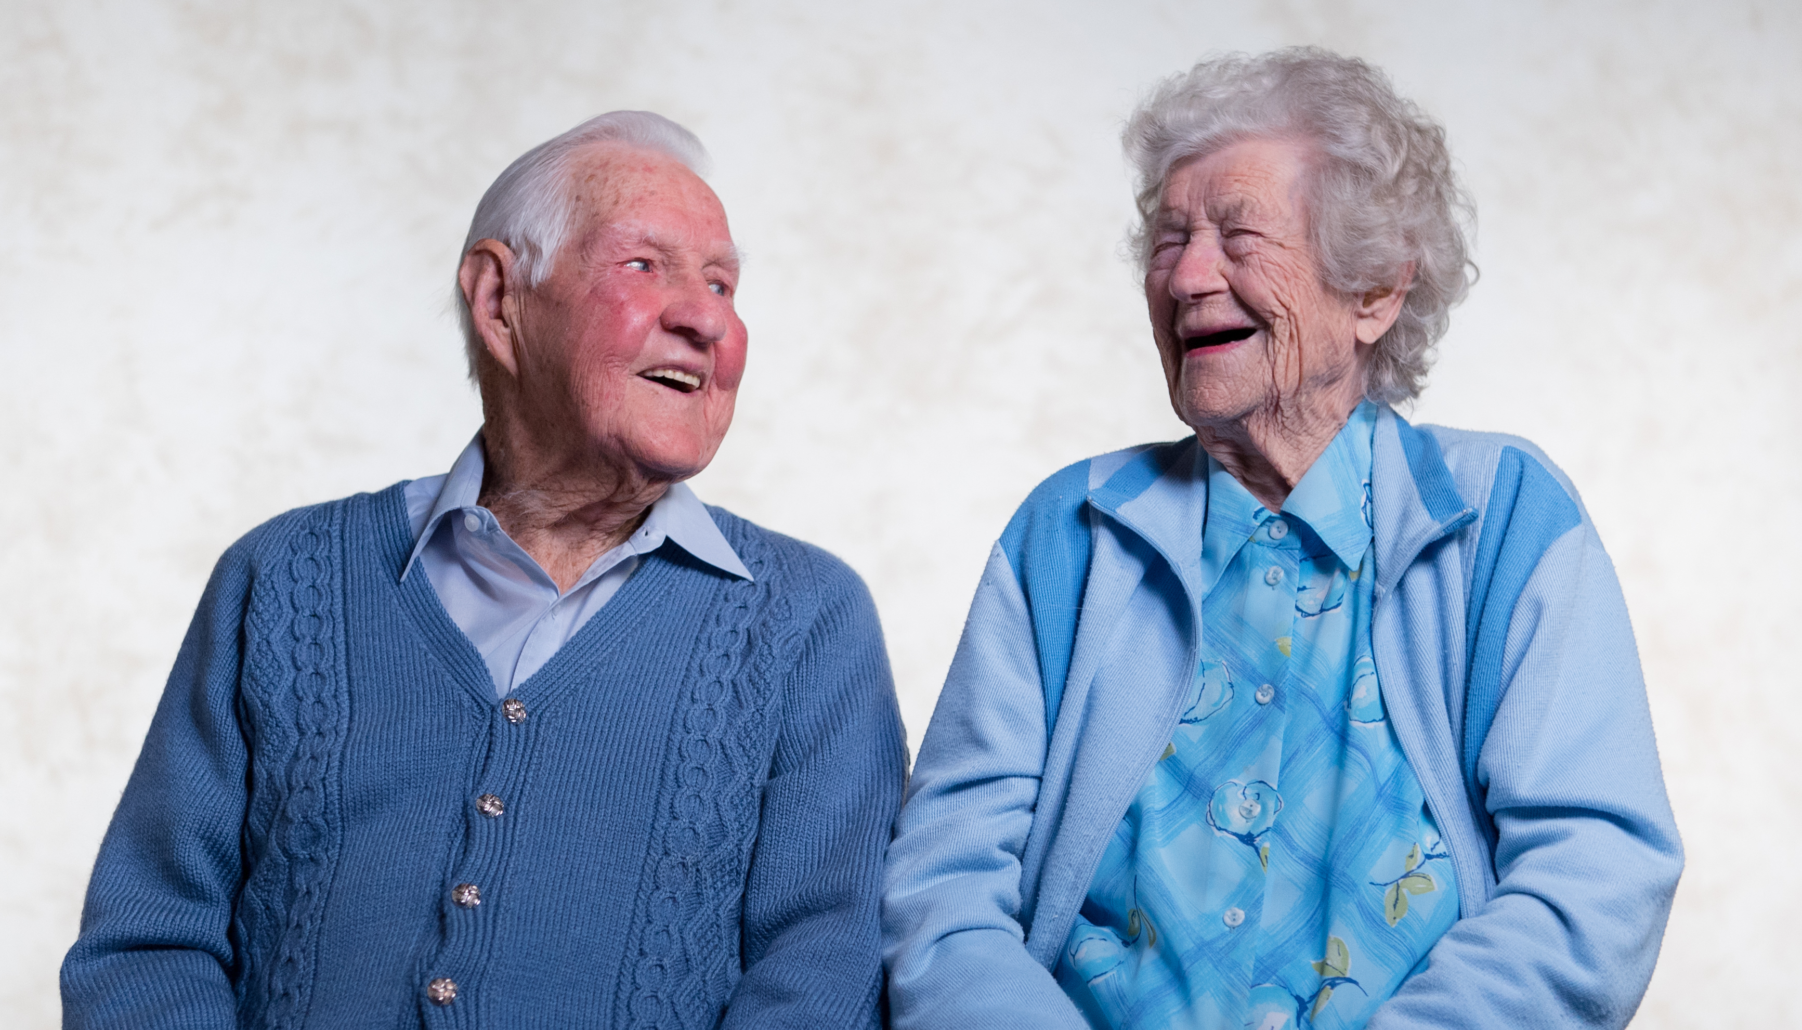
Notes:
Too long on warm up, questions that weren’t important, that by the time I got to the good stuff they were falling asleep.

Slide 21




Notes:
So for our episode YCAT HR Professionals,
What wouldn’t you typically ask someone in this room?
In a moment you are going to brainstorm questions.
So on the show, when we brainstorm questions, we try and come up with ones that…

Slide 22
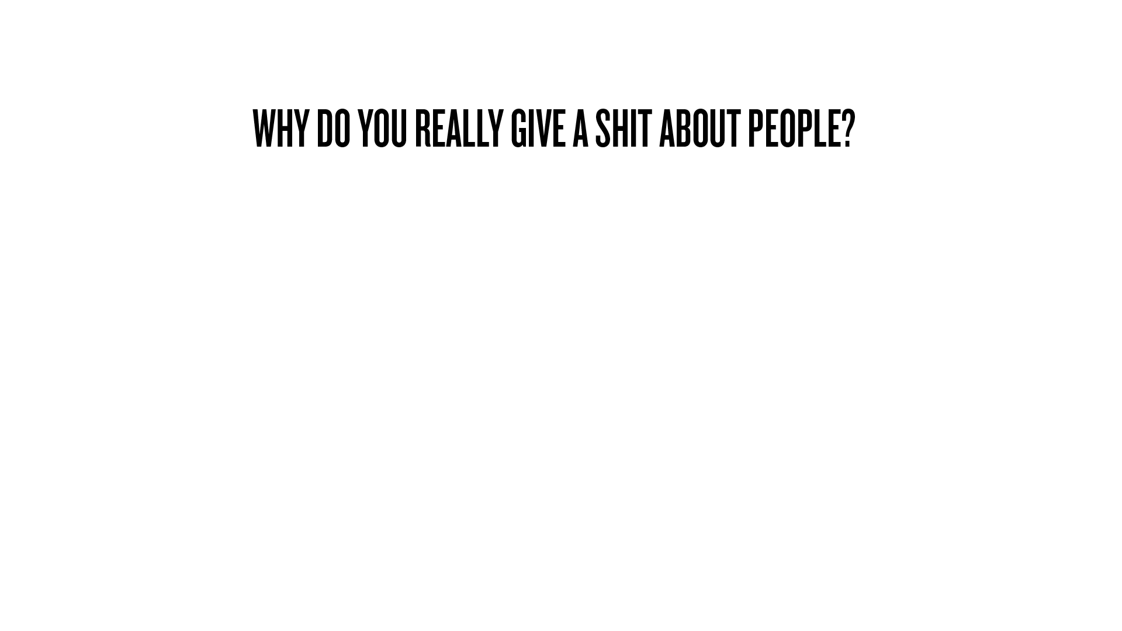
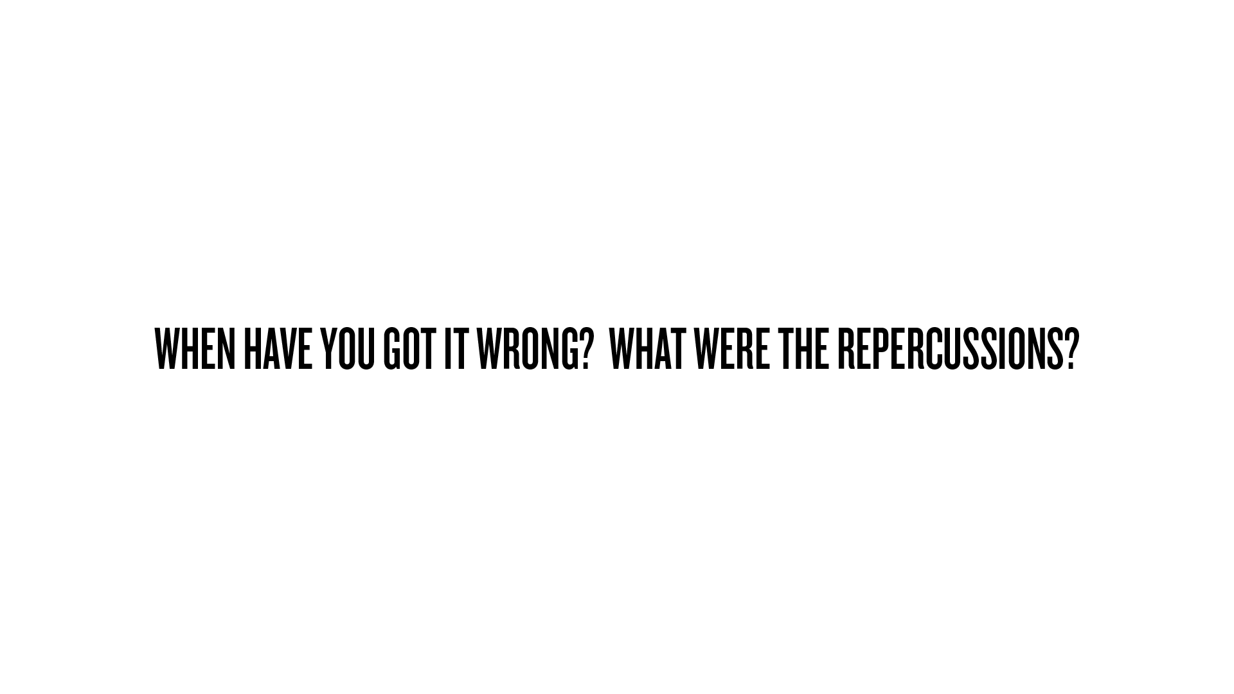


Slide 23
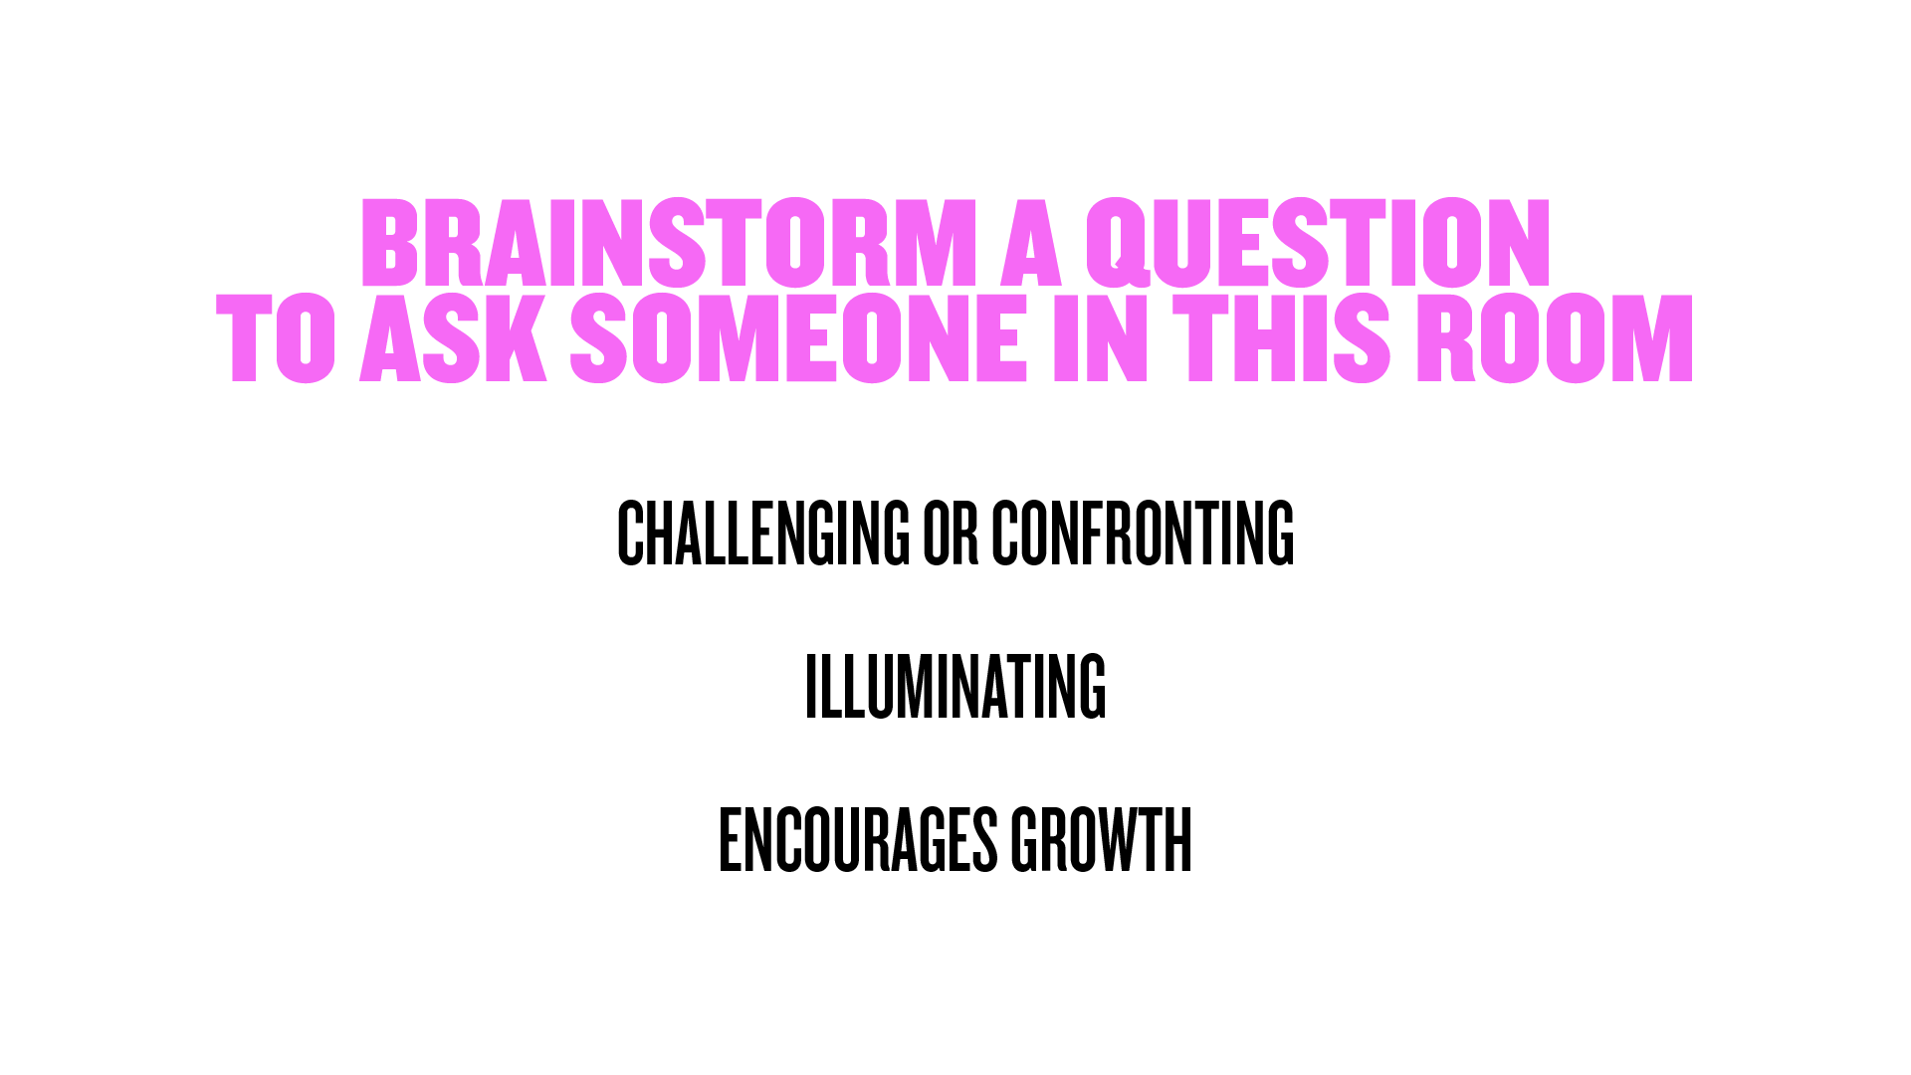
Notes:
Person next to you, come up with a question, that you’d love to ask someone in this room, but you typically wouldn’t. Questions that anyone in this room could answer.
An example might be:
What have you had to sacrifice for you work?
Would your 18-yo self want to be you?
Have fun with it. Lean on your curiosity.
If you could ask anything, what would you ask?

Slide 24
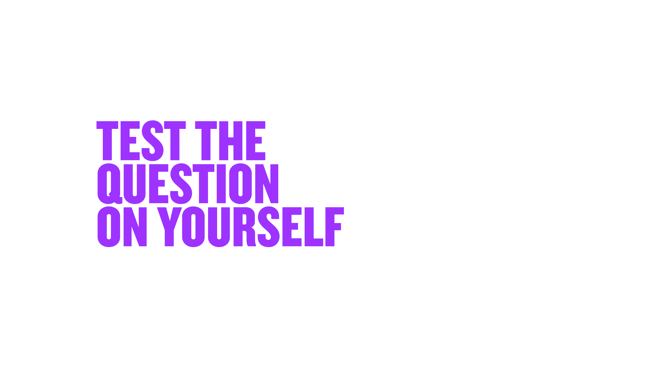


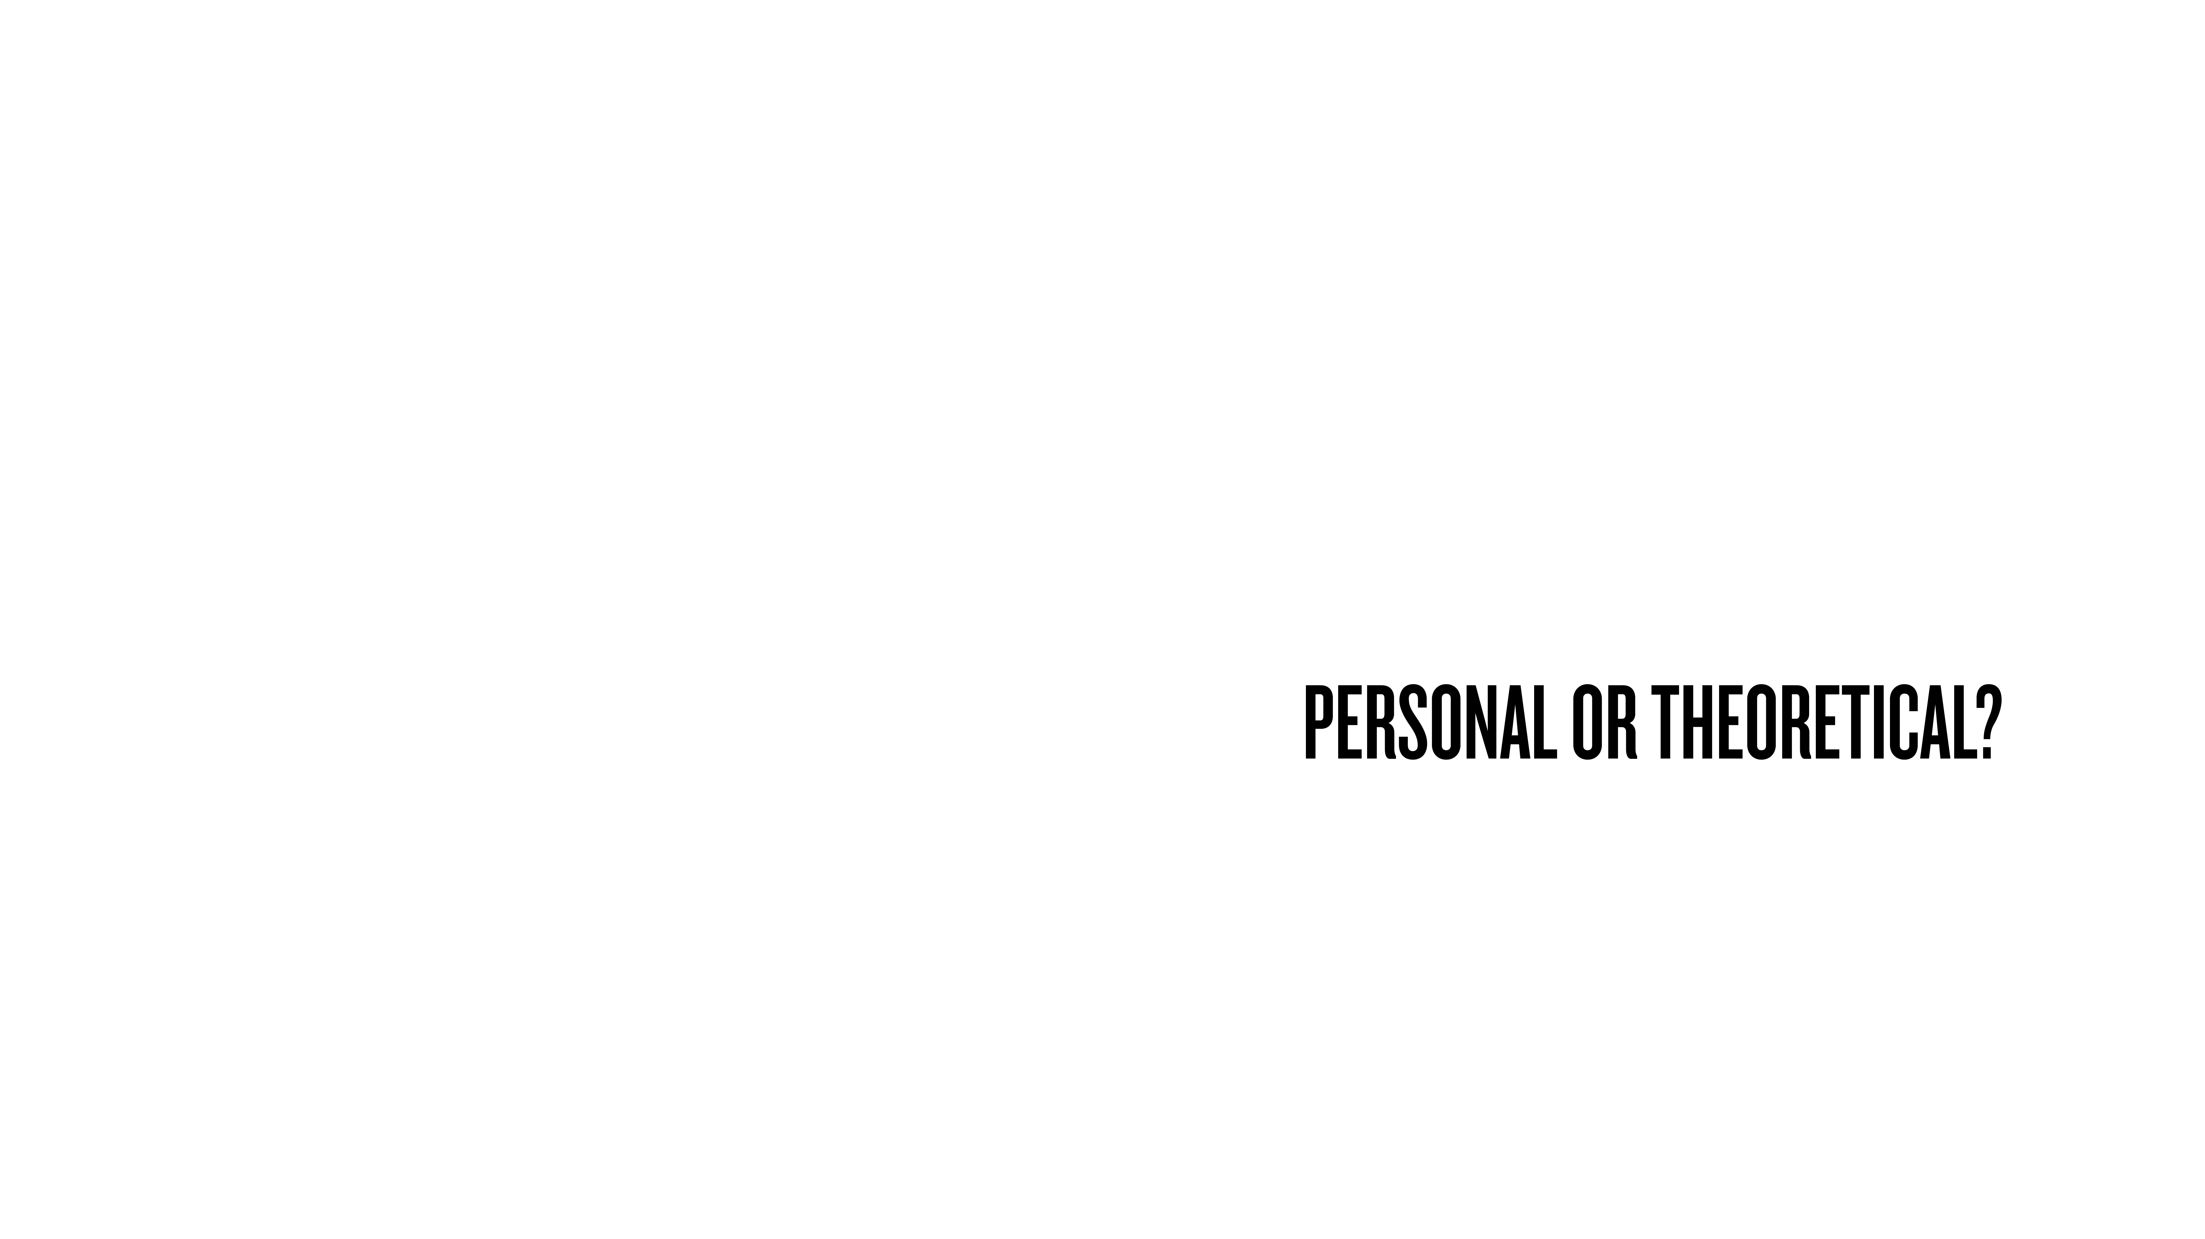
Notes:
How? The best way, answer the question yourself out loud to hear what comes out of your mouth.
If you do this, not in your head, but out loud, you’ll immediately be able to ascertain a couple of things.
*People love hiding behind showing you how smart they are. Others freak out about looking stupid by getting the question wrong.
By testing out loud, it also gives you an idea of what it’s like to be in the hot seat, being interviewed.
I have a rule, I won’t ask a question that I haven’t answered myself. How can you expect someone to answer something that you haven’t got the courage to answer?
You might realise your question isn’t working, but the theme you’re getting at is right.
So you might need to adjust the wording, make it simpler, or less specific.
Turn back to the person next to you and test your question out loud to hear how you would answer it.
Afterwards I’m going to collect a few…

Slide 25

Notes:
Being in the hot seat helps you empathise with interviewee when you’re in the position of asking questions.
When someone comes to work on YCAT as a producer…
As you climb ranks, become question asker, forget what it’s like to be in other seat.
I’d love a volunteer, who wants the experience of sitting in the hot seat and being interviewed?
NAME: _______ (why get up? How do you feel about these questions?)
Answer however you like. Please answer as honestly as you feel comfortable. I will ask some follow ups. I won’t go super deep because we are demoing. Any questions?
-What do people get wrong about you?

Slide 26
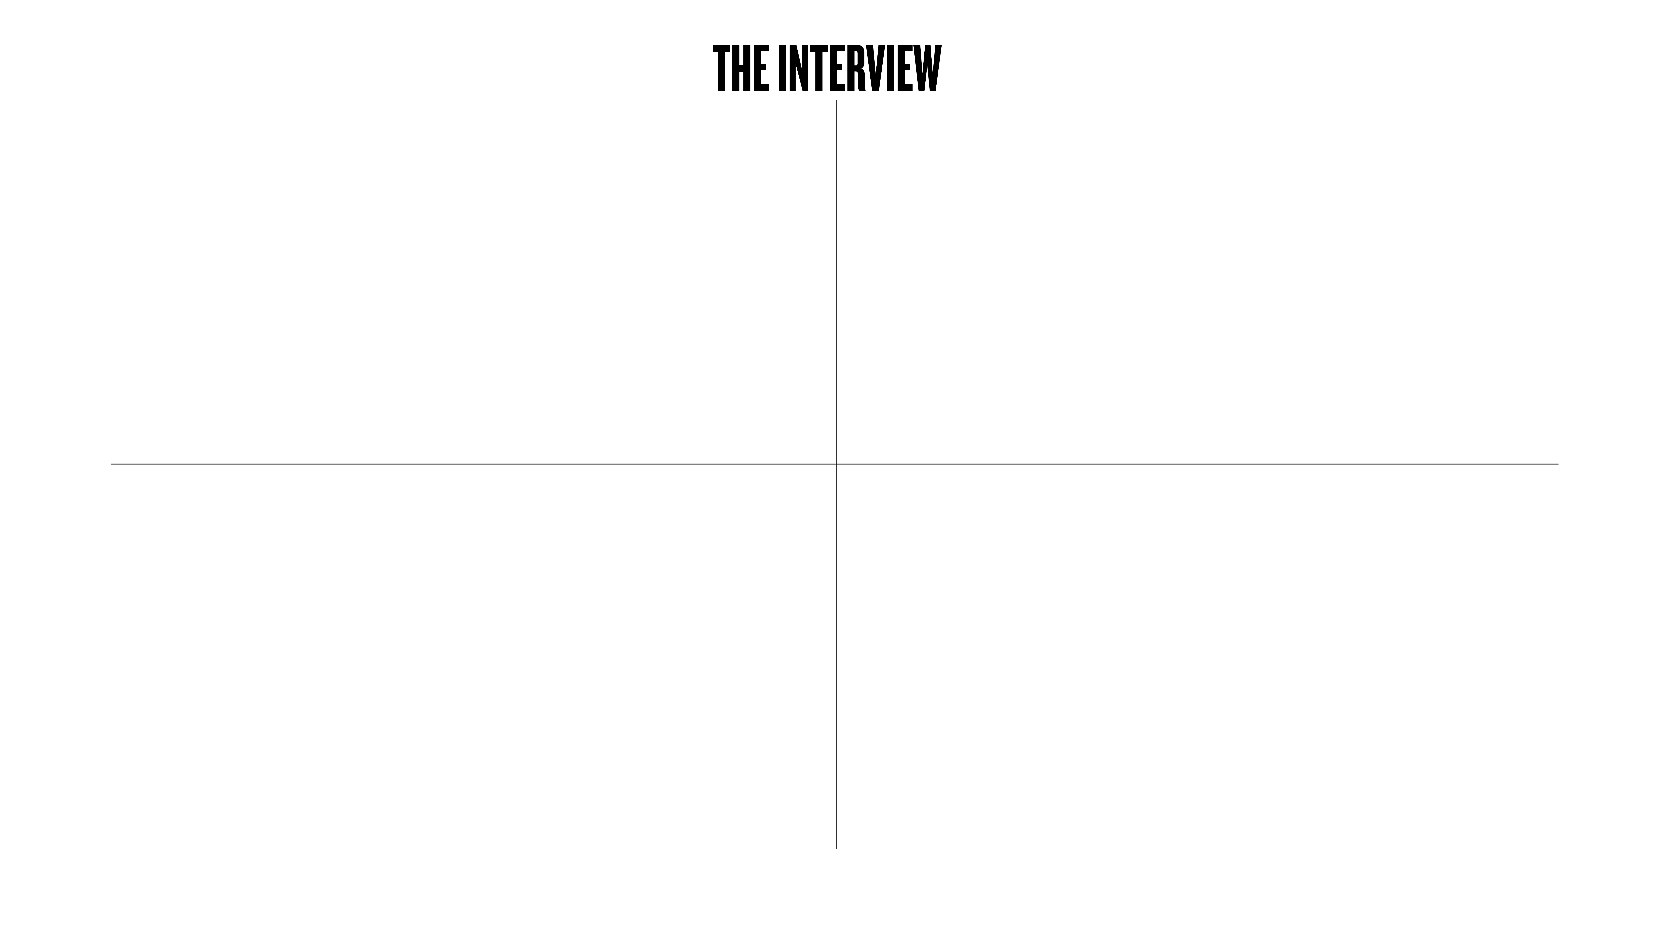




Notes:
When someone comes in to see me, I want them to not only be themselves, I want them to shine, I want them to be great, so I do whatever it takes to help make that happen.
*I hold a lot of power in how this interaction will go.
For me it’s about aiming for them to have a positive experience.

Slide 27




Notes:
You make people feel comfortable quickly if they trust you…
Doesn’t matter who you are, you are nervous coming into an interview…
I am on.
-From the moment they walk thought the door, my focus is 100% on them - not desk, home, phone.
-I genuinely care for this person, I’m on their side. There’s no-one more important to me, right now, than them.
-I think about it this way. IV with love. I’m in love with them in that moment. People can feel that.
-Being on doesn’t mean being fake. Every person deserves this.
*Easy to become blaze about people’s stories, particularly when you hear them all the time. But they don’t know that. All they know is they’re about to share something very personal. I owe it to them to be on.
Being on
Find common ground
Find a way to form a small connection. It helps break the ice and show that you both had a similar experience, and that you get each other on some small level…
Be transparent
-There are no secrets, not trying to set them up or trick them.
-People don’t want to look stupid/make mistakes
-Clear how going to work to eliminate doubts. This is where I stand, this is the cameras etc
-Also organised + prepared. (I’m not in the corner madly writing questions). They will trust the process if they feel they are in the hands of a professional.

Slide 28
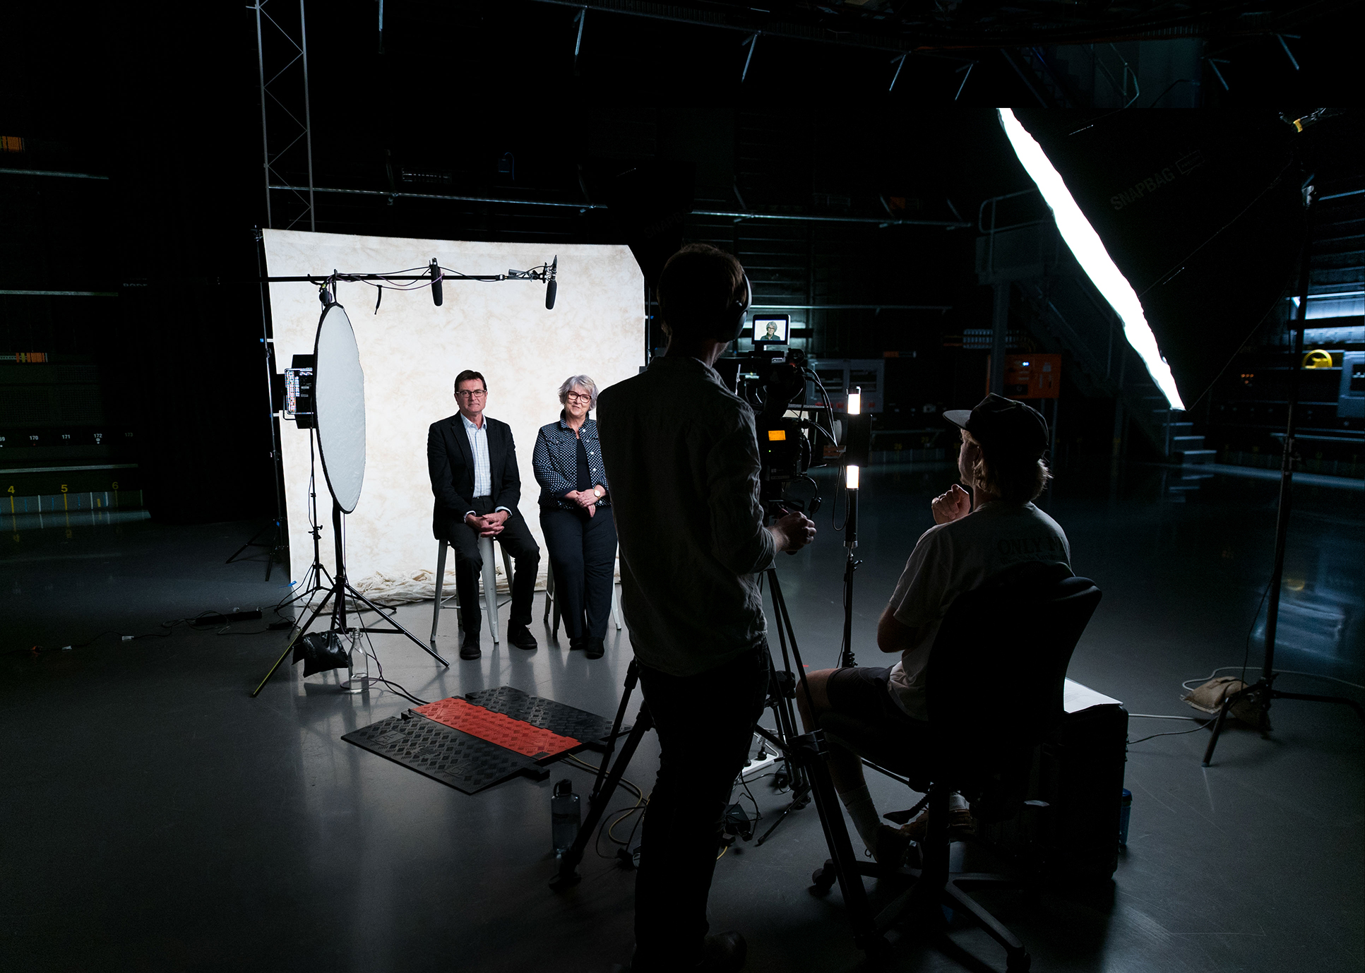
Notes:
Here’s a pic of my set. As you can see it’s a bit intimidating, especially for someone who’s never been interviewed before.
So I work really hard when that person walks through the door, to make them feel comfortable and to help alleviate anxiety.

Slide 29
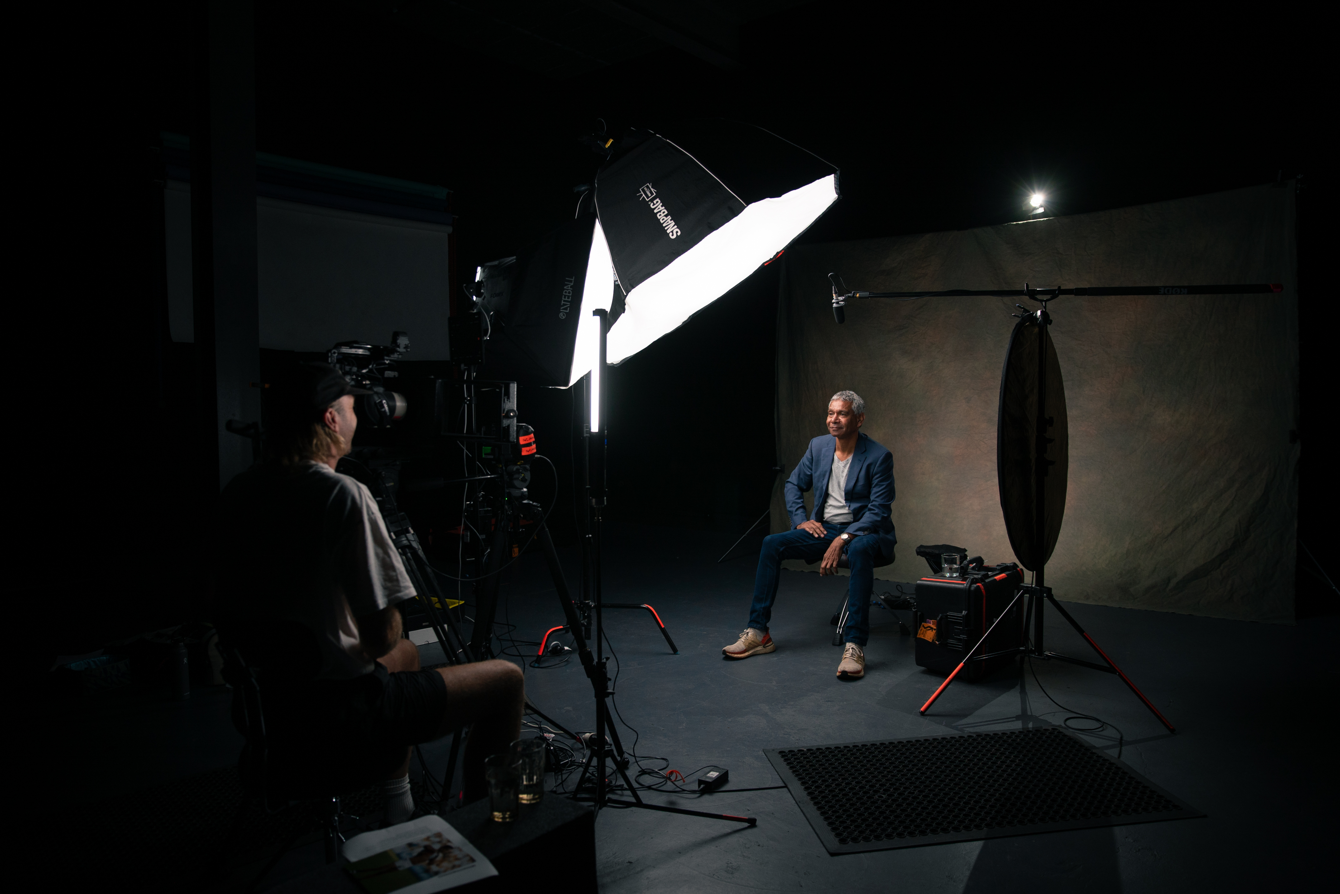

Slide 30



Notes:
One of my best skills is being able to talk to anyone. And ultimately get anyone to open up. To be able to read people in there moment, you need to get on their level. When you can get on someone’s level you can empathise with them and their experience…
When you start talking, GENUINELY LISTEN & GIVE A SHIT - this is also called “Active Listening”
Not just hearing the words, but taking in body language and emotive cues. Acknowledge what they are saying is hitting home.
USE YOUR WEALTH OF EXPERIENCE TO TRANSPORT INTO THEIR SHOES
I’m constantly trying to find ways in which I have understood, in my own life, a certain feeling they’re talking about - loneliness, being judged, fear, joy.
I may not have cheated on my partner, but find ways to identify with the feelings or experience, use in question asking.
You also need to be aware of your biases - or not bring your biases or emotions to your question asking.
This is about trying to understand someone, not be sorry, or sad, or angry for them.
So rather than, “How could you do that to someone you love?”, ask “What was it like to hurt the person you love?”

Slide 31
VIDEO 2: UNCUT VOX POP
Notes:
I’m going to send a link to an example. This is an uncut interview from Hello Stranger
-street iv, 15mins, person never met, universal questions, intro & 3rd question.
When watching this, I want you to reflect on how I show empathy, what questions I ask, and what you would ask.
She goes on to tell about stealing cars from foster parents - she was trouble it sounds like!
*How quickly you can get to something real.
But why I wanted to show you is how quickly someone I’ve just met, will get honest about their life - this was a minute or two into our interaction
She throws out lots of hooks- areas to ask about, I could have gone deep into the trauma she experienced as a child
But I only had a few mins with her on the street and her kid was clearly very present, so I was interested in how it impacted her being a mother, and we got that beautiful moment at the end there - which is important, often when we get into gritty areas that’s where people stay, but for me it’s hearing the wisdom, the wins that is just as important.

Slide 32

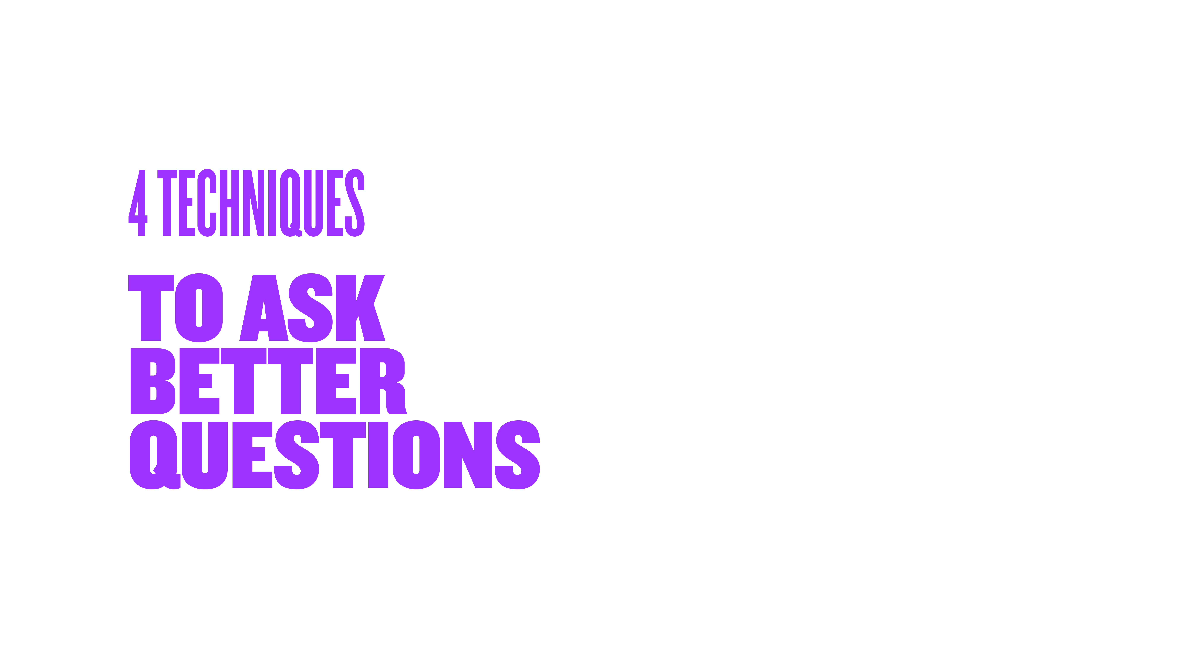



Notes:
Plan vs Moment
When I interview, i go in with a series of pre-written questions…
But most of the interview takes place “in the moment”. In follow-up questions that arise…
Curiosity vs Interrogation
Interviewing with love. I am on the side of the person I’m speaking to. Looking for ways to be positive.
Not there to interrogate or get to the bottom of something or crucify them. Hard questions from a place of care.
Be aware of the weight of the questions you're asking, and what it takes to answer them honestly.
“How are you?” can be a confronting question to answer really truthfully
Shut up & listen - our normal mode is to jump in.
-If you’re not thinking about jumping in with your story, your focus is on what’s happening in front on you.
-When you listen, you’ll start to hear what I call Hooks - little moments that hook your attention…
-if you’re silent, people will fill in the gaps, elaborate, give you more information…
Be playful - find ways to find light and shade. It doesn’t always have to be heavy or serious.
People think that if you’re having a serious dialogue there can be no humour. People deal with life with humour.
In some of my most serious topics, DV, suicide, people have dealt with their circumstances with humour.

Slide 33
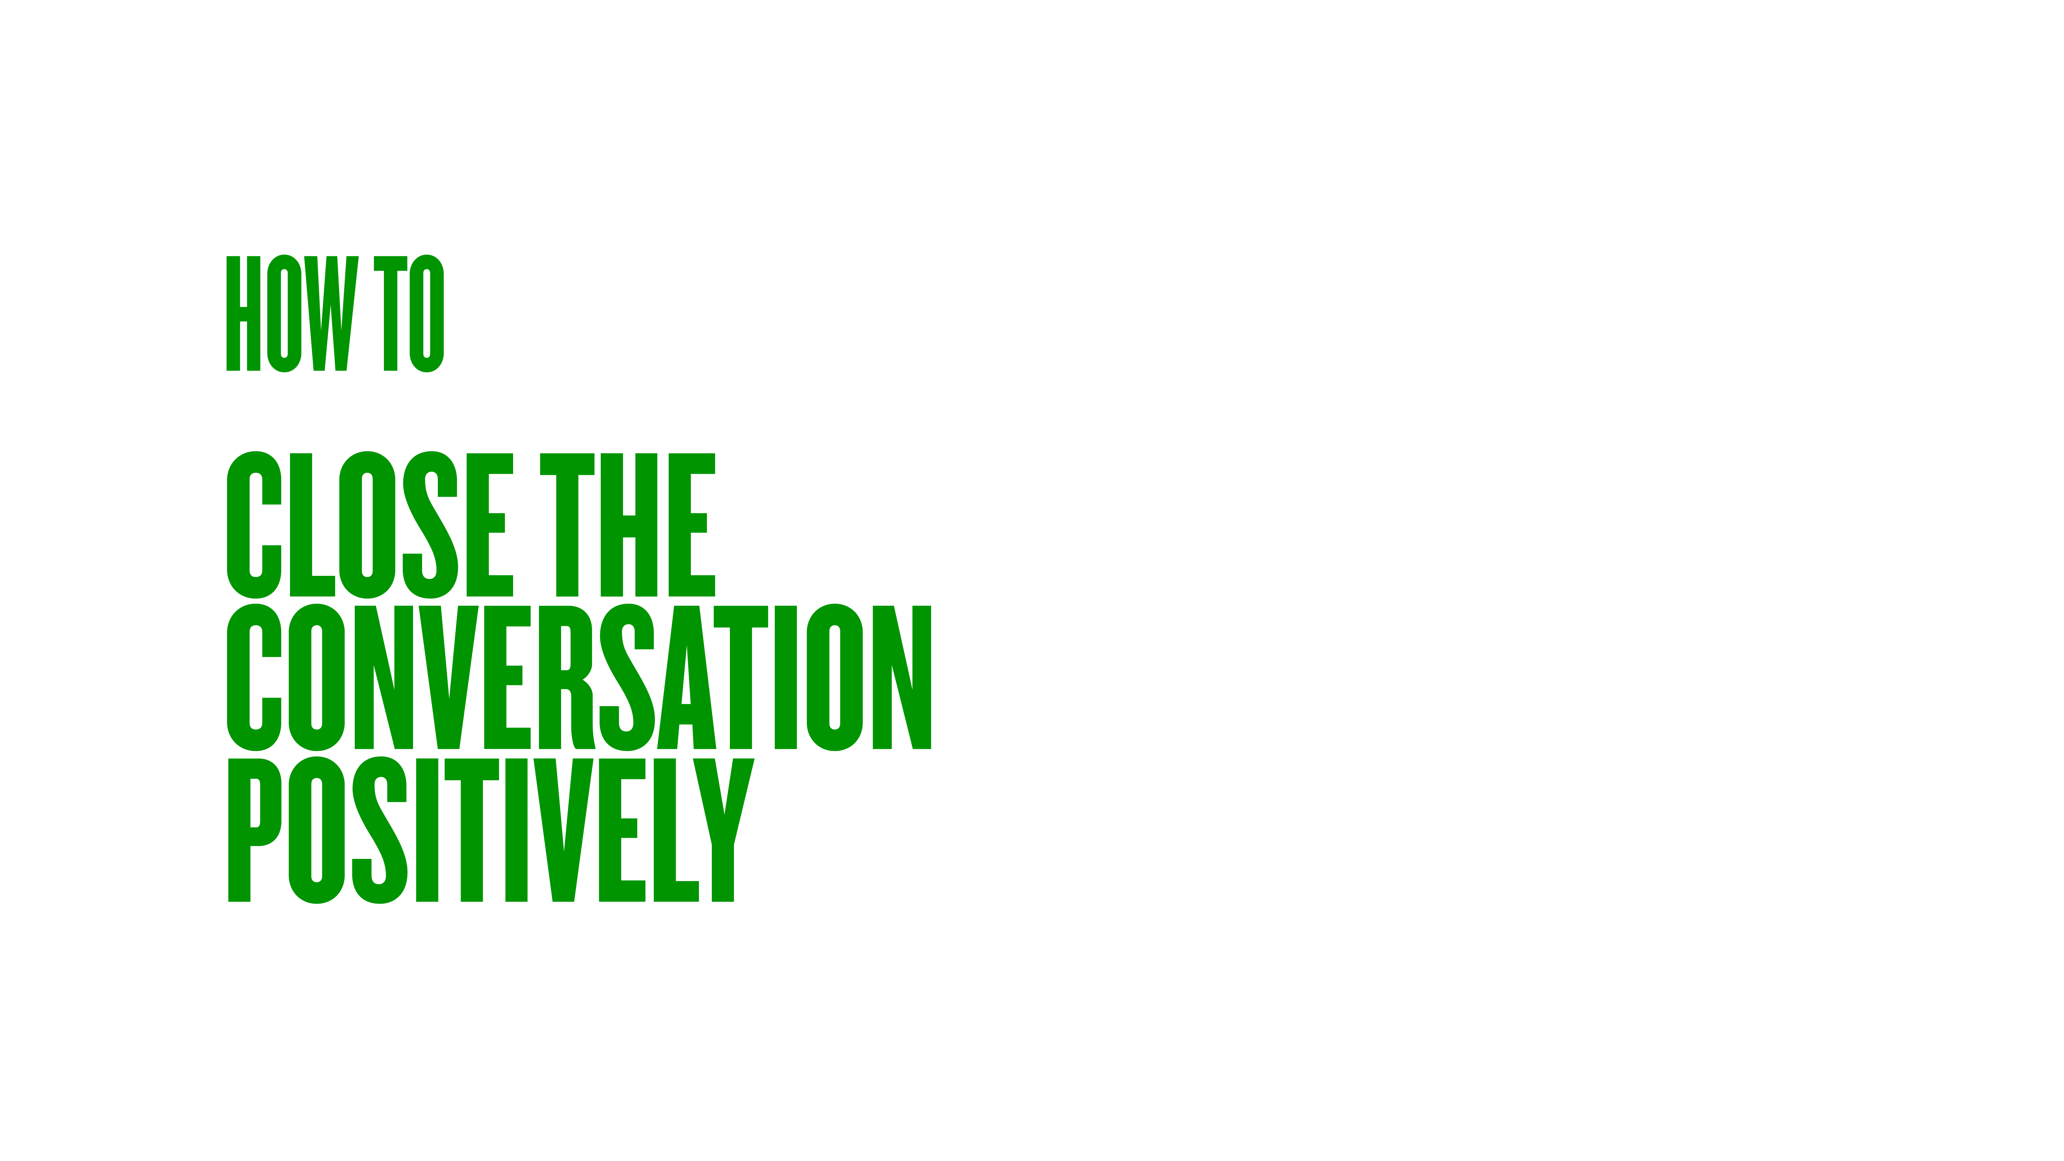

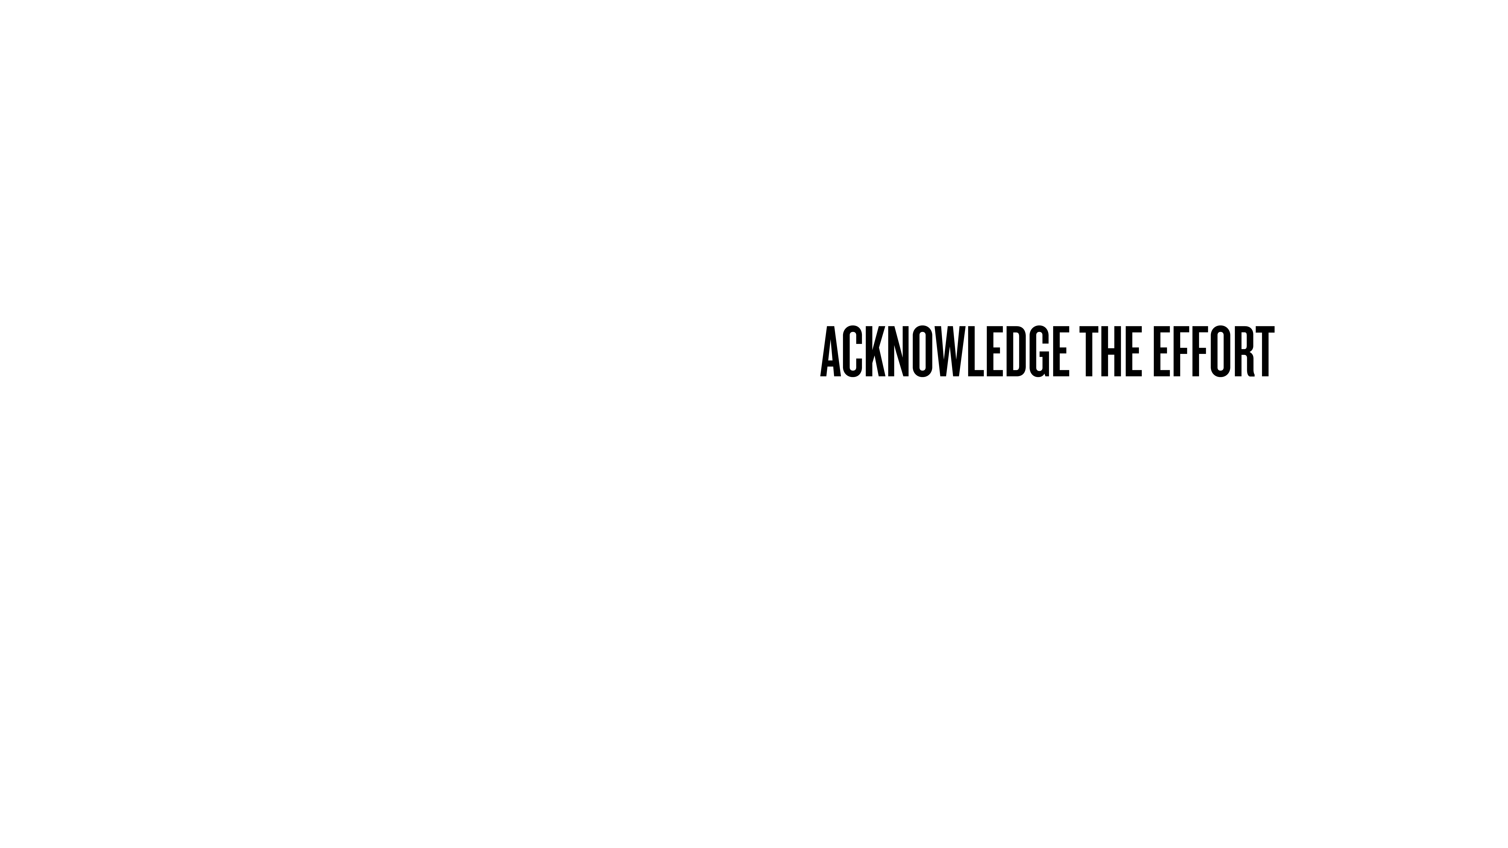

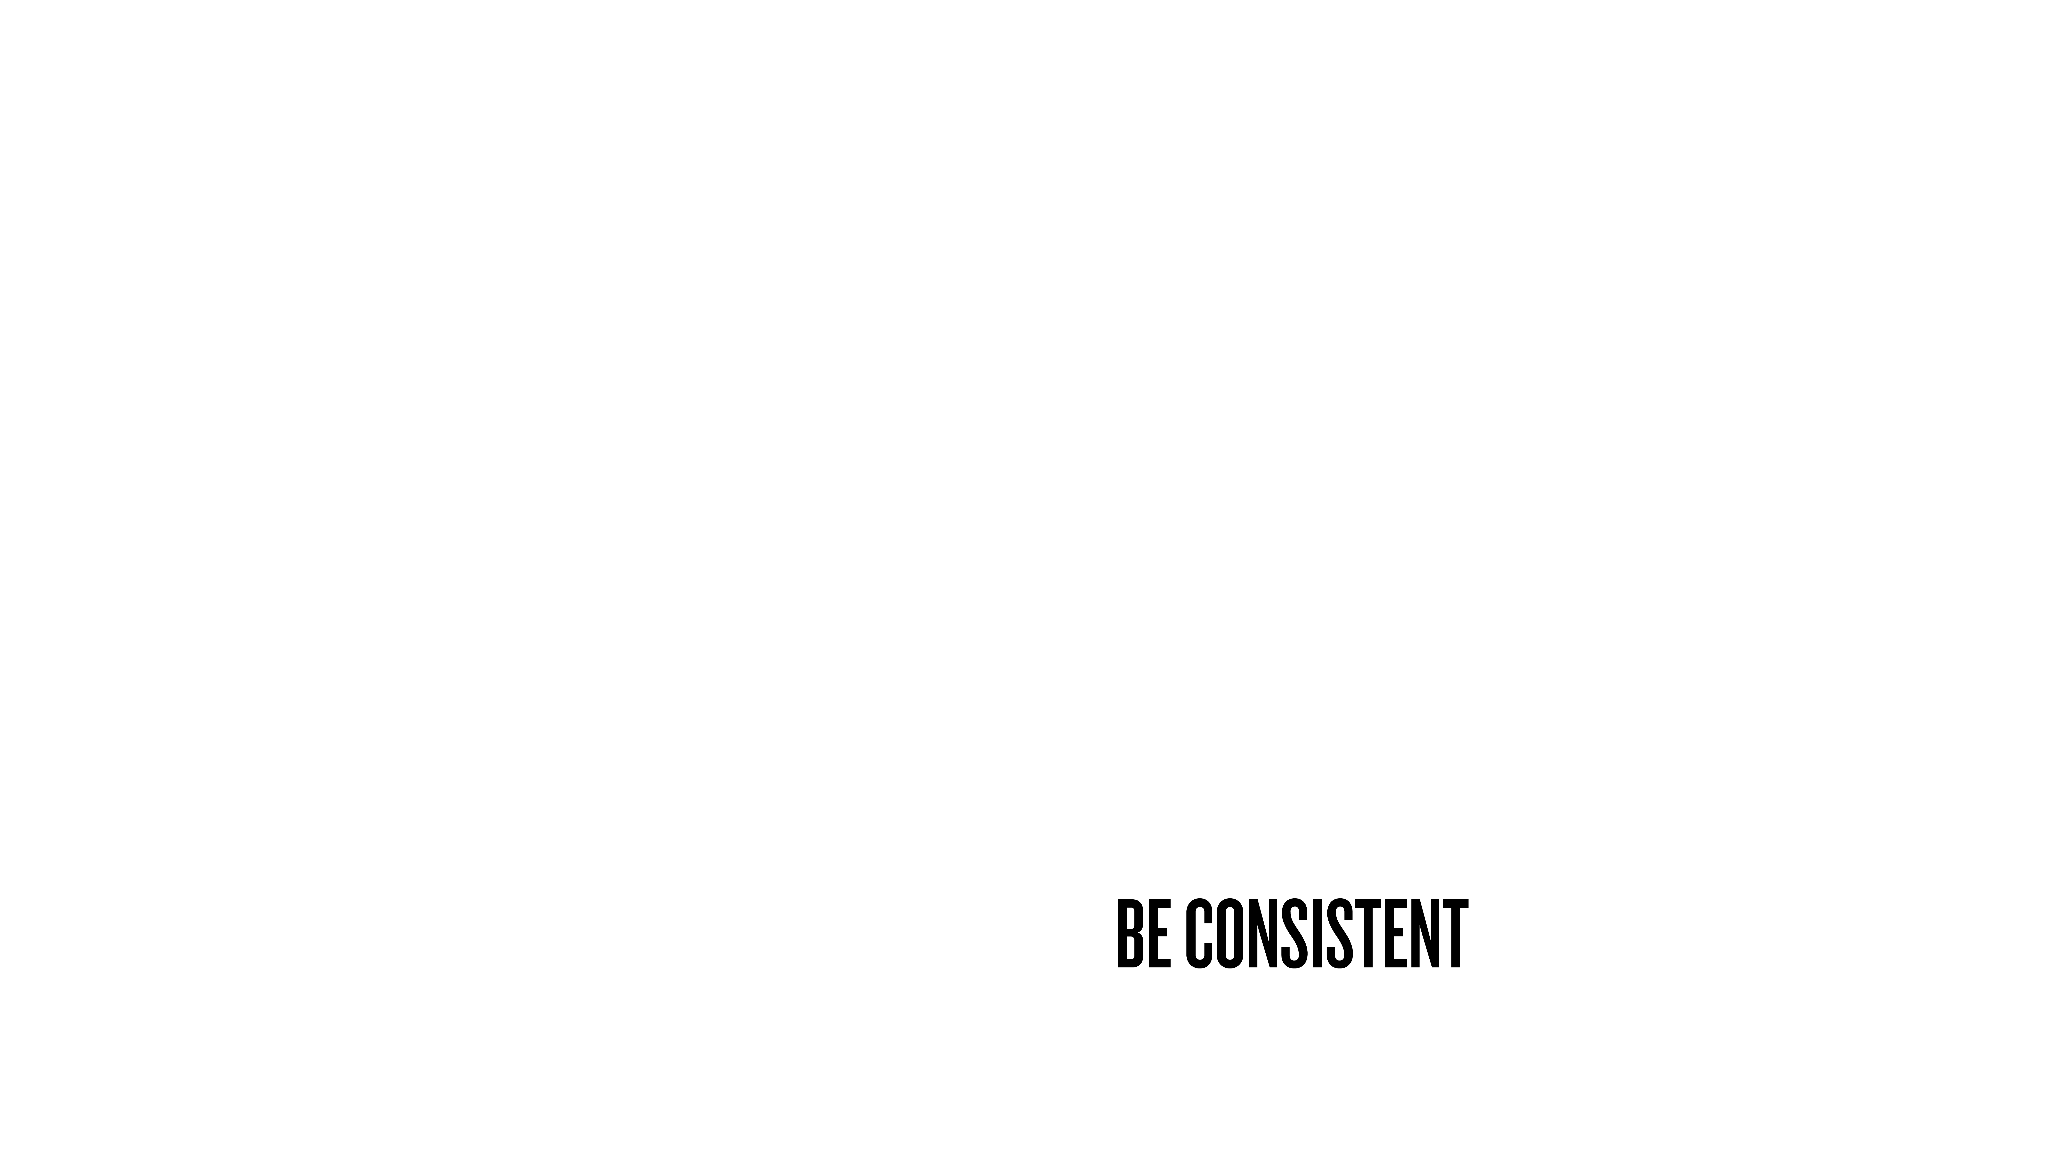
Notes:
When you get people to express authentically, you need to be aware of how you close it out.
Don’t want to ask a big question about life and suddenly the meeting’s over (dust hands)
Don’t want to leave them open and feeling vulnerable.
Final steps will help forge the relationship and build your reputation.
Plan how you finish. A good way is to have a question about learning or growth or wisdom.
“After all that, what do you think you learnt about yourself...?” “How do you think that changed you for the better...?”
This gives them a chance to reflect on what they’re just told you…
Then acknowledge the effort. Acknowledge the effort it takes to sit there and answer honestly.
Clear about next steps
They want to know what they did was not a mistake and will be looked after once they’ve left the room.
For me, it’s editing, when it’s going to air, etc.
Wrapping it all up so walk away with all questions answers and feel good. No buyers remorse
Being consistent
You never know which interaction will be your most important

Slide 34
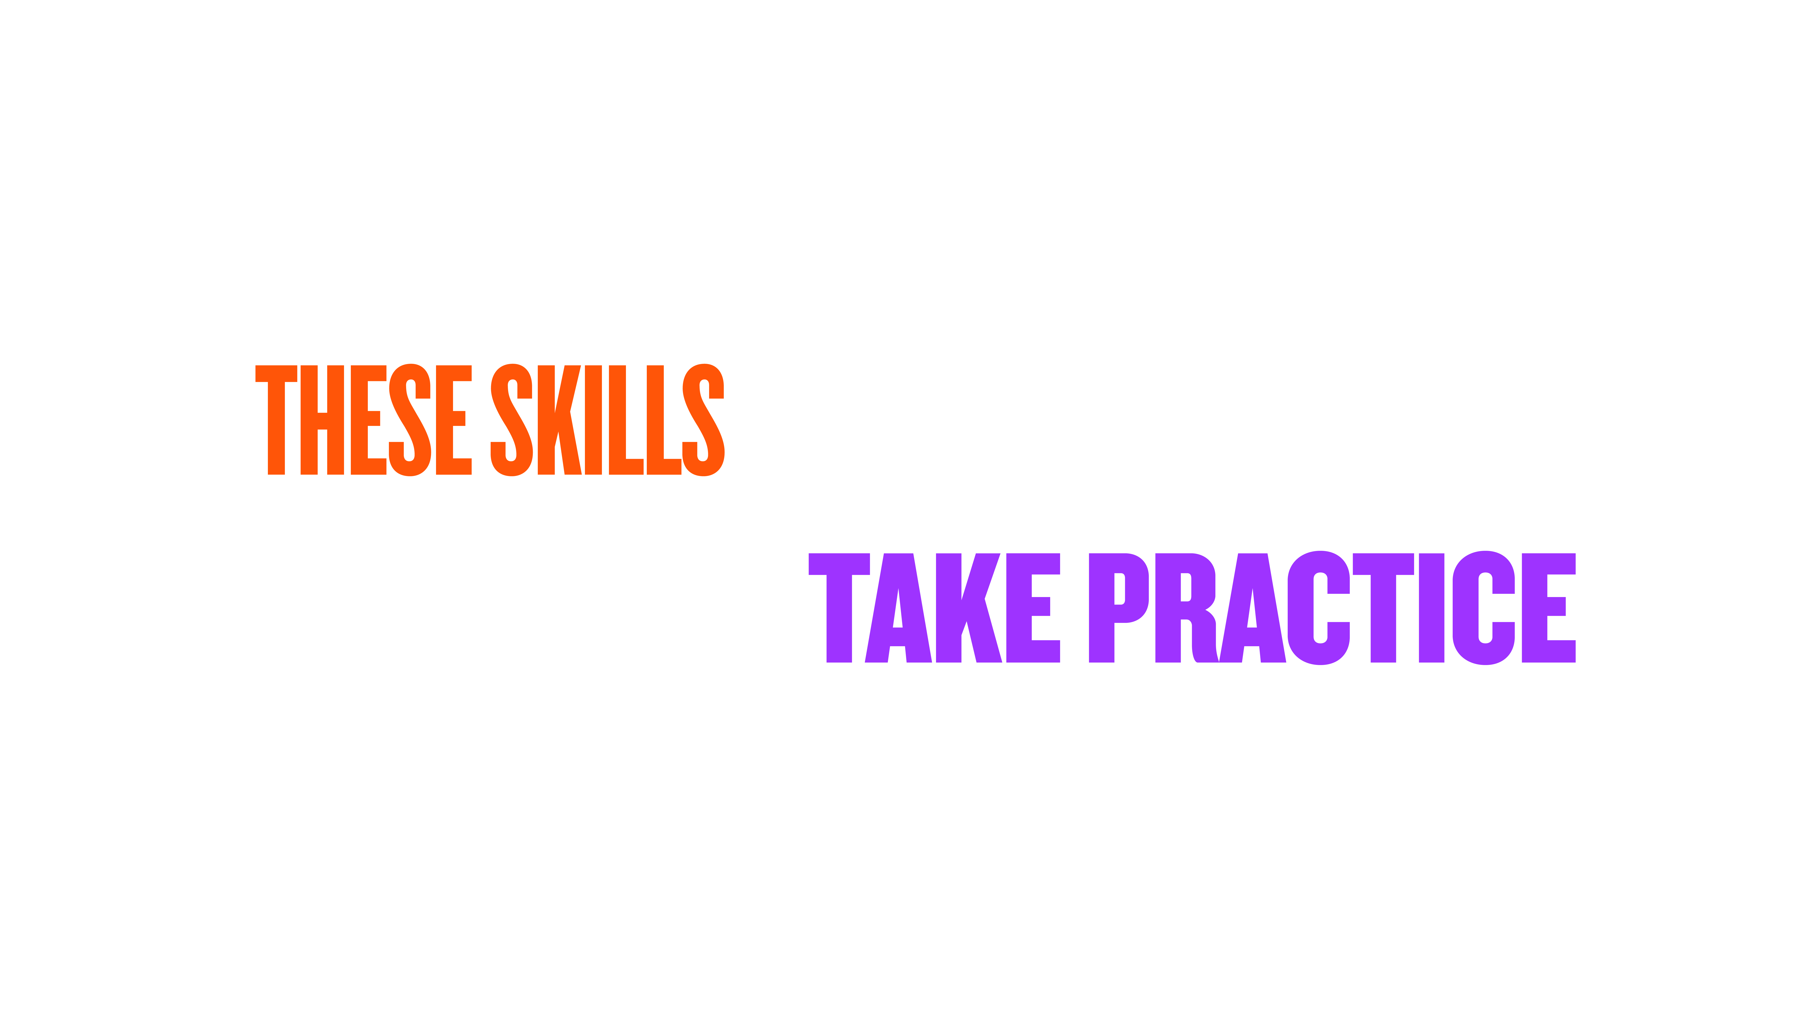
Notes:
Like any skill, these techniques take practice.
Elements can be applied multiple times a day…
When you’re in conversations with friends or colleagues, be aware of what you do…
Line up a couple of short sharp interviews…
When you practice asking the hard questions and look to understand someone, you will have deeper and more authentic communication.

Slide 35

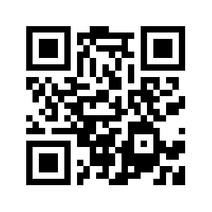
Notes:
To finish!
-If you’re into this stuff, I’ve just launched a newsletter called Questionable Advice,
-More details and other stuff in my digital swag.
-If you want to connect with me directly, LinkedIn, happy to answer questions.
-Or come to my fireside chat tonight.

