Slide 1


AI's Impact on Human Resource Management
Transforming recruitment, training, and employee engagement
PRESENTER
Scott Keane Assistant Commissioner ATO People Workplace Relations & Strategy Australian Taxation Office

Slide 2




What we’ll cover…
01
02
03
04
What is AI?
AI’s impact on HR
AI in action
Getting started

Slide 3

Artificial Intelligence
How does AI learn?
‘AI is the theory and development of computer systems able to perform tasks normally requiring human intelligence, such as visual perception, speech recognition, decision-making and translation between languages’
Learning from Data
Reinforcement Learning
Pattern Recognition
Definition from: “An introduction to artificial intelligence”, Cyber.gov.au

Slide 4
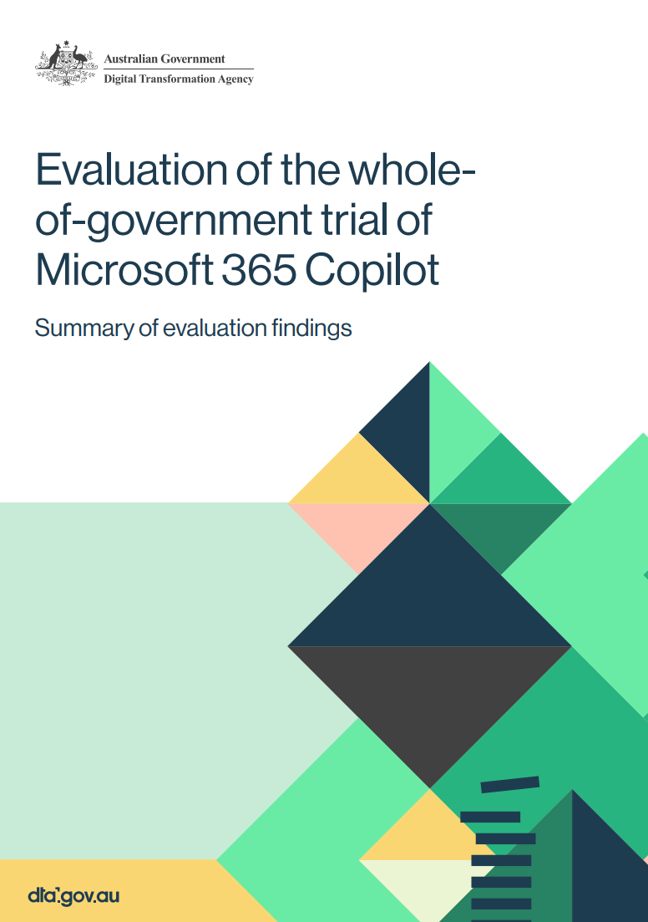


Why AI matters
Key findings from the Australian Government trial of Copilot
1 in 3 participants used Copilot daily
69% agreed it improved the speed of task completion
61% said it improved the quality of their work
40% reported they could reallocate time to higher-level strategic and staff engagement tasks
Source: “Australian Government trial of Microsoft 365 Copilot”, Digital.gov.au

Slide 5




AI’s impact on HR
Focus areas
AI Augmenting Human Roles
Uneven AI Adoption & Shadow Use
Shifting Skills Demand
Inclusive Workforce Focus

Slide 6

AI will augment more jobs than it automates
AI empowering employment | AI is viewed as a tool that empowers workers rather than replacing them, improving productivity and job quality.
Low automation risk jobs | Most jobs, about 79%*, have low risk of automation and are more likely to be augmented by AI technologies.
Focus on upskilling | HR leaders should focus on upskilling staff to integrate AI into workflows and enhance strategic decision-making.
‘Artificial Intelligence is a tool, not a threat’
Rodney Brooks
Australian Roboticist
*Source: Jobs and Skills Australia, “Our Gen AI Transition”, jobsandskills.gov.au
Quote from: “Artificial intelligence is a tool, not a threat”, Robohub

Slide 7

Adoption is accelerating, but uneven: ‘Shadow Use’ is common
‘AI’s success in government hinges on robust governance, transparency, and ethical considerations.’
Rapid but uneven AI adoption | AI adoption grows quickly in tech and finance but varies widely across other sectors.
Shadow AI use | Employees independently use AI tools without formal approval, increasing efficiency and risks.
Governance and training | Develop guidelines and training to manage AI use and address security concerns.
HR role in AI adoption | HR must implement governance frameworks to balance innovation with safe, consistent AI use.
Christina Montgomery
VP & Chief Privacy Officer at IBM
Quote from: “Risks and Rewards of AI in the Public Sector”, apolitical

Slide 8

Skills demand is shifting: Digital and human-centric capabilities
Rising demand for digital literacy | AI integration increases need for digital skills alongside traditional knowledge across industries.
Importance of human-centric skills | Ethical decision-making, communication, and adaptability are critical alongside technical skills.
Continuous upskilling and reskilling | HR must ensure equitable access to training to maintain employability in AI-driven markets.
HR skills as strategic differentiators | Traditional HR capabilities should be enhanced to guide workforce transformation in AI era.
‘AI is not going to take your job, but somebody who’s willing to use AI is.’
Kristen Howe
VP of SHRM Business Products
Quote from: “Disruption as Opportunity: 10 Key Quotes from HR Visionaries”, SHRM

Slide 9

Entry-level roles and vulnerable cohorts need special attention
AI impact on entry-level jobs | AI automates administrative tasks, shifting entry-level roles towards oversight and human-centered responsibilities.
Importance of entry-level jobs | Entry-level positions remain vital for workforce renewal and promoting social inclusion despite technological changes.
Vulnerable cohorts risks | Older workers, First Nations Australians, and people with disabilities face digital access and occupational risks.
Need for targeted upskilling | Upskilling programs and inclusive HR policies are essential to support vulnerable cohorts and ensure equitable workforce participation.
‘AI is a tool, and its values are human values.’
Fei-Fei Li
Co-Director of Stanford’s Institute for Human-Centered AI
Quote from: “Interview with Fei-Fei Li”, 26-29-Interview-Spring-2024.pdf

Slide 10



AI in Action
Examples
Digital HR Assistants and Chatbots
Employee Engagement & Wellbeing
Workforce Planning & Analytics

Slide 11
Practical Implementation
Focus on use cases Begin AI adoption by identifying inefficiencies and repetitive tasks in HR that AI can address effectively.
Build AI awareness and literacy Increase HR staff understanding through courses and webinars to foster AI literacy and acceptance.
Start small Use simple AI tools like Copilot to demonstrate immediate value in tasks.
Define ethics and governance Establish AI governance frameworks to promote ethical use, transparency, and accountability.
Pilot and Collaborate Collaborate to pilot AI tools, measure outcomes, and iteratively improve HR processes.

Slide 12

Checklist How to start with AI in HR
Audit HR processes for inefficiencies
Identify high-impact use cases
Engage staff in AI discussions
Start with free or low-cost AI tools
Invest in basic AI literacy training
Define ethical guidelines and governance
Ensure human oversight in decisions
Monitor for bias and fairness
Collaborate across departments
Pilot, measure, and iterate

Slide 13
Final thoughts
AI is not a universal fix but can enhance impact, fairness, and agility.
Understanding risks and opportunities enables HR leaders to integrate AI responsibly.
Use cases and checklists can guide agencies in their AI journey.

Slide 14

Questions

