Slide 1
Uplift of Integrity at NEMA
Vidoshi Jana
Chief Operating Officer (COO)

Slide 2
Integrity uplift is a strategic priority for NEMA
Committed and focused on strengthening governance and ethical capability
Enhancing systems, processes, and visibility of key integrity data
Continuing to support informed decision-making and agency accountability
Embedding integrity as a core element of NEMA’s culture
Introduction
Integrity at NEMA
Notes:
When we talk about integrity at NEMA, it’s not about just a compliance exercise. It’s about creating an environment where decisions are made transparently, where data and systems support accountability, and where integrity is truly part of our everyday culture. This is what sets the tone for how we deliver outcomes to the community.

Slide 3
NEMA Integrity Framework Structure
NEMA has an Integrity Framework that outlines the Agency’s approach to foster a strong integrity culture and is based on the Commonwealth Integrity Maturity Framework which is a set of Integrity Principles that are derived from the key Commonwealth integrity laws, policies and procedures.
Integrity Framework
Fraud
Corruption
Declarations
Physical and Information Security
Human Resources
Culture
Fraud detection and assessment
Investigations
AFP Liaison and assessments
Public Interest Disclosures
Risk Management
Corruption detection and assessments
Investigations
NACC Liaison and assessments
Public Interest Disclosure
Risk Management
Conflict of Interest
Outside Employment and Volunteering
**Gifts and Benefits
Pre-employment Suitability Screening
Security Clearances
Personal, physical ICT breaches
Access controls
Protective Security
Privacy Breaches
Code of Conduct Investigations
Performance Management
Unscheduled absence
Overtime and leave balances
WHS
Training Completion
NEMA’s Charter of behaviours
NEMA’s values
NEMA Employee Engagement & Culture: Action Plan
Responsible
Branch/Team
People, Governance and Integrity Branch (Governance and Coordination Team)
*Financial Management & Claims Assurance Branch (Finance Team) for G&B
Business Operations, Security and Technology Branch (Security Team)
People, Governance and Integrity Branch (Conditions & Wellbeing team, and Engagement, Strategy and Performance team)
Notes:
Building a positive integrity culture is a whole of agency effort.
NEMA has in place an Integrity Framework, which is made up of a number of elements across the key domains of:
Fraud and Corruption
Declarations
Physical and Information Security
Human Resources, and
Culture
The responsibility of these elements spans across fraud and integrity, finance, Human Resources and Security teams.
Within our Risk Management Framework we have also defined our risk tolerance as LOW for Integrity related risks.
This demonstrates NEMA is committed to maintaining high standards of integrity, good governance and ethics.

Slide 4
Integrity Leadership Roles
Coordinator-General and the Senior Leadership Team set the tone for NEMA’s workplace culture and expectations.
SES Cohort role-model good practice and behaviour—including ethical decision making and addressing difficult issues with sensitivity and courage.
Chief Operating Officer oversights key integrity functions and is a role-model for good practice and behaviour.
Chief People Officer (SESB1) ensures our workforce is supported and that fairness and respect are embedded into how we manage people and culture.
Chief Risk Officer (SESB1) responsible for the Enterprise Risk Management Framework, ensuring all risks are identified and managed in a way that strengthens accountability.
Chief Information Officer (SESB1) upholds integrity in technology, security, and business operations by ensuring systems are reliable secure, and transparent.
Chief Finance Officer (SESB1) drives ethical stewardship of public resources, ensuring we’re financially responsible and transparent in how we manage budgets.
Chief Data Officer (SESB1) embeds integrity into how data is governed, analysed, and used to inform decision-making across the agency.
Notes:
Our integrity culture is led by our Coordinator-General and the Senior Leadership Team who set the tone for NEMA’s workplace culture and expectations. They demonstrate high standards of personal behaviour, are viewed as role models of integrity and professionalism, and foster a culture that makes it safe and straightforward for employees to do the right thing.
As COO, I lead the corporate and enabling functions that underpin how the agency operates every day. Together, these areas form the backbone of NEMA’s operational integrity systems and frameworks to ensure an integrity culture and that NEMA adheres to the key Commonwealth integrity laws, policies and procedures.
I am supported by:
The CPO who ensures our workforce is supported and that fairness and respect are embedded into how we manage people and culture.
The CRO takes that further by overseeing the Enterprise Risk Framework, make sure all risks are identified and managed in a way that strengthens accountability.
The CIO, on the systems side, safeguards the technology and security environment so our business remains secure, reliable, and resilient.
The CFO drives ethical stewardship of public resources, ensuring we’re financially responsible and transparent in how we manage budgets.
Finally, The CDO embeds integrity into how data is governed, analysed, and used to inform decision-making across the agency.
What links all these roles is not just their functional expertise, but their responsibility to weave integrity into the foundations of NEMA. Whether that’s through people, systems, finances, or data. Together, these positions create the conditions where integrity is not a standalone function, but an expectation built into every part of the organisation.

Slide 5
NEMA’s Integrity Team
Our Integrity Team at NEMA has built its capabilities since NEMA was created in September 2022.
The team consists of an EL1 and three APS6 staff who handle all policy, guideline and framework requirements, awareness and engagement activities, allegations, assessments and investigations of fraud and corruption both internally and externally including against NEMA administered programs, the agency’s fraud and corruption risk assessment, integrity assurance plan and the agency’s conflict of interest declaration process.
Typically, in larger departments, these functions are split amongst multiple teams.
Being in a smaller agency generally offers a more diverse opportunity for work, responsibility and skills development then larger departments.
Notes:
Our Integrity Team has come a long way since NEMA was established. We’ve built strong foundations – policy frameworks, assurance processes, and guidance that didn’t exist two years ago. And, there’s still more to do! As we continue to mature, the team will play a critical role in supporting the uplift of integrity across the agency and embedding it as a part of how we work.

Slide 6
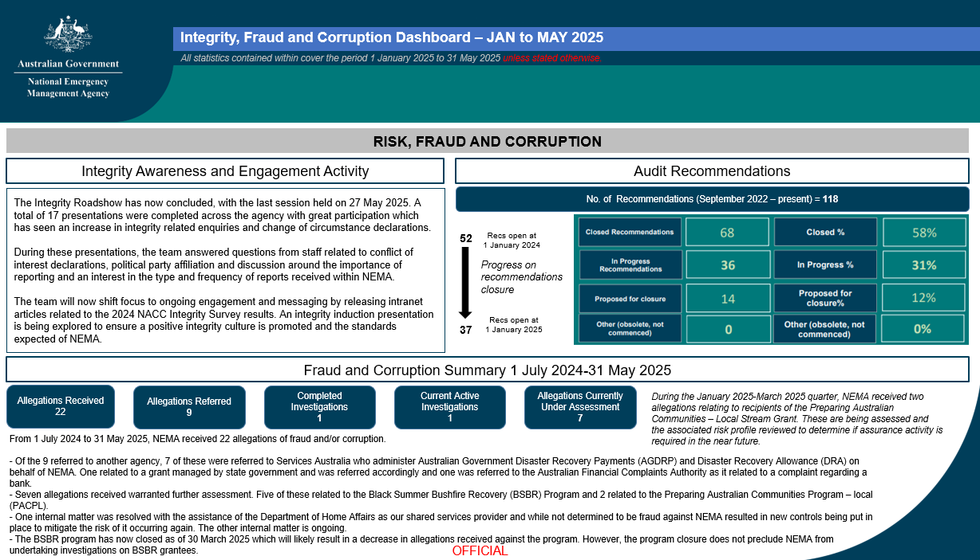
Integrity Reporting
Integrity Dashboard
The Integrity Dashboard plays a critical role in supporting a strong integrity culture within the agency. By consolidating key data across human resources, risk, fraud and corruption, security, and declarations and disclosures, it provides high-level visibility, promotes transparency, and enables proactive oversight. It delivers timely insights to inform ethical decision-making, strengthen accountability and identify emerging risks.
Notes:
This dashboard is presented at NEMA’s Audit and Risk Committee and Executive Group meetings to provide an understanding of NEMA’s integrity landscape and what messaging they can give their work areas.
The Integrity Dashboard is a way of turning a lot of moving parts into one clear picture. It gives executives visibility of risks and emerging issues, and ensures we’re making decisions backed by evidence rather than anecdotes. It’s also about transparency – being open about where the risks are and how we’re addressing them.
As we continue to mature this dashboard, we will look to start to report on themes and trends overtime.

Slide 7
Current Key Initiatives to build our Integrity Culture
Implementation of NEMA’s Integrity Framework and Fraud and Corruption Control Framework.
Making integrity and ethical behavior a focus of ongoing culture work underway across NEMA.
Continuous review of our Fraud and Corruption Risk Assessments and implementing a scheme of control testing through NEMA’s Integrity Assurance Plan and Strategic Internal Audit Plan.
Undertaking a NEMA-wide integrity roadshow as part of our Integrity Engagement Strategy:
  Build greater staff awareness of integrity obligations.
  Raise the profile of the Fraud and Integrity team as a resource for case-by-case advice and an avenue for reporting fraud and corruption.
Integrity Maturity Assessment undertaken by Internal Audit and implementation of recommendations.
Updating and uplifting our Conflict of Interest policies and procedures, with an increased focus at an activity level (procurement, recruitment, grants management).
Maintaining a register of advice provided on Conflict of Interest matters to ensure consistency.
Notes:
Right now, our focus has been on putting the building blocks in place. We’ve refreshed key frameworks, strengthened fraud and corruption controls, and rolled out engagement activities to raise awareness. These steps are about establishing a solid baseline – making sure staff have clear guidance and confidence to act, while we continue embedding integrity into daily practice.

Slide 8
Future Key Initiatives to build our Integrity Culture
Implementation of an induction presentation on Integrity expectations at NEMA.
Implementation of a Decision Making guide within NEMA’s Integrity Framework as part of the Louder Than Words: APS Integrity Action Plan report.
Development of an active fraud detection capability using existing data and capabilities of our Data & Analytics Branch.
Consideration around current integrity reporting options and how this could be improved to encourage reporting.
Continuing to support the APS wide ‘speak up culture’
  The speak up culture guidance is designed to help all APS employees, managers and senior leaders understand the importance of speak up culture and how it supports integrity and performance. It includes practical actions built around the 4C practices – listen with compassion, show curiosity, act with courage and speak with candour.
Notes:
Looking ahead, the focus shifts from building the baseline to deepening maturity. That means moving beyond awareness into capability – providing tools like ethical decision-making guides, expanding our reporting and data insights, and contributing to whole-of-APS reforms. These initiatives are about ensuring integrity isn’t just understood, but consistency applied across all levels of the agency.
Background information only.
Continuing to support the APS wide ‘speak up culture’
Background: Capability and Workforce Committee released new guidance to support ‘speak up culture’ in the APS.
This work delivers on Secretaries Board’s commitment in response to the Louder than Words report, to bolster APS capability to lead with integrity, with a focus on ethical decision making and fostering psychological safety (recommendation 4).
The speak up culture guidance is designed to help all APS employees, managers and senior leaders understand the importance of speak up culture and how it supports integrity and performance. It includes practical actions built around the 4C practices – listen with compassion, show curiosity, act with courage and speak with candour.

Slide 9
Integrity Health Check Initiatives
Executive Group and the broader SES cohort consideration of the NACC Commonwealth Integrity Survey results and APS Census Results.
Analysis and comparison of data from the most recent NACC Commonwealth Integrity Survey and APS Census to determine the direction of integrity awareness and engagement activities including addressing barriers to reporting matters.
Review allegations received against existing fraud and corruption risks to determine if controls are adequate and working as intended.
Review reports and findings from NACC investigations and ANAO reports to compare against existing NEMA procedures, risks and controls as a proactive uplift measure.
Notes:
These health check initiatives give us a way of looking under the hood of our integrity systems. It’s not just about compliance – it’s about testing whether our controls are practical, whether staff feel barriers to reporting are being addressed, and whether lessons from investigations and audits are being absorbed.
By systematically reviewing allegations, risks, and recommendations, we're able to take a proactive approach rather than waiting for issues to escalate. It’s essentially our early warning system, ensuring that integrity safeguards are not only in place but working as intended.

Slide 10
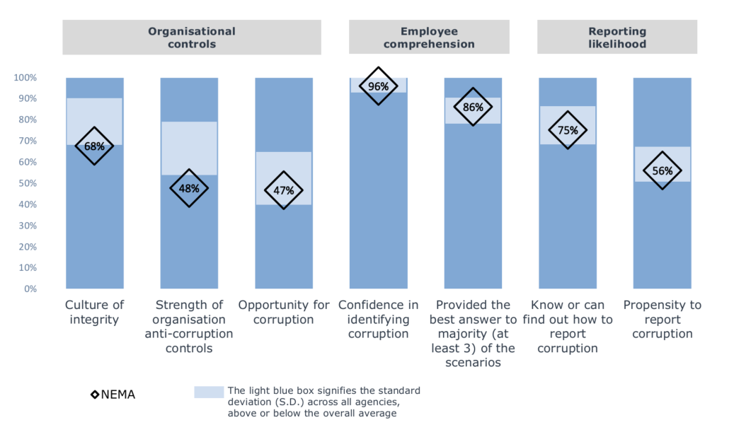
2024 NACC Commonwealth Integrity Survey
The 2024 National Anti-Corruption Commission (NACC) Commonwealth Integrity Survey conducted between 19 August and 20 September 2024, assessed corruption risks and perceptions of integrity in the APS. At NEMA, 37% of NEMA invitees (173 out of 471) responded, a strong result compared to the broader APS response rate of 21%.
Findings have been grouped into three main areas: organisational control, employee comprehension, and likelihood of reporting. These results provide a valuable baseline for NEMA – highlighting areas where staff are already strong, particularly recognising and understanding corruption risks, and identifying where further uplift is needed, such as strengthening organisational controls and encouraging reporting.
The chart (right) illustrates NEMA’s results against APS averages, giving us clear insights into where we can build on our culture of integrity and strengthen systems to support staff confidence in reporting and preventing corruption.
Notes:
The survey provides us with an external benchmark to measure our progress against the broader APS.
What stands out is that NEMA is performing strongly in areas like recognising risks and understanding corruption scenarios, which shows our awareness initiatives are making a difference.
At the same time, the results highlight areas where we can do more – particularly in removing barriers to reporting and reinforcing organisational controls. That balance of strengths and gaps is important; it tells us we’re on the right path, but it also keeps us focused on where uplift is most needed.
Ultimately, the survey results confirm that integrity is being noticed, felt, and acted on across NEMA. And that external validation is critical in strengthening both staff confidence and public trust.
We had good discussions on these results both with our Executive Group and the broader SES cohort.

Slide 11
Conflicts of Interest (COI) at NEMA
Establishing the Fraud and Integrity Team has strengthened NEMA’s culture of accountability by providing employees and mangers with direct access to specialist advice, fostering openness, building confidence, and contributing to a positive uplift in integrity through an increased and improved disclosures and management of these disclosures.
Staff are required to declare COIs at commencement, annually, and when circumstances change.
Clear COI Guideline provides definitions, examples and steps for declaring and managing COIs
The Guideline reassures staff that having a COI is not inherently wrong – there is a focus on transparency, trust, and appropriate management.
Self-assessment checklist helps staff make informed decisions.
Flow chart supports staff with clear, consistent processes for identifying, assessing, and reporting COIs.
Notes:
We’ve normalised conflict of interests as a part of professional life. It’s not about catching people out, it’s about encouraging openness and transparency. The increase in disclosures it actually a positive sign – it shows staff are becoming more comfortable declaring and managing conflicts rather than hiding them.
To support this, the COI guideline provides clear, practical steps for staff and managers, including a self-assessment checklist and a simple disclosure flow chart. This clarity helps staff navigate COIs confidently and ensures the agency can manage risks consistently.
Ultimately, it reinforces that integrity is safeguarded through transparency and accountability.

Slide 12
Measuring Success of Integrity Uplift
We do value the data that comes from the NACC Commonwealth Integrity Survey or comparing APS Census Results against previous years to measure the success of our awareness and engagement activities and staff knowledge on integrity.
However, measuring the success of our Integrity Uplift is measured by more than just statistics.
We can see if our actions are working based on the level of engagement with our Integrity Team including:
Requests for input into operational documents to ensure fraud and corruption considerations are included.
Advice being sought by staff and managers on conflict of interest reporting requirements and appropriate mitigation strategies.
Positive feedback from staff on engagements with the Integrity Team.
An increase in proactive conflict of interest disclosures and declarations.
Greater participation in integrity-related workshops, training, and events.
Evidence of integrity conversations being embedded into team meetings and decision-making processes.
Uptake of new tools such as the conflict of interest checklist and disclosure flowchart.
Collaborative engagement across business areas to address integrity challenges.
The success of integrity uplift is not measured by statistics alone, but by a cultural shift where staff actively consider integrity in daily decisions, seek advice with confidence, and embrace transparency in reporting. By embedding integrity into our practices, we are building an organisation defined by trust, accountability, and strong governance – ensuring integrity remains central to how we operate, now and into the future.
Notes:
Numbers tell part of the story, but real success is seen in the shifts we can feel across the agency. Staff are asking for advice before problems arise. Leaders are building integrity into decisions at the table. Conversations about risk and accountability are becoming routine, not exceptional.
The measure of success is not just stronger controls – it’s confidence, trust, and consistency in how we operate. Integrity is no longer an initiative; it’s becoming part of NEMA’s identity. And that is what will sustain us into the future.

Slide 13
Conclusion & Questions

