Slide 1
CSC Super – Here to support you
Small Agency Forum
14 May 2025

Slide 2



It’s important to know
Any financial product advice in this presentation is general advice only and has been prepared without taking account of your personal objectives, financial situation or needs. Before acting on any such general advice, you should consider the appropriateness of the advice, having regard to your own objectives, financial situation and needs. You may wish to consult a licensed financial advisor. You should obtain a copy of the relevant Product Disclosure Statement from csc.gov.au and consider its contents before making any decision regarding your super.
We want to let you know that a Target Market Determination has been made for ADF Super, PSSap and CSCri which is available at csc.gov.au/tmd. A Target Market Determination (TMD) describes the class of customers a financial product is appropriate for based on their likely needs, objectives and financial situation (target market), and establishes the distribution conditions and restrictions in relation to how the product can be distributed to customers. It also describes the reporting requirements and events or circumstances where we may need to review the TMD for a financial product. The TMD is made to ensure that CSC is keeping customers at the center of our approach to the design and distribution of our products.
The information in these slides is designed for eligible public sector employers and is current as at July 2024. Information covered in these slides may change in the future. Examples of member salaries used in this presentation are hypothetical only and relate to fictional members. This presentation remains the property of the Commonwealth Superannuation Corporation (CSC) and should not be distributed or incorporated into any training without our express consent.
This document provides general guidance only. It includes the steps you may need to take to help you meet your responsibilities as an employer. If you are unsure of your obligations we recommend you obtain independent legal advice.
*This is not an exhaustive list of all your obligations as an employer.
Commonwealth Super Corporation
ABN: 48 882 817 243
AFSL 238069
RSE Licence No L0001397
As Trustee for
CSS ABN: 19 415 776 361 RSE R1004649
PSS ABN: 74 172 177 893 RSE R1004595
ADF Super ABN: 90 302 247 344 RSE R1077063
PSSap ABN: 65 127 917 725 RSE R1004601

Slide 3
Agenda
Who is CSC
What we will cover today
Scheme Eligibility
Contributing to CSC
Unexpected life events
Budget update
Our services

Slide 4
Who is CSC?
1922
The '1922 Scheme' was set up to serve federal public servants. Fastrack to 2011 after several restructures & name changes - CSC - Commonwealth Superannuation Corporation began.
Today
Meeting the needs of eligible current & former Australian Government employees & members of the Australian Defence Force. We positively contribute to the community.
Beyond
Building retirement outcomes. We focus on fairness, collaboration & a commitment to both member outcomes & the member experience.

Slide 5








Who is CSC

Slide 6







Who is CSC?
Closed
Open
TO NEW Members
TO ELIGIBLE Members

Slide 7
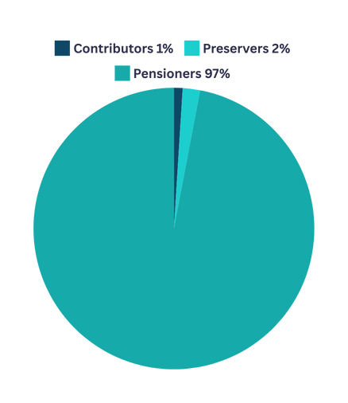
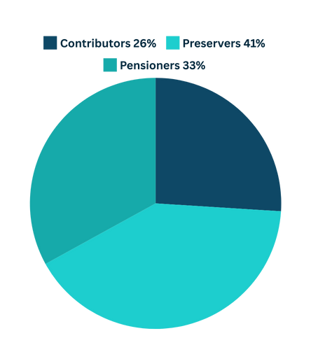
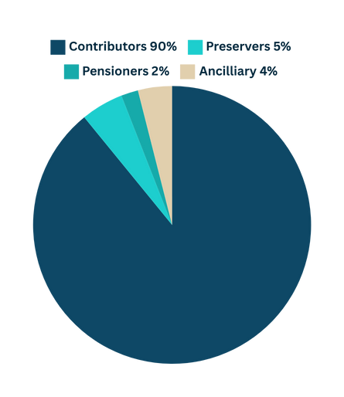




Our membership
1%
2%
4%
5%
2%
33%
26%
90%
97%
41%
776 CSS Contributors
48,660 PSS Contributors
129,000 PSSap Contributors
35,000 ADF Contributors
DEFINED BENEFIT
ACCUMULATION

Slide 8

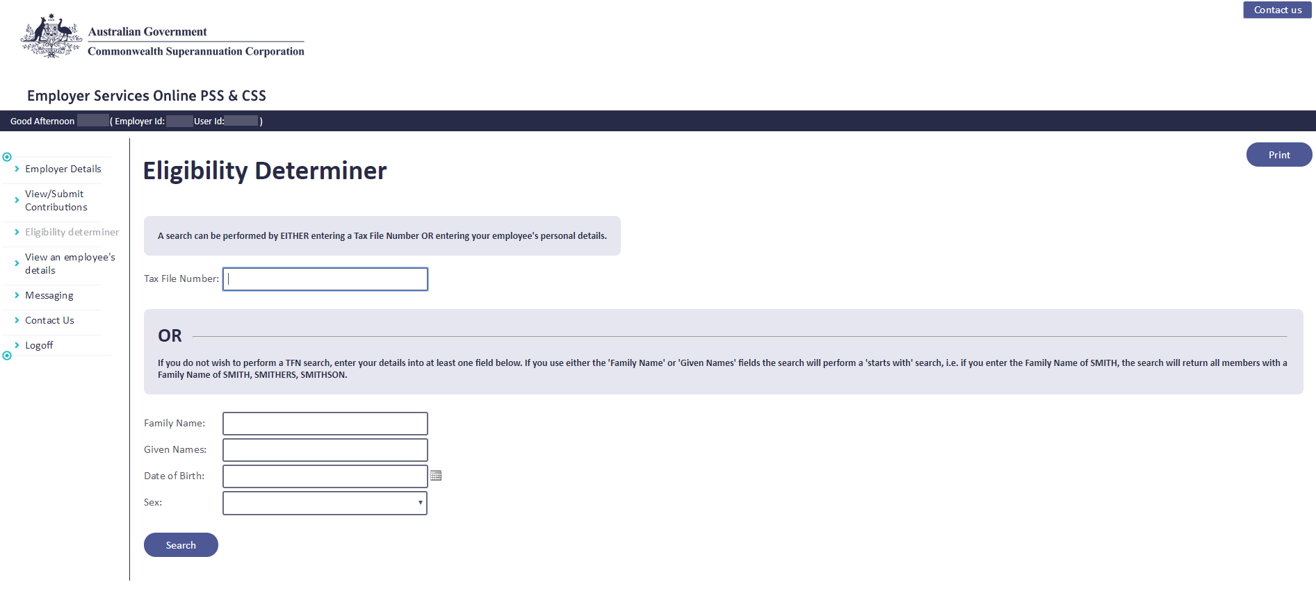

Scheme Eligibility
1
Employee Tax File Number is the best identifier.
2
Surname, Given name & DOB.
3
Ensure you select the right person.
Accidentally joining an employee to the incorrect scheme could result in financial consequences for the employee, and the employer.
A good rule of thumb is to confirm eligibility for anyone born before 1 July 1990.
csc.gov.au/employers

Slide 9
Eligibility
Factors
1
No DB account found
Previous memberships
Super balance left in the fund
Employment conditions
A new employee may be able, or required to contribute to CSS, PSS or another fund
Part-time, full-time, casual, ongoing, non-ongoing
2
Informed decision
3
ATO Portal - stapling
4
Default fund (PSSap)

Slide 10





Contributing
to CSC
Characteristics
Contributions
  Productivity paid by employer | Pre-Tax | Concessional
  Liability paid by employer | Does not form part of super benefit
  Member contributions paid by member | Post Tax | Non-Concessional
Super Salary
  CSS | the annual rate of salary
  PSS | the base salary + recognised allowances
Tenure
  The length of contributory service

Slide 11


Accumulation
Characteristics
Contributions
  Minimum 15.4% employer contributions, 16.4% for ADF members
  Personal Contributions | Pre or Post tax | Salary Sacrifice
  Spouse Contributions | Post tax | Tiered tax offset for low income spouses
Super Salary
  FCS | Default method | Same as PSS | Updated at birthday
  OTE | Only if in EA | Based on prior fortnight earnings | Some exclusions apply

Slide 12



Contributions
CONTRIBUTION caps - accumulation
Caps are placed on how much can be added to super.
Set by the ATO and may change periodically. If breached, additional tax might be payable.
Two types:
  concessional | pre-tax contributions
  non-concessional | post-tax contributions
2024- 2025 CAPS
The concessional contributions cap for 24/25 is $30,000.
The annual non-concessional contributions cap for the 2024–25 financial year is $120,000.
CONTRIBUTION caps - defined benefit
For employees asking about these - refer to the cap space estimator
ato.gov.au
13 10 20

Slide 13
Unexpected life events
PSSap - life PLUS Auto & lifePLUS Choice
CSS
PSS
What's included
What's included
Income protection, plus access to rehabilitation
services if/when required
Death & Total Permanent Disablement ‘TPD
Terminal illness
Inbuilt Partial Invalidity Payments (PIPS)
Invalidity Retirement Benefits
Death & Terminal Illness

Slide 14

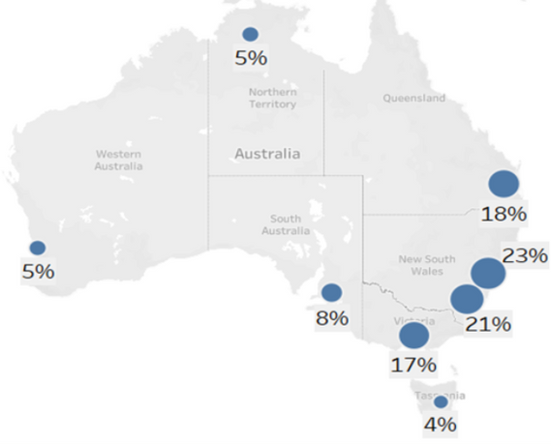






PSSap lifePLUS cover claims overview
Claims by benefit type | Claims by benefit type | Claims by benefit type | Claims by benefit type | Claims by benefit type | Claims by benefit type
Income Protection | Total Permanent Disablement (TPD) | Death | Death | Death | Death
63% | 22% | 15% | 15% | 15% | 15%
Top 5 claim causes | Top 5 claim causes
Mental Health Conditions | 37%
Cancer | 18%
Sickness and disease | 15%
Neurological disorders | 6%
Musculoskeletal back/neck conditions | 5%
Geographical location of claims
Age at time of claim event
31%
28%
27%
Claims by gender | Claims by gender
Female | 63%
Male | 37%
10%
1%
3%
18-24
25-34
35-44
45-54
55-64
65+

Slide 15
Early Intervention
Early notification = higher chance for a good outcome
In terms of physical conditions, if the person is off work for:
Make contact.
20
Days
Encourage the employee to reach out to us. CSC
and the insurer can assist in lodging applications.
45
Days
70
Days
Connect with experts.
Sometimes finding the right person or working with the insurer’s rehab providers can be difficult. We can provide support around the process, and what to expect.
70%
50%
35%
Keep communication open.
Stay in regular contact with your employee to
foster better outcomes.
Chance of getting back to work
Chance of getting back to work
Chance of getting back to work
The Royal Australasian College of Physicians, Australasian Faculty of Occupational and Environmental Medicine Position Statement on Realising the Health Benefits of Work, Sydney 2010

Slide 16



Budget Update -
Super changes
SG Increases
The Super Guarantee is set to increase from 11.5% to 12% on 1 July 2025.
Super on Government funded parental leave
Super will be paid on Government funded Paid Parental Leave (PPL) for parents of babies born or adopted on or after 1 July 2025.
Payments will be made annually to individuals’ super funds from 1 July 2026. This will help to reduce the impact of career breaks to care for young children on superannuation balances.
Federal Budget 2024/2025
Pay Day Super – Draft Legislation
Expected start date of 1 July 2026, employers will be required to pay their employees’ super at the same time as their salary and wages.
The start date will provide employers, super funds, payroll providers and other parts of the superannuation system with sufficient time to prepare for the change. This measure is not yet law.

Slide 17

Get your super sorted Next Steps
Consider:
Registering for CSC Employer News
Want to register to attend an upcoming training session?
Use the Eligibility Determiner
Member Education for your staff
Scan here
Refer to Employer Quick Guides and web articles
Consider Early Intervention Strategies
Register to attend upcoming CSC training

