Slide 1
APS Learning Bank
ACT Small Agencies HR Forum
February 2025

Slide 2


Why a APS Learning Bank?
This project originated from recommendations within the Thodey Review, addressing the significant duplication of effort and L&D resources across the APS and related inconsistent outcomes.
The APS Learning Bank provides a transformative opportunity to promote reuse within the APS under a One APS networked model.

Slide 3
Project summary to date
Discovery
Consulted various line areas and external agencies L&D teams.
Reviewed existing processes and undertook internal stocktake of solutions.
Design
Catered to support current and future state and address past actions.
Updated internal governance and processes.
Development
Established governance, forms and created the APS Learning Bank using existing platforms.
Delivered minimum viable product (MVP).
Constantly refining, building and communicating.
Deploy
MVP – launched and invited Non-corporate Commonwealth entities
Now
Currently, undertaking tasks to broaden access to other entity types.
Discovery
Design
Development
Deploy

Slide 4
Reuse and sharing challenges
L&D Solution complexities. Not all learning material (assets) can be treated the same.
Technology complexities. Compatibility of systems at the authoring (development) and hosting (learning tech stack) level.
Different entity structures. Affects who and how we can reuse and share files with.
Governance. Inconsistent processes, mechanisms and knowledge across the group.
L&D Community. Various levels of knowledge, skills and time and resources (people, money and systems) invested in L&D. Competing priorities.
Intellectual Property. Various levels of contracts, record keeping, knowledge and awareness about IP.

Slide 5
Reuse and sharing benefits
Reduction in duplication of learning solutions.
Improve and increased consistency of learning solutions.
Upskilling knowledge across the L&D community.
Reduced effort in undertaking procurements or learning solution development.
Increased access to existing solutions (particularly small agencies or teams with low resources).
Reduction in risk of misuse of solutions through current unregulated sharing practices.
Quantification of volume of sharable/non sharable content in system.

Slide 6

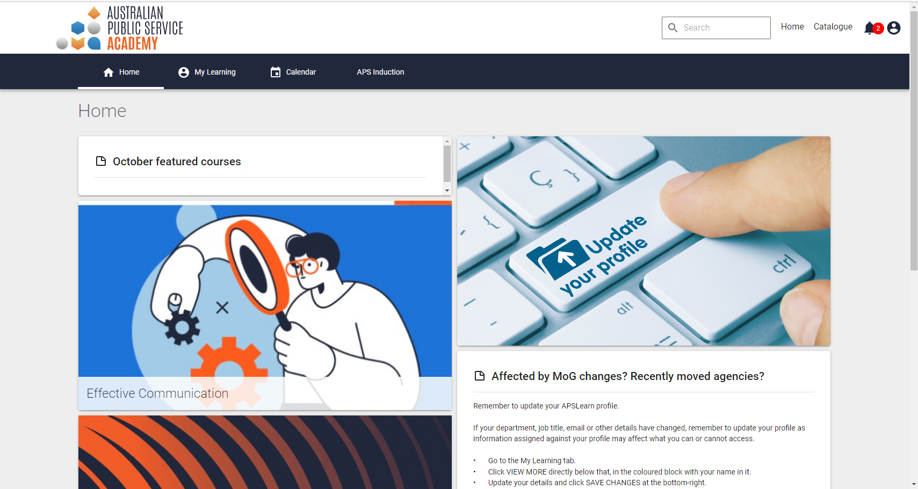
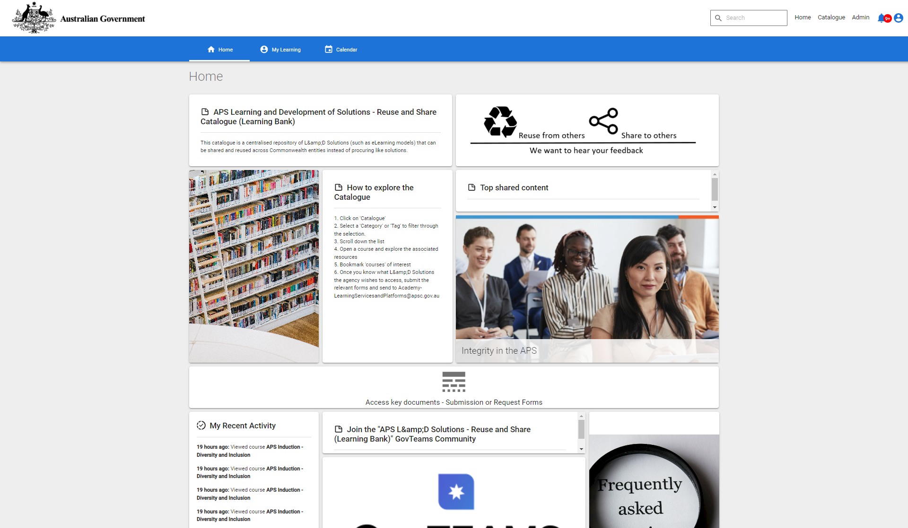
The APS Learning Bank
The APS Learning Bank aims to centralise and coordinate the reuse and sharing of Learning & Development (L&D) solutions across (presently) Non-Corporate Commonwealth agencies.
The APS Learning Bank is designed for L&D practitioners.
Practitioners view a catalogue of solutions available for reuse either “as is” or able modify to suit their agency’s needs. It is up to each agency to review and determine the suitability of a solution and relevant use for their agency.
Share and reuse learning experiences | Australian Public Service Academy
3

Slide 7
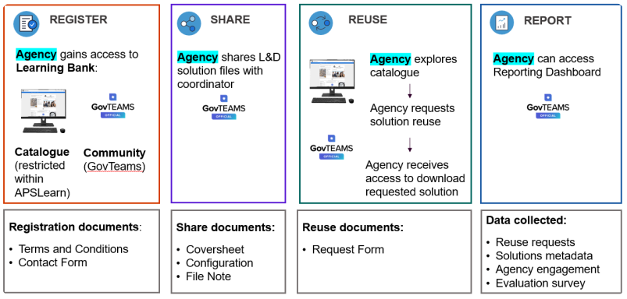
Overview of process and platforms

Slide 8
Thank you.

