Slide 1






APS Integrity
Presentation to Small Agencies Forum
13 November 2024

Slide 2
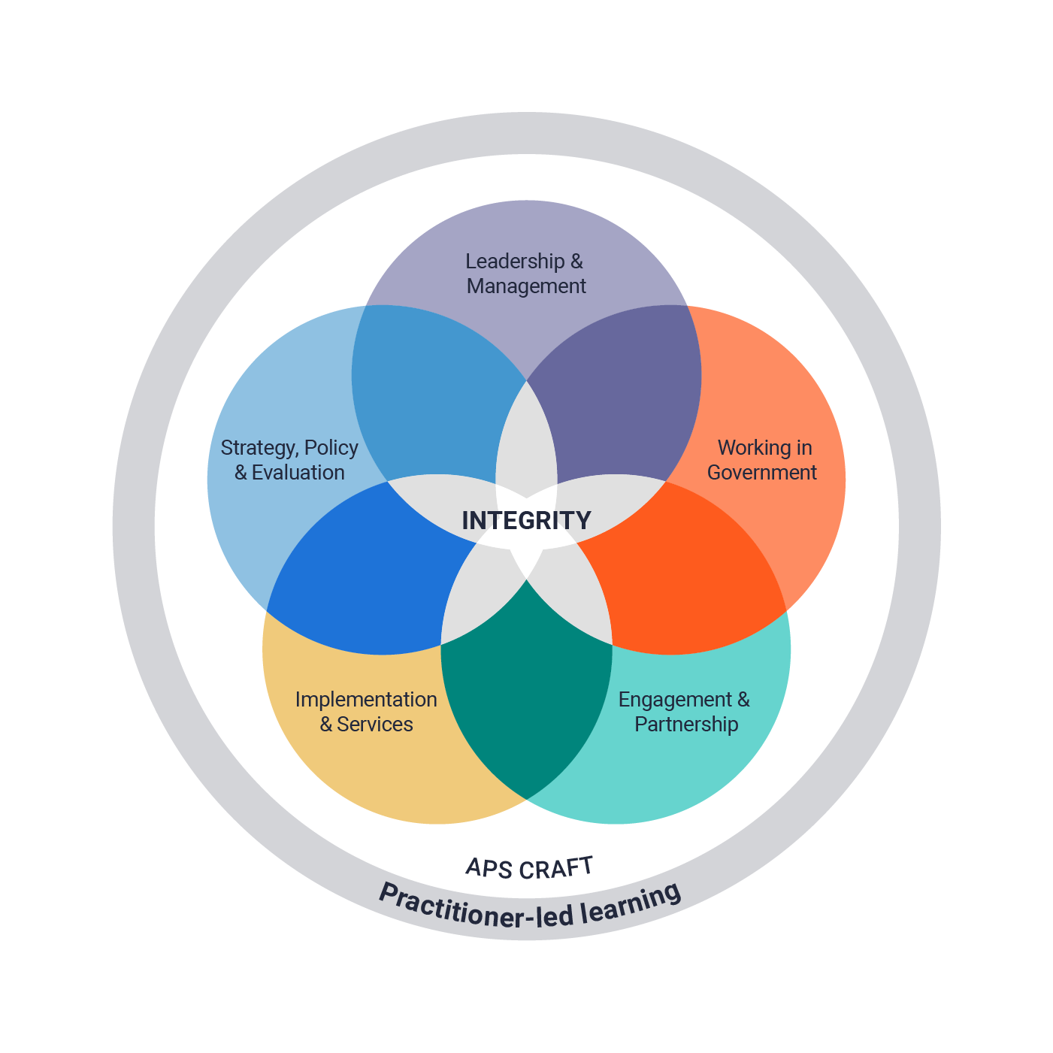
What is APS integrity?
“The pursuit of high standards of professionalism… doing the right thing at the right time to deliver the best outcomes for Australia and the government of the day”
- Sedgwick, 2021

Slide 3
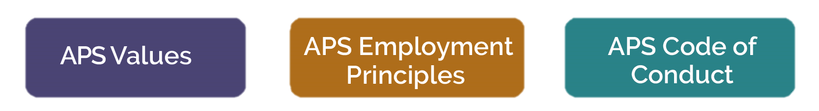
Pro-integrity culture is key
Culture

Slide 4
Integrity Resources
Courses
A variety of Integrity based courses from foundational eLearning packages, to facilitated SES level workshops.
Resources
Frameworks, toolkits, templates, podcasts, key reports, recordings of live events and links to other key integrity agencies – covering a wide variety of integrity topics
Research
Research papers and articles on Integrity based concepts
Networks
Information on the various integrity networks and communities of practice across the APS – including how to join in.

Slide 5
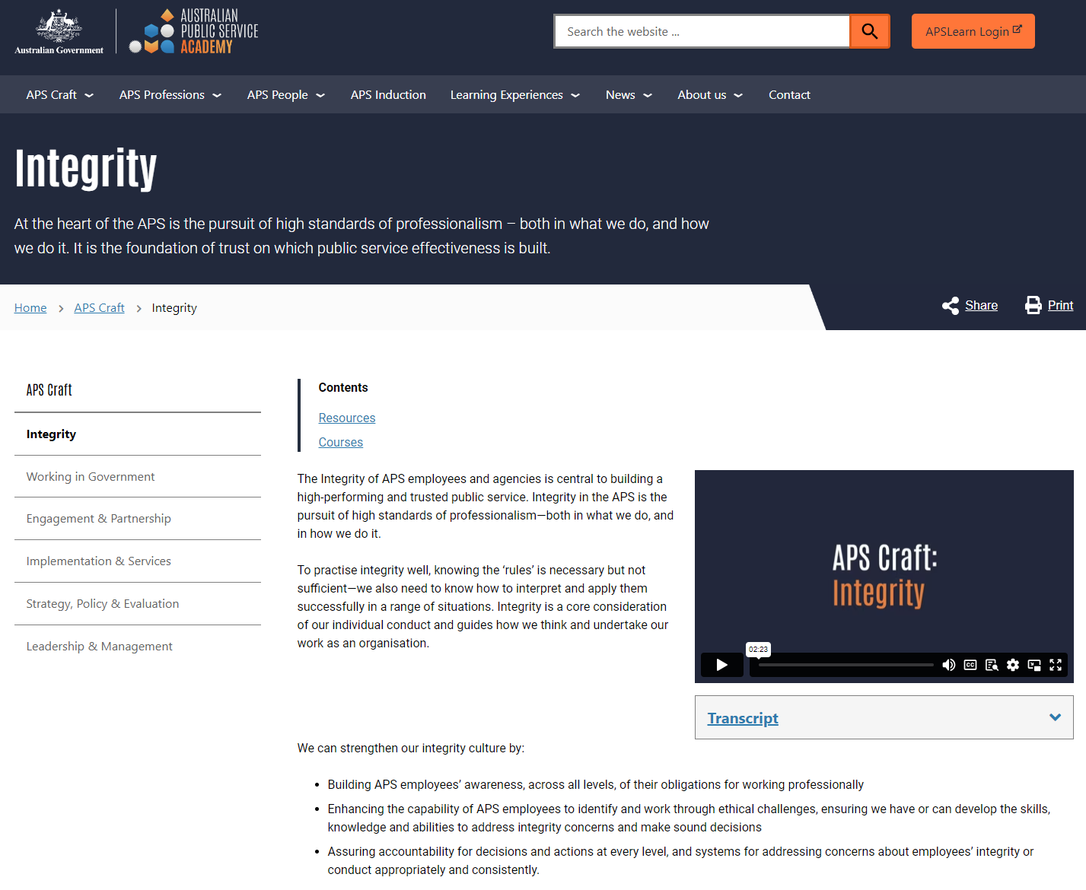
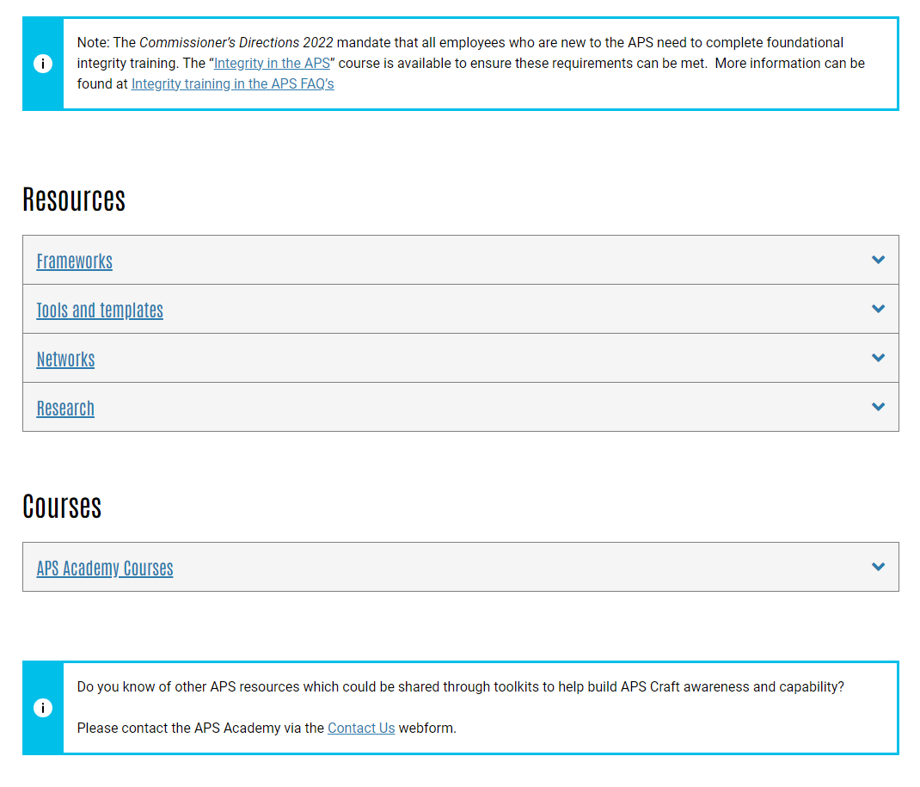
APS Academy website – Integrity (apsacademy.gov.au)
APSAcademy.gov.au

Slide 6


Two key Integrity courses
Induction
The Commissioner’s Directions 2022 mandate that all employees who are new to the APS need to complete foundational integrity training.
The “Integrity in the APS” eLearning course is available for all APS employees to ensure these requirements can be met.
The “Louder than words: An APS Integrity Action plan” recommendation 4 includes “Secretaries are to support all SES (particularly those newly promoted) to undertake the APS Academy’s SES Integrity Masterclass to increase their understanding of:
The expectations and accountabilities of leading in the APS
How to exercise integrity and ethical decision making in all aspects of their work.
Look out for some exciting updates coming to the SES Integrity Masterclass in 2025.
SES level

Slide 7
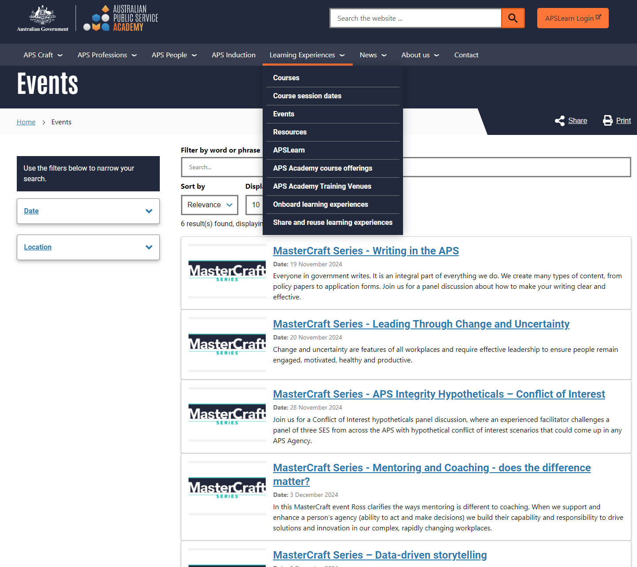
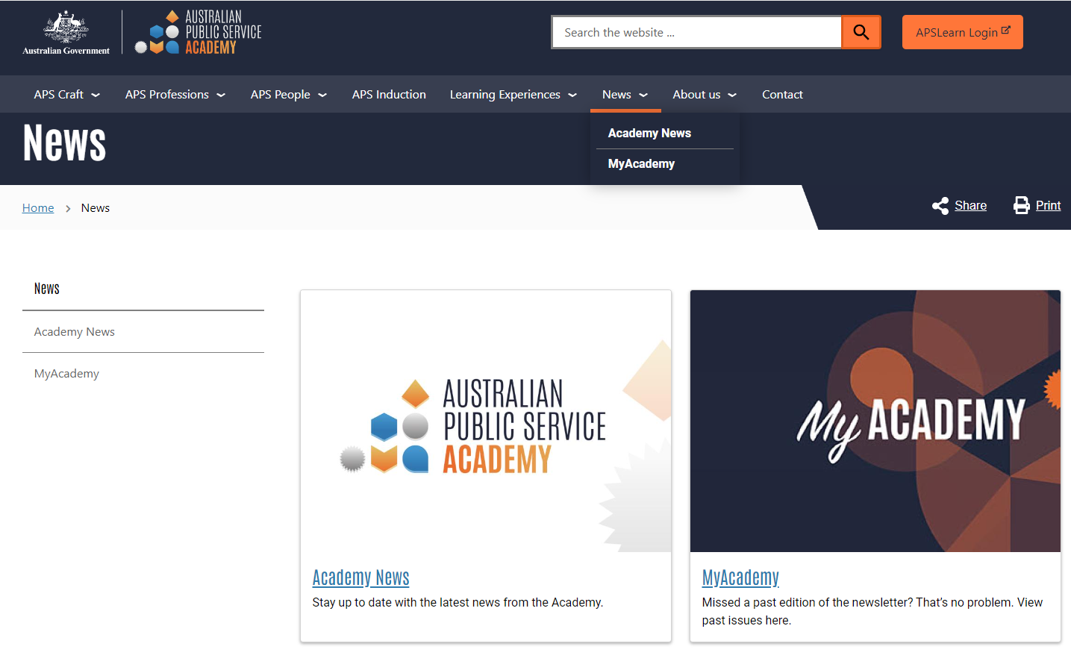
APS Academy website – Events & News

Slide 8
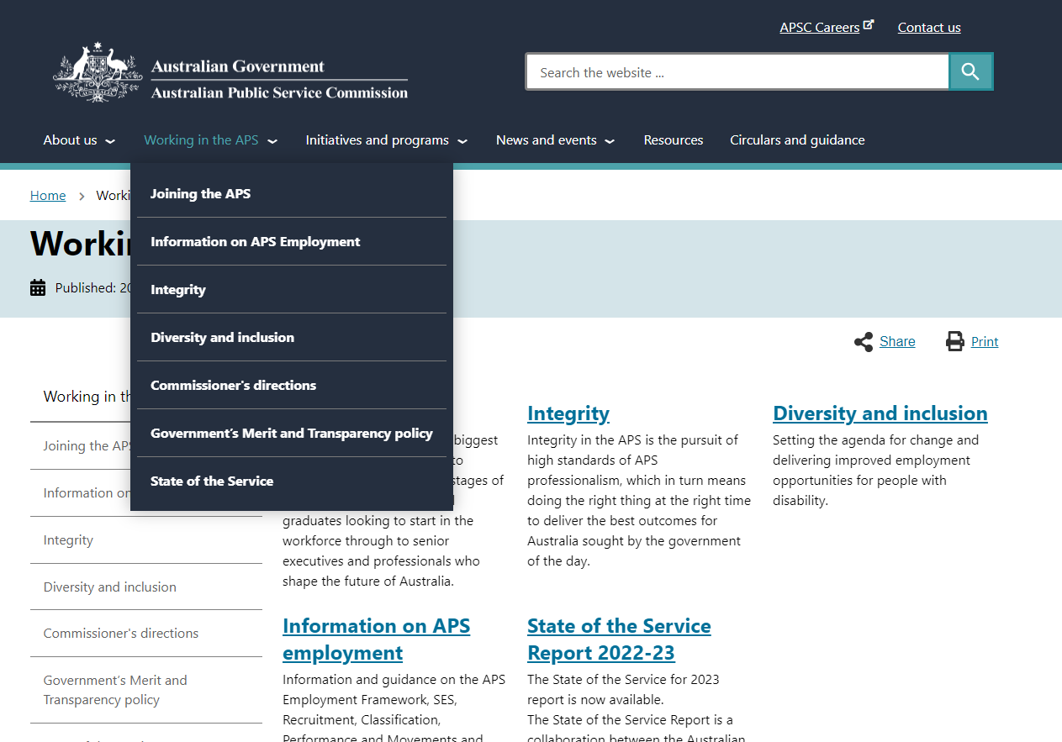
APSC Internet page
APSC.gov.au

Slide 9
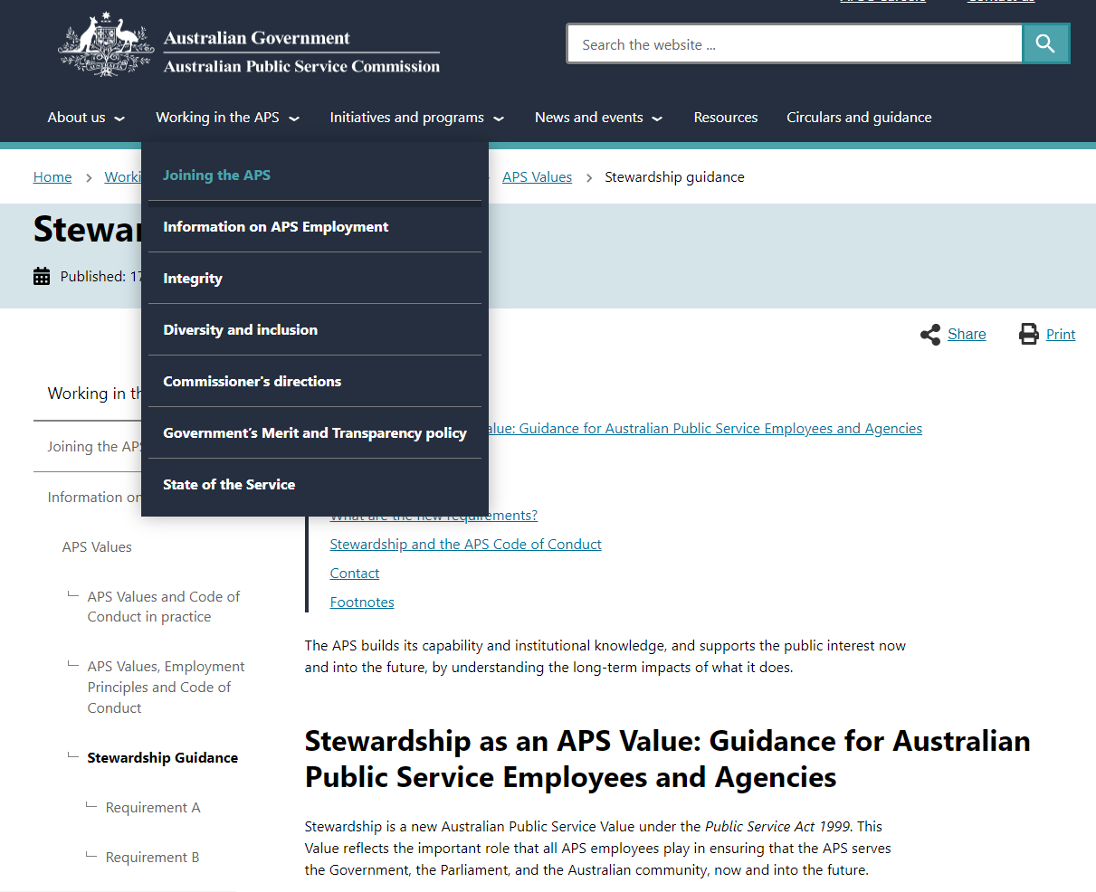

Stewardship as a new value

Slide 10
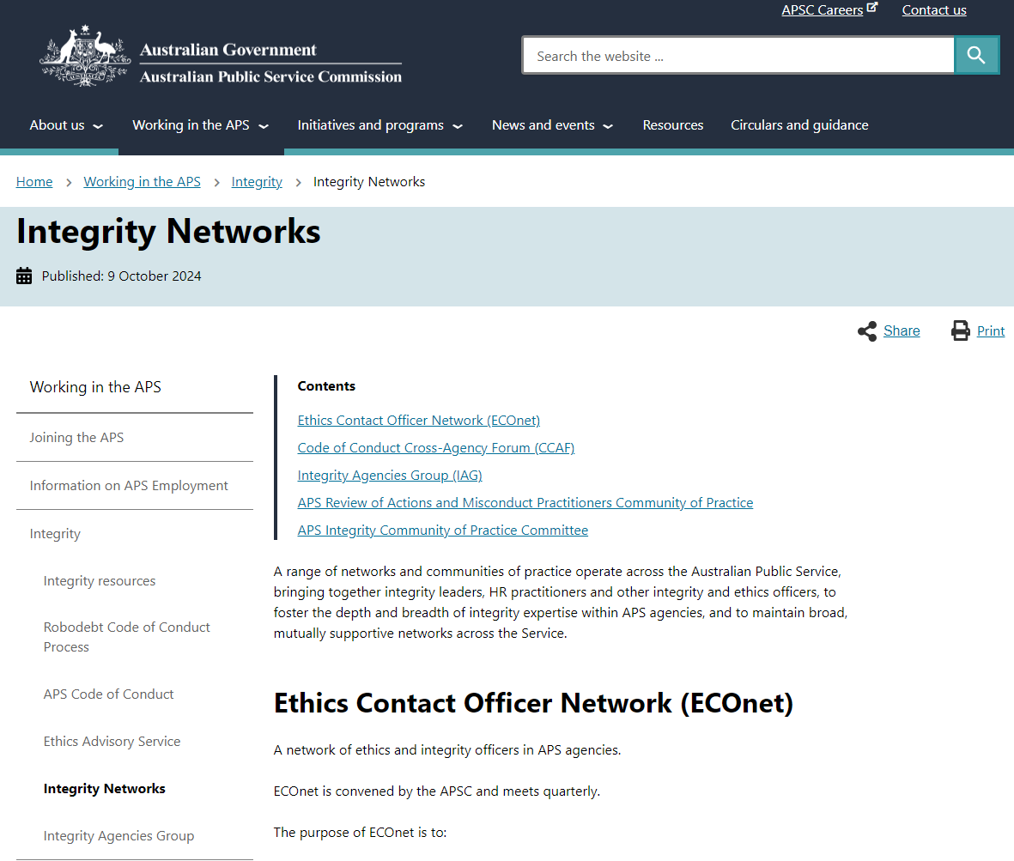
Integrity networks

Slide 11


Ethics Advisory Service
A phone and email service for APS employees – including HR and SES – to discuss and seek advice on ethical issues in the workplace.
We provide guidance, advice, and information on:​
the application and interpretation of the APS Values and Code of Conduct​
strategies and techniques for ethical decision-making in the APS.​
(02) 6202 3737​
ethics@apsc.gov.au ​

Slide 12
Any questions?
Contact us:​ ​
Academy@apsc.gov.au
Craft.learning@apsc.gov.au
Ethics@apsc.gov.au

