Slide 1
APS HR Workforce Strategy and Action Plan
Pathways to Professionalisation Framework
Presented by
Vanessa Clark, Assistant Director,
APS HR Professional Stream Team

Slide 2
HR Workforce Strategy and Action Plan
Pillar 1: Growing individual capability
Pillar 2: Delivering consistent,
high-quality services
Pillar 3: Maturing the HR profession
UNCLASSIFIED
2
Notes:
WFS has 3 pillars, each with a different focus

Slide 3
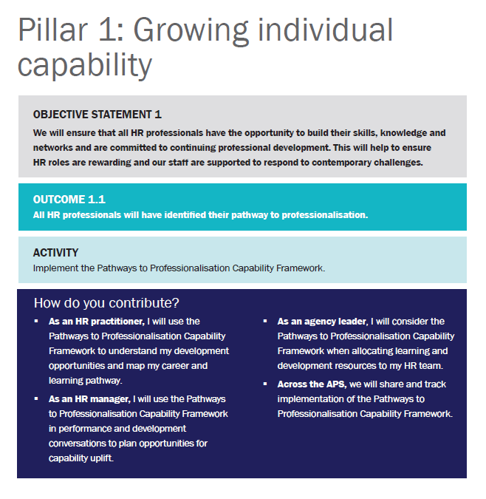
Pillar name
Every pillar opens with an overarching objective statement
Each pillar has three outcome statements
Each pillar calls out three major activities – each activity is linked to an outcome
The ‘how do you contribute’ section calls out the specific role everyone can play to contribute to that outcome and activity.
UNCLASSIFIED
3

Slide 4
The pillar action plan provides suggested actions under each activity for that pillar.
The dark blue boxes outline some suggested actions for organisations to drive, again, with HR professionals encouraged to engage with and support these actions.
Action boxes are colour coded, based on the lead for those actions. For example, teal boxes are for the HR Professional Stream and APS leaders to drive, with all HR professionals encouraged to engage with and support these actions.
Each set of actions also has an indicative time frame. This suggests how soon after launching the strategy these actions may commence. As with the whole strategy, the timeframes are a guide.
UNCLASSIFIED
4

Slide 5
UNCLASSIFIED
5

Slide 6
Pathways to Professionalisation Framework
The framework is one of the key implementation activities outlined in the APS HR Workforce Strategy and aligns to the first pillar, ‘Growing individual capability’.
UNCLASSIFIED
6

Slide 7
Key sections of the framework
APS HR Leader Attributes
Hold HR or related qualification
Relationships
Qualified, or working towards a HR or HR-related qualification.
Skilled at building authentic and valuable relationships rooted in trust, including professional networks across public and private sectors.
Experienced expert
Credible communicator
Demonstrated breadth of HR experience across different types of organisations and HR functions. Technical excellence in one or more specialist HR domains.
Influential leader
Demonstrates gravitas, political nous and the ability to deliver engaging and compelling messages and decisions, even when unpopular.
Expert practitioner
Shapes business decisions and culture without need for formal authority, demonstrates passion and cultivates trust that inspires others.
Demonstrated contemporary technical capabilities, commitment to lifelong learning
and development of others.
Emotional intelligence
Life-long learner
Future-fit APS HR leader
Demonstrates emotional intelligence (EQ) skills such as self-awareness, self-regulation, motivation, empathy, resilience and social skills to understand the needs of clients and staff, and promote an inclusive and collaborative culture.
Ongoing commitment to development of self and others.
Systems thinking
Strategic thinker
Evidence based
Considers impacts and interrelationships between components of the larger system in which the organisation operates.
Understand and shape business strategy and align HR functions to work with the business to deliver outcomes.
Applies a long-term and broad perspective, incorporating trends, interconnections and diverse data sources to analyse and consider the impacts of solutions to broader organisational goals. Looks for new and innovative ways of working.
Business acumen
Takes a proactive approach to understanding and monitoring the business, broader government agenda and relevant industry and private sector trends impacting it. Ability to quickly adapt to environment changes and respond rapidly and flexibly to client needs, understanding new technology and data that impacts the business.
7

Slide 8
Key sections of the framework
How we work
As an HR professional, I aim to demonstrate the below behaviours in the work that I do.
I have a client service mindset
I am courageous
I encourage collaboration
I value evidence
I am adaptable
I am responsive to clients
I provide clients with support on other services that may be available
I use plain language
I ensure issues are resolved
I see the bigger picture and use my experience to add value
I can have open and frank conversations
I want to be known as the font of HR knowledge
I lead by example
I am honest and act with integrity
I engage in risk
I am inclusive
I communicate expectations
I work with others to get the best results
I learn from my colleagues and share my knowledge
I focus on understanding and building my business acumen
I nurture and develop my networks
I use information to better understand the business needs
I provide consistent and accurate services to build trust and confidence
I understand what good data looks like and how to use it
I make evidence-based decisions
I use evidence to proactively manage and mitigate risk
I shape my response to meet my clients’ needs
I maintain currency of my knowledge to ensure I know what my clients' options are
I drive transformation and innovation within my organisation
I am keen to learn new things
I tailor the application of change management
8

Slide 9
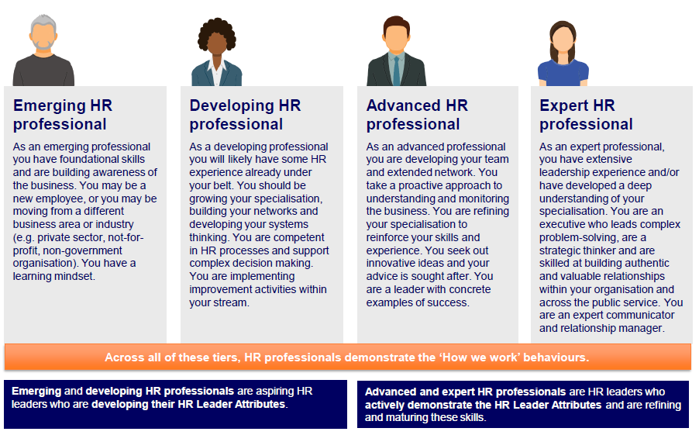
Key sections of the framework
HR professional personas
UNCLASSIFIED
9

Slide 10
Key sections of the framework
Mapping your pathway
UNCLASSIFIED
10

Slide 11
Implementation – where to start?
Familiarise yourself with the strategy and framework
Use the framework when considering capability development
Discuss with your team about what you can do to implement the strategy in your agency.
Engage with posts on GovTEAMS and participate in HR professional stream events.
Contact us if you have any HR programs or initiatives you would like to share or showcase with the network.
Review your existing HR frameworks and see how they align with the Strategy and Framework.
UNCLASSIFIED
11

Slide 12
Looking ahead
Continuing communications and engagement activities
Podcast series 2
Sharing opportunities for mobility
Capability in Focus program (webinars and masterclasses)
UNCLASSIFIED
12

Slide 13
Questions and discussion

