Slide 1
Indigenous Secondment Program
2019

Slide 2
House of Representatives
The House of Representatives is one of the two houses of Australia’s Commonwealth Parliament.
There are 150 representatives elected by the Australian people. These elected people are known as the Members of Parliament.
They represent the interests of the community.
The House of Representatives is the house in which government is formed.

Slide 3
House of Representatives
The House of Representatives has a number of important functions:
it determines the government;
debates and passes laws;
watches over government administration and expenditure, and
provides a forum for public debate on issues of national importance.
It shares the power to make laws with the other House of Parliament, the Senate.

Slide 4
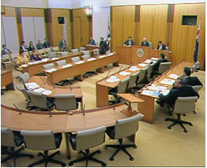
Committees
Committees carry out certain functions on behalf the Parliament and are an important tool for policy development and oversight of Government administration.
A parliamentary committee is a group of Members or Senators (or both in the case of joint committees) appointed by one or both Houses of Parliament to undertake certain specified tasks.

Slide 5
Department of the House of Representatives
The Department of the House of Representatives provides services to support the efficient conduct of the House of Representatives, its committees and certain joint committees as well as a range of services and facilities for Members in Parliament House.
The Department also undertakes activities to promote the work of the House in the community and is responsible for the conduct of the Parliaments' international and regional relations.
The Speaker has accountability obligations to the Parliament for the Department. The Clerk of the House of Representatives is responsible for managing the Department.

Slide 6
Department of the House of Representatives
The Department has a single outcome:
The House of Representatives fulfils its role as a representative and legislative body.
Five activities support this outcome:
Activity 1 - Chamber and Federation Chamber
Activity 2 - Community awareness
Activity 3 - Committee support
Activity 4 - Inter-parliamentary relations and capacity building
Activity 5 - Members' services and corporate support

Slide 7
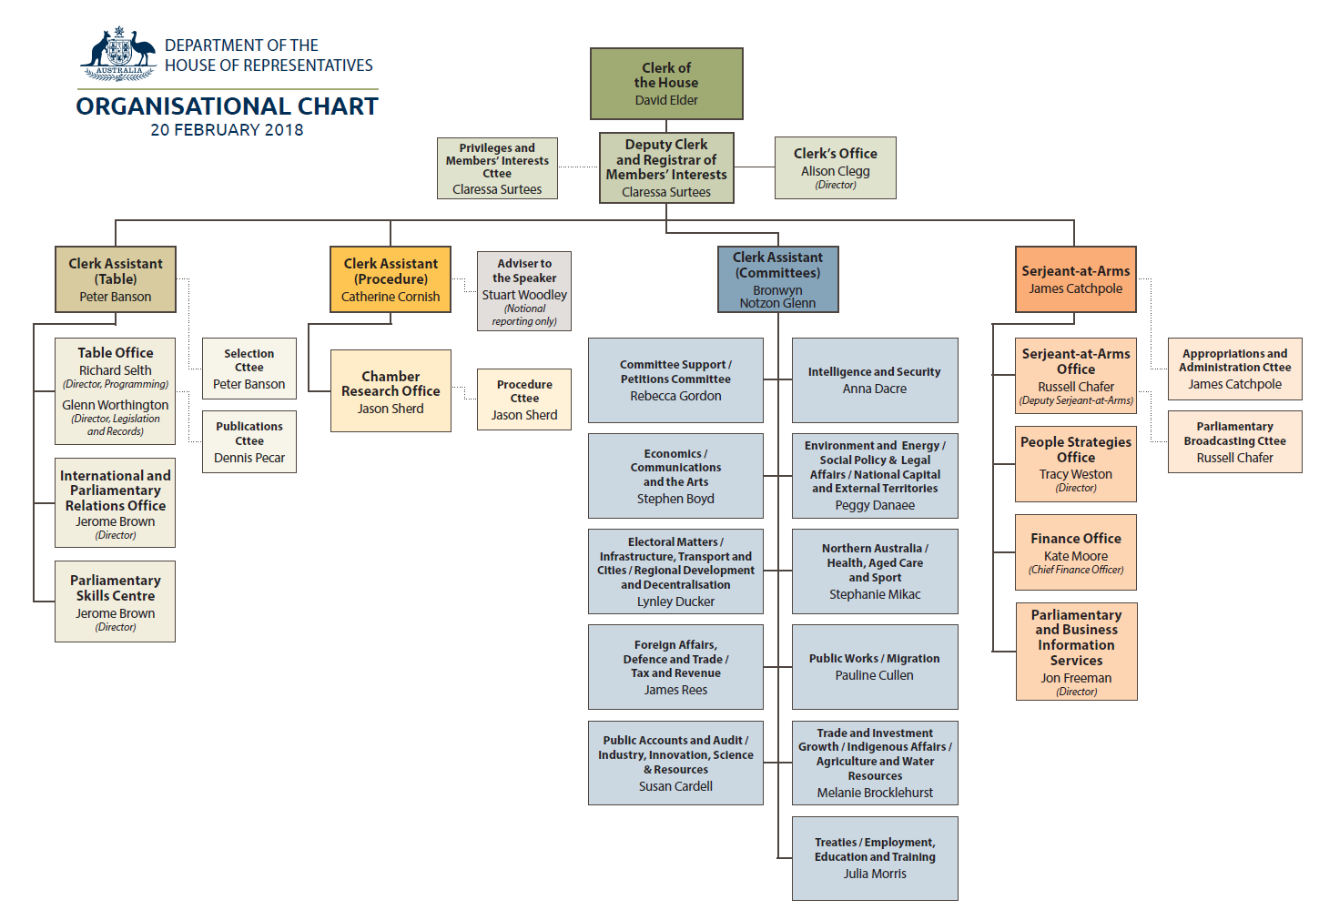
Organisational Chart

Slide 8
Indigenous Secondment Program
The Department of the House of Representatives is offering 3 month placements for successful graduates of the IAGDP in 2019.
The Indigenous Secondment Program is a graduate’s opportunity to be involved in the work of the Parliament without being political.
A diverse range of challenging and rewarding work for graduates is offered through a variety of work areas.
Placements offer graduates a valuable opportunity in a high-profile environment with excellent professional development opportunities

Slide 9
2017 Indigenous Secondment Program
L-R Vickie Gouvoussis (Program Manager) Shanece Liddy Wilde (Department of Education and Training) Russel Chaffer (Indigenous Champion for the Department of the House of Representatives) and Nathan King (Austrade)

Slide 10
Placement Opportunities
Where possible, graduate placements will be in areas which complement placements in their home departments or agencies.
Placements may involve:
Work with a Committee Secretariat providing research and administrative support to Parliamentary Committees;
Working in support of Parliament through placement in areas such as Serjeant-At- Arms office, International and Parliamentary Relations Office, Parliamentary and Business Information Services and People Strategies Office.

Slide 11
Professional Development
The skills and knowledge graduates obtain through the Secondment Program may assist in building the foundation for career progression and professional development.
This is a unique and valuable opportunity in a high profile environment with excellent professional development opportunities.
A placement in the department is a IAGDP graduate’s opportunity to be involved in the work of the Parliament without being political.
A diverse range of challenging and rewarding work for graduates is offered through a variety of work areas.

Slide 12
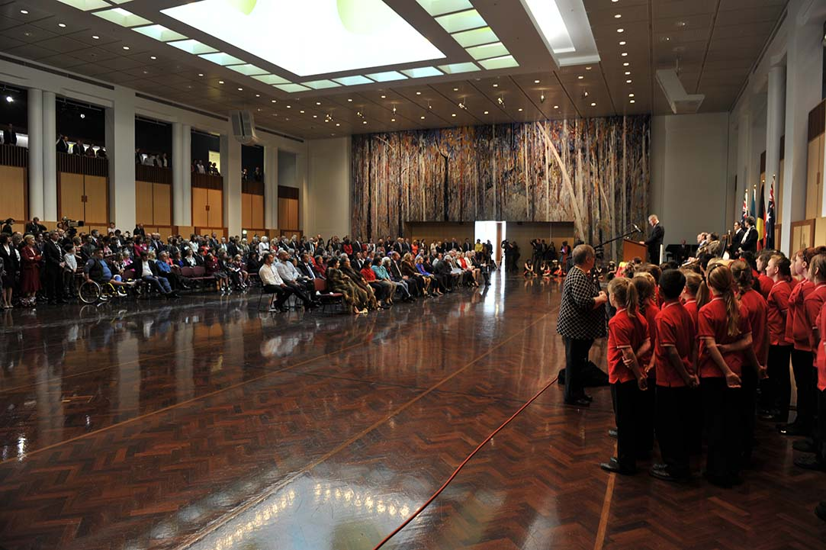
Welcome to Country

Slide 13
Question Time

Slide 14
Meeting important people

Slide 15
‘One of my main takeaways from the last 3 months would undoubtedly be sitting in on the Joint Standing Committee on Migration. This was a new experience and it provided me with the insight as to the level of involvement that our Members of Parliament have in not only Australian but also international crises. I was made aware of the amount of travel and meetings that the Members are subjected to and the family sacrifices they must make thanks to their busy schedules.’
Nathan King

Slide 16
‘The experience I’ve had so far through this pilot program has been truly positive and eye opening. I’m happy and proud to say that I was one of the first to be in the program and trial it. It has given me the opportunity to work in a challenging high profile environment and see how things work and run within Parliament house. In the future I hope to continue my career through the government. ‘
Shanece Liddy-Wilde

Slide 17
“ The 2018 Indigenous Secondment Program provided me with a great opportunity to work in a unique and challenging environment. It has been a valuable learning experience, giving me skills and development that will benefit my professional career development. I thoroughly enjoyed and valued my time working in the Department of the House of Representatives.”
Ben Vea Vea

Slide 18
2018 Indigenous Secondees
(L-R) Ben Vea Vea (Murray–Darling Basin Authority),Michael Ohrin (Department of Foreign Affairs) and Elizabeth Olive (The Treasury)

Slide 19
(L-R)Ben Vea Vea (Murray–Darling Basin Authority),Michael Ohrin (Department of Foreign Affairs), Vickie Gouvoussis (Program Manager), Bronwyn Notzon Glen (Indigenous Champion for the Department of the House of Representatives) and Elizabeth Olive (The Treasury)

Slide 20
How to apply
Applications are invited from successful graduates of the IAGDP to work in the Department of the House of Representatives in 2019.
Successful applicants will be employed for a 3 month period commencing April 2019.
Applicants need to seek endorsement from their home Department or agency to be eligible.
Working at Parliament House in the Department of the House of Representatives will give you the opportunity to be involved in the work of the Parliament.
We are looking for outstanding graduates from a range of disciplines who are highly motivated with sound research and analytical skills, effective communication skills and good interpersonal skills.

Slide 21
Eligibility
Applicants must:
be of Aboriginal and/or Torres Strait Islander heritage;
have successfully graduated from the IAGDP; and
have successfully attained a Diploma of Government qualification.
Successful applicants will be will be temporarily transferred and will be paid at their substantive APS 4 classification.

Slide 22
Selection Process
Applications for the 2019 Indigenous Secondment Program opens on
1 March 2019 and close on 1 April 2019.
Applications will need to include:
a résumé, including the names and contact details of two work-related referees;
a copy of your academic transcript;
endorsement from your home department or agency; and
a one page statement addressing the selection criteria.
Referees may be contacted at any time throughout the process.

Slide 23
Questions?
Contact: Vickie Gouvoussis
Email: vickie.gouvoussis.reps@aph.gov.au
Phone: 62774284
Website Address:
www.aph.gov.au/About_Parliament/House_of_Representatives

