Slide 1
APS HR PROFESSIONAL STREAM
Presentation to Small Agencies HR Forum
Jacquie Walton Group Manager, People and Business Management
Australian Public Service Commission

Slide 2
13 November 2019
APS HR Professional Stream Strategy

Slide 3
13 November 2019
Challenges for HR in the APS
Inadequate talent management
Lack of career pathways
Rigid recruitment practices
Insufficient knowledge sharing

Slide 4
13 November 2019
Profession Based Models
Facilitate recruitment of skilled people at all levels
Identify and provide bespoke development opportunities
Offer profession specific bespoke development opportunities
Develop models to deploy people across agencies to share skills and fill short-term capability gaps.
Identify and develop talent to improve staff retention, protect institutional memory and implement succession planning.

Slide 5
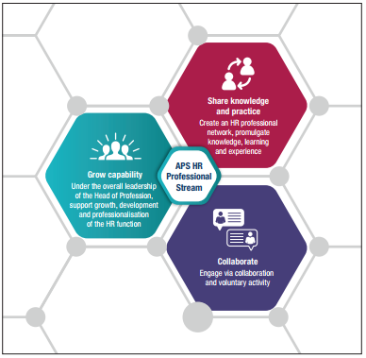
13 November 2019
Key Principles and Approach

Slide 6
13 November 2019
28 October 2019
Signature Initiatives
Signature Initiatives

Slide 7
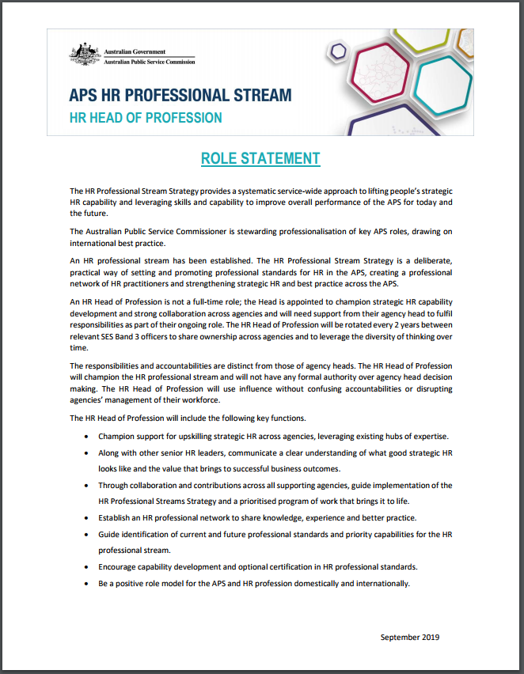
HR Head of Profession
13 November 2019
Ms Jacqui Curtis
Chief Operating Officer, Australian Taxation Office

Slide 8
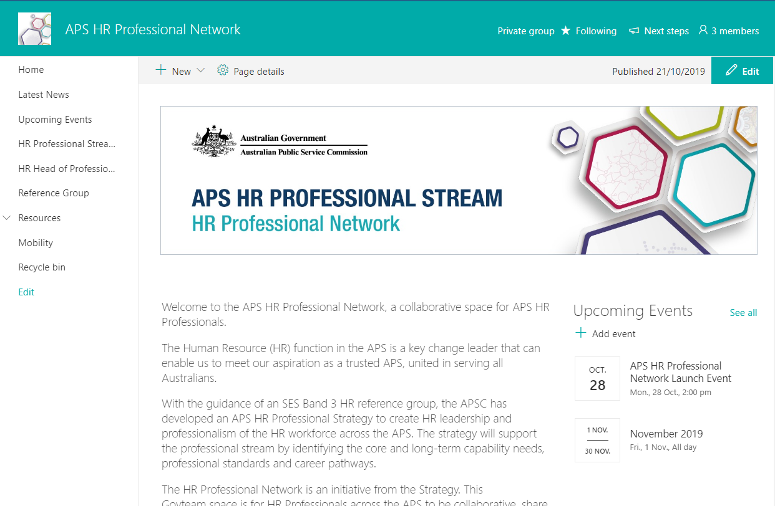
13 November 2019
GovTEAMS

Slide 9
Questions?
13 November 2019

Slide 10
Thank you.
For more information on the APS HR Professional Stream visit www.apsc.gov.au or join the GovTEAMS Community.

